Slide 1
Olmstead 20
Years Later:
The case for community
6.25.19
Washington DC
Notes:
Good afternoon. THANK YOU for the invitation to be here with you this afternoon. Also thanks to ACL and DHHS for planning this event to recognize the importance of the Olmstead Decision and its effect on long term services and supports for people with disabilities in the United States over that time period.
While I did not know Lois Curtis and Elaine Wilson, who had both been languishing in an institution for years and was not involved in this case, I do however remember exactly where I was standing when this court decision was handed down because I knew this decision was very significant.

Slide 2
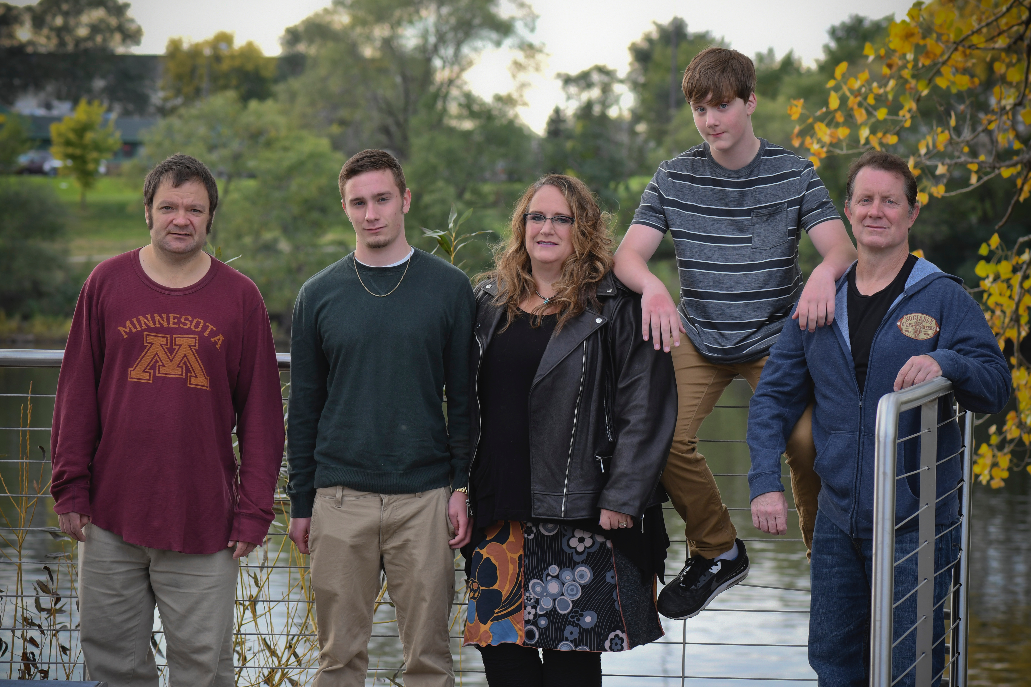
Amy’s Family
Notes:
I can, without question say that the Olmstead decision changed my family’s life and the lives of tens of thousands of people in the United States with disabilities. While I come to these issues form the perspective of a researcher who focuses my work on community living, I also understand it in my personal life. This is a photo of my family, and YES, you are correct, I am surrounded by an awful lot of men!
My husband Brad is on your righthand side and my son Jack is between us and Amos next to me. To your far left is Brad’s brother Nathan who is a 45 year old man who lives with autism and other complex mental health disabilities. There were times in his past when institutional services were his only choice; he lived in an institution and a group home. For the past 16 years, Nathan has been supported in Minnesota through a program called Consumer Directed Community Supports – he self-directs his services with our support and lives in his own apartment attached to our home. Today, he experiences a person-centered life in his community. I know and am forever grateful for the influence the Olmstead Decision had on making his opportunities available.

Slide 3
Olmstead vs. L.C. Supreme Court Decision
Unjustified segregation of people with disabilities in institutions is form of unlawful discrimination
Led to new opportunities for people with disabilities to live, work and be educated in the community
DOJ enforcement has resulted in numerous statewide Olmstead settlements
  Variety of population groups
  Variety of service systems and community
Notes:
The Olmstead Decision was a result of a case brought forward by Lois and Elaine based on discrimination, under the protections of the Americans with Disabilities Act, for being unjustifiably segregated in an institution. These two women wanted the right to be freed and have an opportunity to live in their community. I think often of Elaine and Lois and their families. I wonder if they could ever imagine what a significant and lasting impact their brave and unwavering advocacy, and fight for freedom and choice, would have on so many people.
This decision and the legal precedent it set, led to new opportunities for people with disabilities, including people with complex needs, to live and be participating members of their communities in their neighborhoods, workplaces and educational institutions. Over the past 20 years, the right to be participating members OF ones community has fundamentally changed the types of services provided to support people and the outcomes we expect.
Certainly, additional cases that have come since Olmstead. The enforcement of the Americans with Disabilities Act and actions of the civil rights division of the Department of Justice have led to several statewide Olmstead settlements that target a wide variety of populations and a variety of service systems and communities across the United States. All, uphold and move forward the rights of people with disabilities to live where and with whom they want and to work for competitive wages.

Slide 4
Much to Celebrate
Rethinking community. Institution closures. Self-determination. Legal precedent.
Notes:
We do have much to celebrate and I appreciate the Administration on Community living for recognizing the need to pause, reflect and celebrate this important legal decision and its impact on people’s lives.

