Slide 1
The Webinar Will Begin Shortly.
Please remember to mute your phone lines and computers.
Please use the below link for closed captioning:
http://www.fedrcc.us//Enter.aspx?EventID=3559552&CustomerID=321
If you have any questions or concerns please let us know VIA chat.
For questions about the presentation, there will be a Q&A session at the
conclusion of the webinar. The operator will provide instructions on how to
submit questions.

Slide 2
CAHPS® Home and Community-Based Services Survey and
Related NQF-Endorsed Measures
HCBS Quality Webinar Series
Administration for Community Living
February 21, 2018
Jean Close, Deputy Director, DCST, DEHPG, CMS
Kerry Lida, DCST, DEHPG, CMS
Elizabeth Frentzel, American Institutes for Research, Survey Developer Team Susan Raetzman, Truven Health Analytics, Survey Developer Team
This document was made possible under Contract HHSM-500-2010-0025I-T006 from the Centers for Medicare & Medicaid Services. The contents of this presentation are solely the responsibility of the author(s) and do not necessarily represent the official views of the Centers for Medicare & Medicaid Services or any of its affiliates.

Slide 3
Agenda
  Testing Experience and Functional Tools (TEFT) Demonstration: Quality Components
    Functional Assessment Standardized Items (FASI)
    Key features of the HCBS CAHPS Survey
    National Quality Forum (NQF)–endorsed measures derived from the survey
  Current state activities
  Publicly available resources
  Q&A

Slide 4
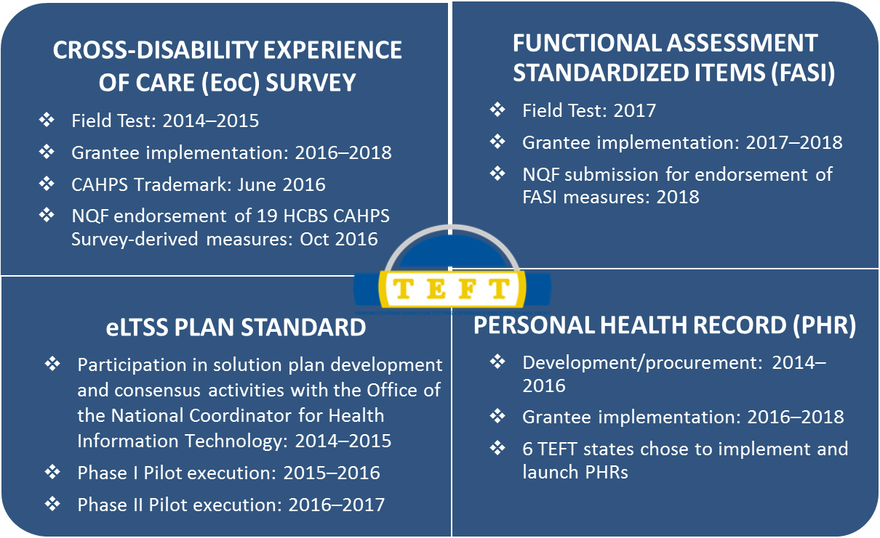
TEFT Demonstration:
Quality Components
3

Slide 5
Functional Assessment Standardized Items (FASI)

Slide 6
Key Features of FASI
Person-centered measures of functional ability & need for assistance
  Aligned with federally standardized items for measuring function in the Medicare program and adapted for the LTSS population
Standardized approach allows for:
  Common approach and definitions
  Following the individual over time and across settings/programs
  Comparisons across state HCBS programs
Electronic exchange of HCBS data:
  Among providers, case managers, and beneficiaries
  Allows data to follow the individual

Slide 7
Elements Included in FASI
  Self care activities such as eating and dressing
  Mobility activities such as bed mobility and transfers, ambulation, and wheelchair use
  Instrumental Activities of Daily Living (IADL) activities such as meal preparation, finances, and housework
  Supports and services needed to complete daily activities such as assistive devices and paid and unpaid assistance services
  Process for participants to identify personal priorities

Slide 8
FASI Timeline Under TEFT
Time Frame | FASI Activity
2015-2016 | Alpha test and OMB clearance
2017 | FASI assessor training
 | Round 1 data collection
 | Data analysis; review by Technical Expert Panel
 | FASI set finalized for Round 2
2018 | 6 Grantees demonstrate FASI use in their HCBS programs (March-May data collection)
 | Develop and test FASI-based performance measures with TEP input (June-August)
 | Submit measures to NQF for endorsement (September)

Slide 9
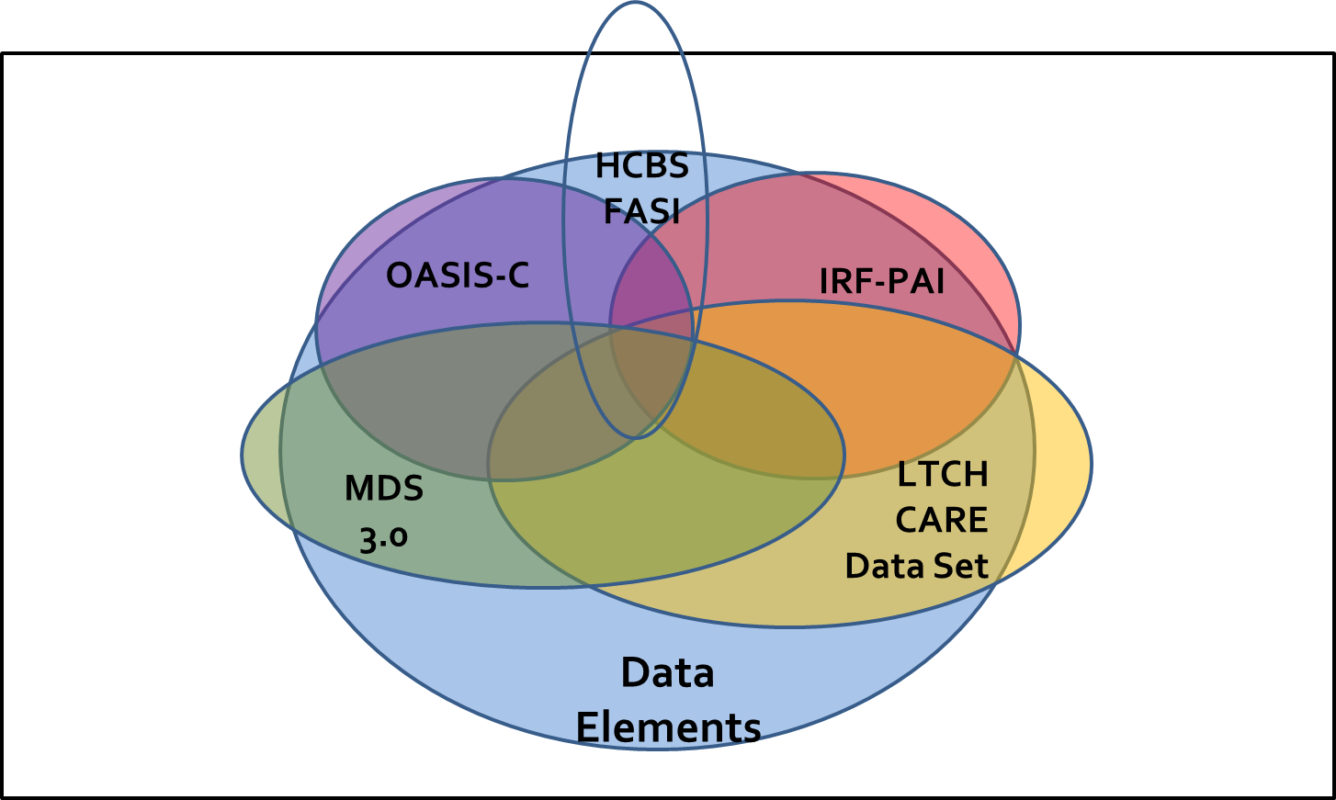
FASI Data Elements: Alignment with CMS Data Standardization Initiatives

Slide 10
Key Features of the
HCBS CAHPS Survey

Slide 11
Overview of the HCBS CAHPS Survey
Cross-disability consumer experience survey for eliciting feedback from beneficiaries receiving Medicaid HCBS services and supports
  Focus on participant experience, not satisfaction
Allows for comparisons across programs serving different target populations
  Individuals who are frail elderly
  Individuals with a physical disability
  Individuals with an intellectual or developmental disability
  Individuals with a brain injury
  Individuals with serious mental illness
  Other HCBS recipients

Slide 12
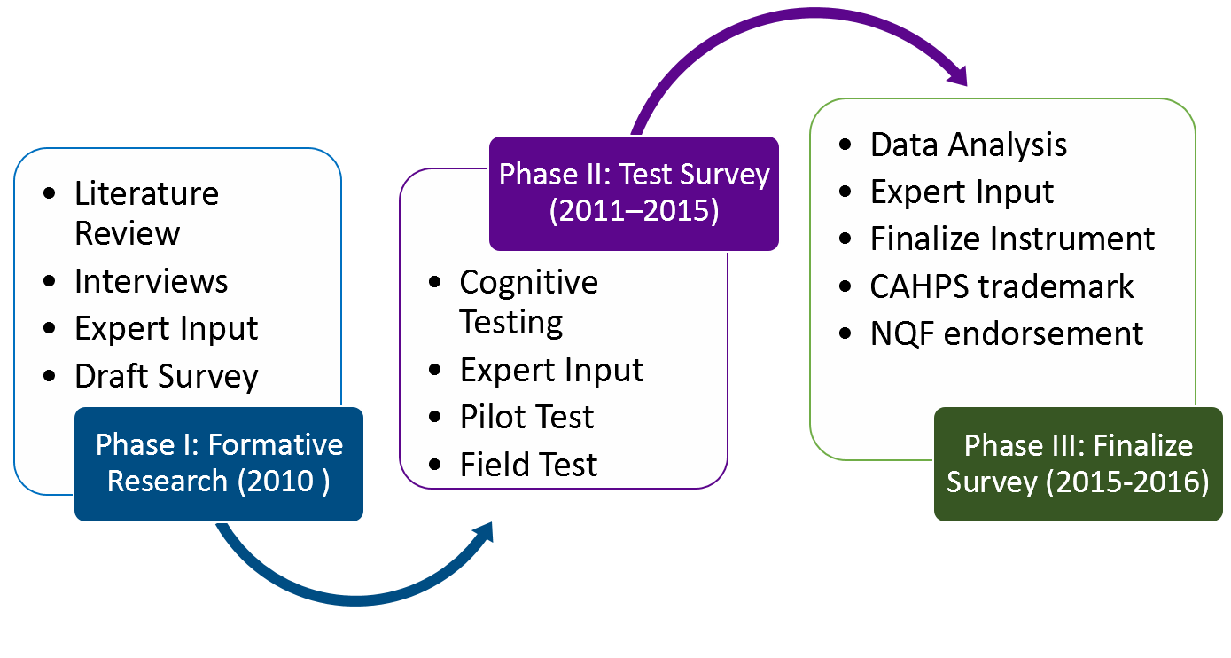
HCBS CAHPS Survey Development Process
11

Slide 13
Sample Design
Unit of analysis = HCBS program or accountable entity
Accountable entity = operating entity responsible for managing and overseeing a specific HCBS program within a given state (e.g., managed care organization [MCO])
Focus of analysis can vary
  Program
  MCO
  Case management agency
  County
  State

Slide 14

Common Services and Providers
Common services
  Personal care and behavioral health care
  Transportation
  Home care
  Case management
  Employment assistance
Common providers
  Personal assistant and behavioral health staff
  Medical transportation services
  Case manager
  Homemaker
  Job coach
13

Slide 15
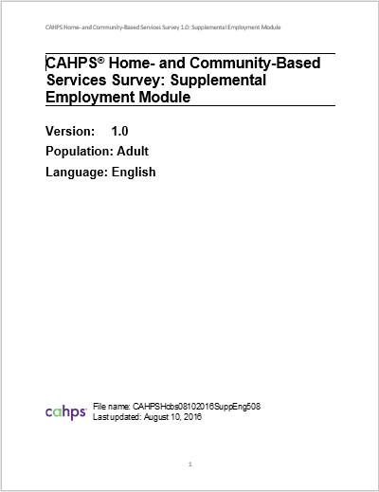
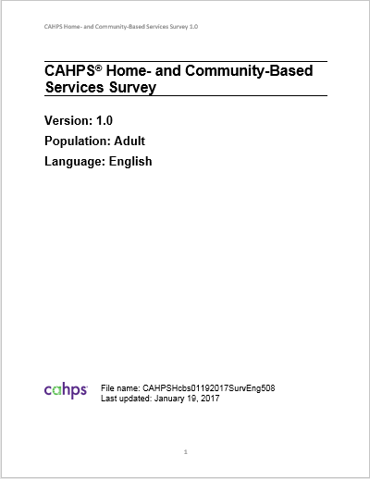
HCBS CAHPS Survey Instruments
Core instrument
Supplemental Employment Module
English and Spanish versions of both
Phone or in-person
Standardized implementation instructions in guide (free from CMS)
14

Slide 16
Domains Addressed by the HCBS CAHPS Survey
Key Survey Sections
Getting Needed Services
Communication with Providers
Case Managers
Choice of Services
Medical Transportation
Personal Safety
Community Inclusion and Empowerment
Employment (optional supplemental module)
Domains Addressed
Community Participation
Choice and Decision Making
Relationships
Service Coordination
Work
Self-Direction
Access
Medications
Wellness
Rights and Respect
Safety
Everyday Living
Person-Centered Planning Process
15

Slide 17
Cognitive Screening Questions
16

Slide 18
Program- and
Provider-Specific Terms
17

Slide 19
Alternate Response
18

Slide 20
Proxy Respondents
19

Slide 21
Data Collection Entity Qualifications
State choice to conduct data collection inhouse or use a vendor
CMS does not approve vendors for the CAHPS® Home and Community-Based Services Survey
NCQA Survey Vendor Certification for CAHPS is not required.
Training ensures consistent data collection within states that use multiple entities and maximizes the quality of data collected
Recommended qualifications of data collection entities
  Be familiar with the instrument structure, content, and intent
  Be knowledgeable about the unique features of the instrument and implications for how it is administered
  Have experience conducting surveys with HCBS populations or people with cognitive impairment
  Have Computer-Assisted Personal Interview (CAPI) and Computer-Assisted Telephone Interview (CATI) capability

Slide 22
NQF-Endorsed Measures Derived from the HCBS CAHPS Survey

Slide 23
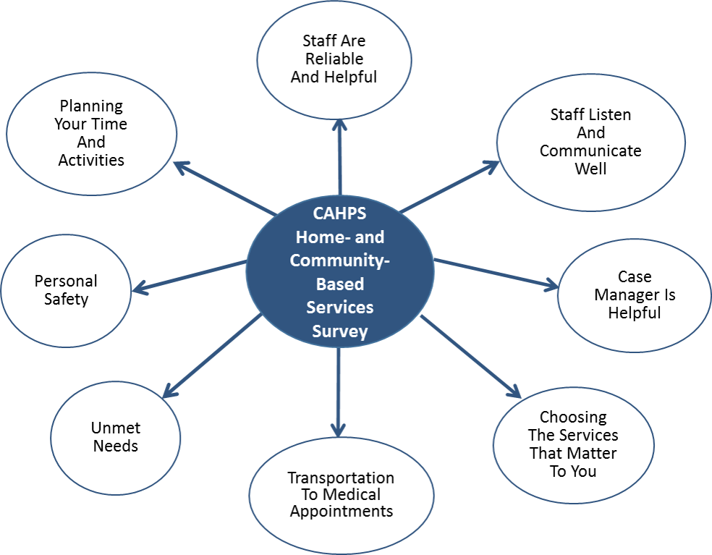
Topics of 19 Measures Derived from the HCBS CAHPS Survey
22

Slide 24
Composite: Staff Listen and Communicate Well
Survey Item # | Composite Measure: Staff Listen and Communicate Well
28 | Staff treat you with courtesy and respect
29 | Staff explanations are easy to understand
30 | Staff treat you the way you want them to
31 | Staff explain things in a way that is easy to understand
32 | Staff listen carefully to you
33 | Staff know what kind of help you need with everyday activities
41 | Homemakers treat you with courtesy and respect
42 | Homemaker explanations are easy to understand
43 | Homemakers treat you the way you want them to
44 | Homemakers listen carefully
45 | Homemakers know what kind of help you need

Slide 25
Composite: Planning Your
Time and Activities
Survey Item # | Composite Measure: Planning Your Time and Activities
75 | Can get together with nearby family
77 | Can get together with nearby friends
78 | Can do things in community
79 | Needs more help to do things in community
80 | Takes part in deciding what to do with their time
81 | Takes part in deciding when they do things each day

Slide 26
Overall Top-Box Scores for Groups of Questions and Global Ratings
Scores include complete cases with proxies. Scores are reported as top-box scores.
Source: NQF Submission, July 2016
25

Slide 27
Case Management Composite Scores, by HCBS Population
Key
^ = Above Average Scores
˅ = Below Average Scores
Scores include complete cases with proxies. Scores are reported as top-box scores.
Source: NQF Submission, July 2016
26

Slide 28
Using the Survey for
Program Quality Management
  Assess program performance
    Point-in-time snapshot
    Track changes over time
  Document successes and identify areas for program improvement
  Assess impact of program improvement initiatives
  Provide information to stakeholders on program performance
    Internal staff, providers, and managed care organizations, beneficiaries, legislators, and the general public
    Measures align with some CMS quality requirements
  Potential to compare results across states

Slide 29
HCBS CAHPS Alignment with Existing Quality Measures
HCBS CAHPS measures are being integrated into the Core Set of Adult Healthcare Quality Measures for Medicaid
NQF MAP Workgroup recommendations to add HCBS CAHPS measures to measure sets for various programs
    MAP Family of Measures for duals and the Starter Set (NQF Dual Eligible Beneficiaries Workgroup, August 2017)
    CI-LTSS Measure Set (NQF Medicaid Innovation Accelerator Project, September 2017)
Managed LTSS Association has integrated HCBS CAHPS measures into existing quality framework
28

Slide 30
State Activities

Slide 31

What Makes the HCBS CAHPS Survey Appealing
Person-centered
Cross-disability
  Ability to compare programs
Increased accessibility via in person and phone modes, alternate response options, proxy respondents
Development aligned with CAHPS
  Reflects what is important to beneficiaries
  Rigorous methods, for example, psychometric testing
  Trademark that providers recognize
Measures available (National Quality Forum-endorsed)
Flexibility to tailor the survey by adding questions
Publicly available from CMS
  Free of charge to access
  Resources for help in using survey
30

Slide 32
Populations Participating in Overall TEFT Demonstration of HCBS CAHPS Survey by State
State | Individuals Who Are Frail Elderly | Individuals With a Physical Disability | Individuals Who are Frail Elderly and/or With a Physical Disability | Individuals With an Intellectual or Developmental Disability | Individuals With a Brain Injury | Individuals With Serious Mental Illness
Arizona | . | . | X | X | . | .
Colorado | X | . | X | X | . | .
Connecticut | X | X | . | . | X | X
Georgia | X | X | X | . | X | .
Kentucky | . | X | X | X | X | .
Louisiana | . | . | X | X | . | .
Maryland | . | . | X | . | X | .
Minnesota | X | . | . | . | X | X
New Hampshire | . | . | X | X | X | X
Tennessee | . | . | X | . | . | .

Slide 33
CONNECTICUT WaiverS
11 Medicaid waivers
  7 Operated directly by Medicaid agency
  3 Operated by the DD agency
  1 operated by Mental Health Agency
Two HCBS State Plan Options
  1915i effective 2012
  1915k effective 2015
Performance measures in Waivers varied
Evidence collection for CMS always challenging
Goal is a consistent approach to reward quality and facilitate reporting

Slide 34
CT Case Management Contract
Added performance bonus incentives to the contracts in 2013
Pool is divided by the number of performance standards
Performance Incentives based on 3 Composite scores
  Case manager is helpful
  Choosing the services that matter to you
  Personal safety and respect

Slide 35
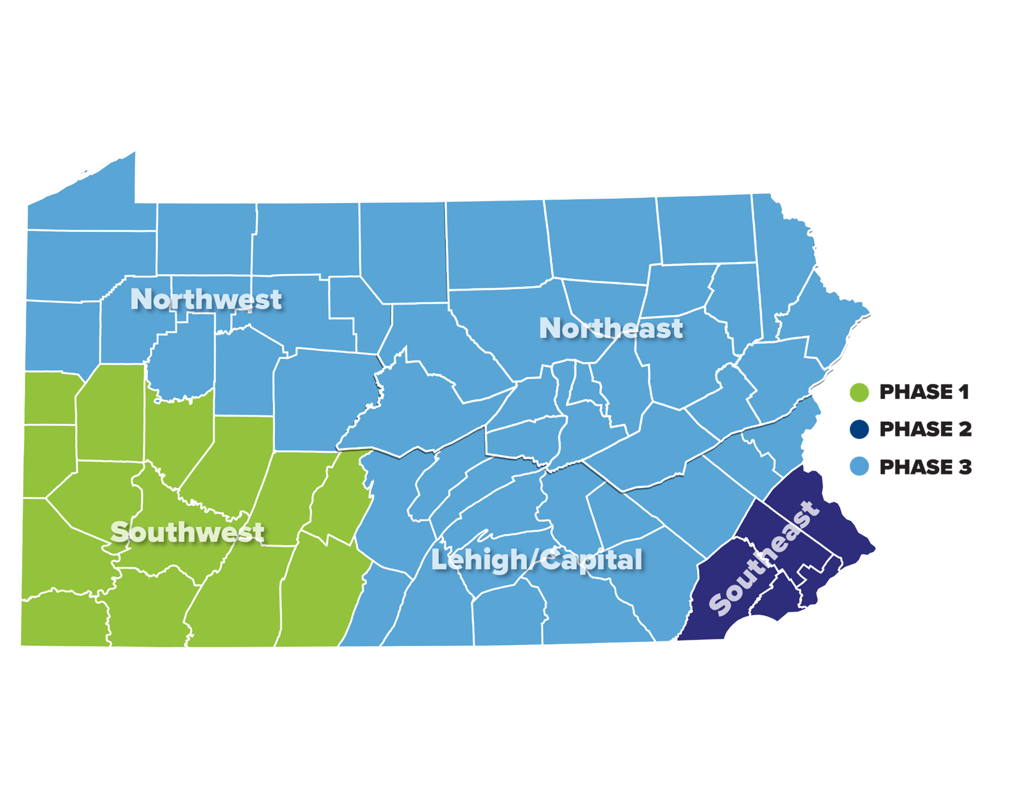

HCBS CAHPS Survey Use
Fee for Service HCBS Waivers
  2018 for all regions except Southwest
MCOs in Community HealthChoices
  2018: Southwest (Phase 1)
  2019: Southeast (Phase 2)
  Annually starting 2020: Statewide
  Include Supplemental Employment Module
34

Slide 36
Publicly Available Resources

Slide 37
Key HCBS CAHPS Survey Resources
CMS webpage on HCBS CAHPS Survey
  Full URL: https://www.medicaid.gov/medicaid/quality-of-care/performance-measurement/cahps-hcbs-survey/index.html
  TA guides forthcoming from CMS
  Standardized instructions for implementing survey
  Detailed instructions for analyzing data
HCBSCAHPS@us.ibm.com mailbox for questions
NQF #2967 in the NQF Quality Positioning System

Slide 38
Questions?

