Slide 1
Senior Nutrition Program
Advancing Health Equity Through Meal Programs Serving Older Adults
May 13, 2021

Slide 2
Presenters
Judy Simon, MS, RD, LDN, National Nutritionist, ACL
Jeanne Ayers, RN, MPH, Senior Advisor, Healthy People Healthy Democracy Initiative, VoteSAFE Public Health
Sara Saye Koenig, MS, RDN, CD, Elder Nutrition Program Manager, Wisconsin Bureau of Aging and Disability Resources
Raia Contractor, MPH, Grants and Data Manager, Baltimore City Health Department
Philip Lanier, MSW, Nutrition Specialist, AgeOptions, Oak Park, Illinois

Slide 3
Learning Objectives
Introduce a systems approach and three practices to building healthy communities and advancing health equity.
Identify the assumptions, policies and practices that influence current patterns of inequities.
Demonstrate ways to use levers within senior nutrition programs to decrease disparities in health and nutrition.

Slide 4
Agenda
Importance of Equity in the Nutrition Program
Systems Approach to Building Healthy Communities and Advancing Health Equity
State Unit on Aging Efforts
AAA and Local Implementation Approaches
Baltimore
Chicago area

Slide 5
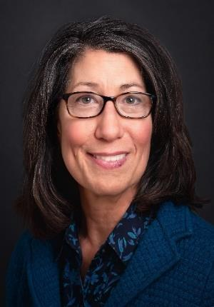
Importance of Equity in the National Senior Nutrition Program
Judy Simon, MS, RD, LDN
National Nutritionist
ACL

Slide 6
Intent of the Older Americans Act
Reduce hunger, food insecurity and malnutrition
Promote health and well-being
Enhance socialization
Older Americans Act
(OAA)

Slide 7
Meals and Groceries
Meals (main purpose of Older Americans Act Senior Nutrition Program)
Other Nutrition Services examples:
Groceries
Liquid Nutritional Supplements
Weighted Utensils

Slide 8
OAA Targeted Populations
Programs target adults age 60 and older who are in greatest social and economic need, with particular attention to the following groups:
Low-income older adults
Minority older individuals
Older adults in rural communities
Older individuals with limited English proficiency
Older adults at risk of institutional care

Slide 9
Targeting Services
Historical Perspective
“greatest social need” includes isolation caused by noneconomic factors, which include racial or ethnic status
Compelling government interest:
In targeting resources, outreach and services to older low-income minorities
To overcome lower life expectancy and poorer health.

Slide 10
Food Insecurity and Health
Money
for Food
Money for Medicine
Ability to Shop
Challenges faced by today’s seniors

Slide 11
Results and Impact
80% of congregate meal participants believe their health is improved
Congregate and HDM participants have lower healthcare utilization
Percentage of low-care nursing home residents are reduced 1% for every $25 spent on HDMs per year per adult
Hospital, Emergency Department and Nursing Homes

Slide 12
Resources
Justification of Estimates for Appropriations Committees Link
AGing, Independence, and Disability (AGID) Program Data Link
National Survey of OAA Participants Link
Using Groceries and other Nutrition Services to Meet Senior Needs

Slide 13
Systems Approach to Building Healthy Communities and Advancing Health Equity
Jeanne F. Ayers
Healthy People Healthy Democracy Initiative
VoteSAFE Public Health

Slide 14
Health is…
“…a state of complete physical, mental and social well-being and not merely the absence of disease or infirmity.”
-World Health Organization

Slide 15
What does “health equity” mean?
Health equity means achieving the conditions in which all people have the opportunity to realize their health potential — the highest level of health possible for that person — without limits imposed by structural inequities.

Slide 16
What is necessary for health?
Peace
Shelter
Education
Food
Income
Stable eco-system
Sustainable resources
Social justice and equity (inclusion, social cohesion, healthy governance)
World Health Organization. Ottawa charter for health promotion. International Conference on Health Promotion: The Move Towards a New Public Health, November 17-21, 1986 Ottawa, Ontario, Canada, 1986. Accessed July 12, 2002 at http://www.who.int/hpr/archive/docs/ottawa.html. (adapted)

Slide 17
Health is a complex system
Health is a complex system or set of systems that intersect and influence one another.
To advance health equity we need to develop the capacity to influence the systems that create healthy communities.

Slide 18
A systems approach to creating healthy communities

Slide 19
A Systems Approach to Navigating Complexity
What?: Identify existing patterns
So What?: Understand the meaning of the pattern what is its impact on our aim? What sustains the pattern?
Now What? What can we do to change the pattern? Employ 3-7 simple practices
What?
So what?
Now what?

Slide 20
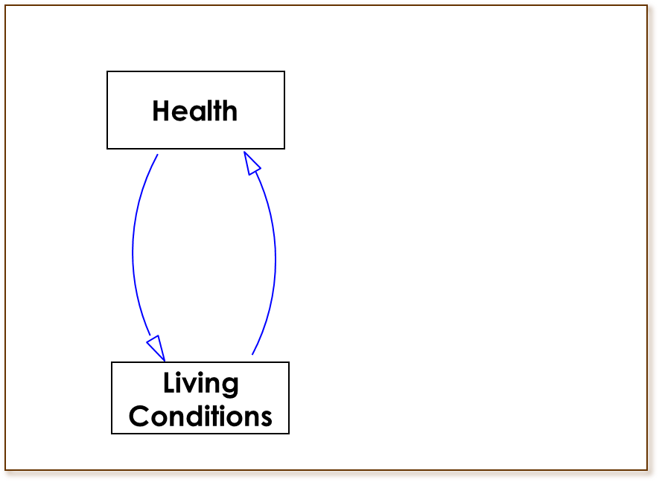
What is the pattern? Seeing a Wider Set of Relationships

Slide 21
Roots of Inequities How did we get here?
Disparities are not simply because of lack of access to health care or to poor individual choices.
Disparities are mostly the result of policy decisions that systematically disadvantage some populations over others.
Especially, populations of color and American Indians, GLBTQ, low income and people with disabilities
Structural racism

Slide 22
Opportunity
Communities of Opportunity
Low-Opportunity Communities
Social/economic inclusion
Thriving small businesses and entrepreneurs
Financial institutions
Good transportation options and infrastructure
Home ownership
Better performing schools
Sufficient healthy housing
Grocery stores
IT connectivity
Strong local governance
Parks & trails
Social/economic exclusion
Few small businesses
Payday lenders
Few transportation options
Rental housing/foreclosure
Poor performing schools
Poor and limited housing stock
Increased pollution and contaminated drinking water
Fast food restaurants
Limited IT connections
Weak local governance
Unsafe/limited parks
Poor Health Status
Good Health Status
Contributes to health disparities:
Diabetes
Cancer
Asthma
Obesity
Injury

Slide 23
Structural/Institutional Racism
Structural racism is the normalization of an array of dynamics—historical, cultural, institutional and interpersonal—that routinely advantage white people while producing cumulative and chronic adverse outcomes for people of color and American Indians.

Slide 24
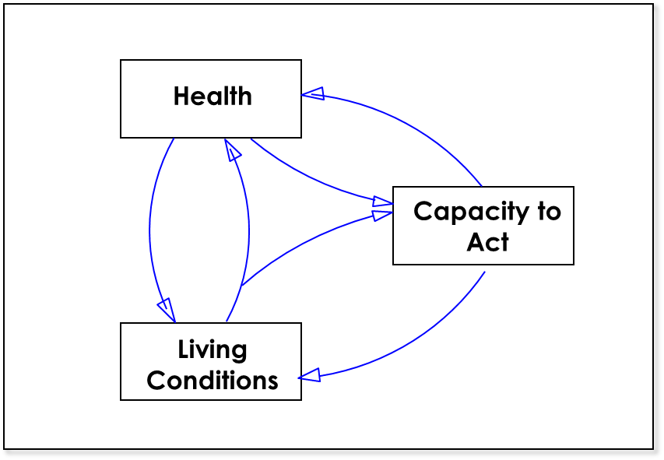
So what holds the pattern in place?
To create health, we must build our skills to foster the “capacity to act” (power).

Slide 25
Now what? Practices to change patterns
Lead with equity and prioritize belonging. Build inclusive, thriving relationships at every level – individual, family, community and population through 3 strategic practices.
Organize narrative: Expand our understanding of what creates health through relationships, data, narrative to – build public and political will.
Organize People: Strengthen the community’s capacity to assure the conditions for health.
Organize Resources: Address how systems work. Apply a policy, systems, environmental and cultural change approach to every level of the system.

Slide 26
Employ Tools with Equity as Aim
Data-collection and analysis
Reports, white papers, bully pulpit
Programs – grant-making
Stakeholder/Partner/ Scan and power analysis
*Convening-Process – community engagement, partnerships
Health in all policies – policy at all levels, health impact assessment
Asking questions

Slide 27
Asking Questions Examine Policies, Processes, Values, Beliefs, and Assumptions
What is working? What is the health impact? Who benefits?
Outcome versus intent?
Who is deciding? What narratives and whose values, beliefs and assumptions influence decisions?
What policies, practices, processes create inequities within our organizations and more broadly?
Where are structural inequities and structural racism creating inequitable health outcomes?
Tension and partnership work together
http://www.health.state.mn.us/divs/opi/resources/docs/1811advancingHEkeyQs.pdf

Slide 28
Overall Lessons
Organic: Must be interwoven with all other work and recognized as iterative
Must be intentional
Commitment: Requires commitment to building our organizational and community capacity and skills
Leadership: Hold ourselves and each other accountable, bring more people into decision-making
Imperfect:
Incomplete work
Navigating toward health equity
Permission to make course corrections

Slide 29
“Public health is the constant redefinition of the unacceptable” Geoffrey Vickers
Jeanne F. Ayers
Healthy People Healthy Democracy Initiative
VoteSAFE Public Health
ayers002@umn.edu

Slide 30
State Unit on Aging Equity Efforts
Sara Koenig, MS, RDN, CD
Elder Nutrition Program Manager
State of Wisconsin Office on Aging

Slide 31
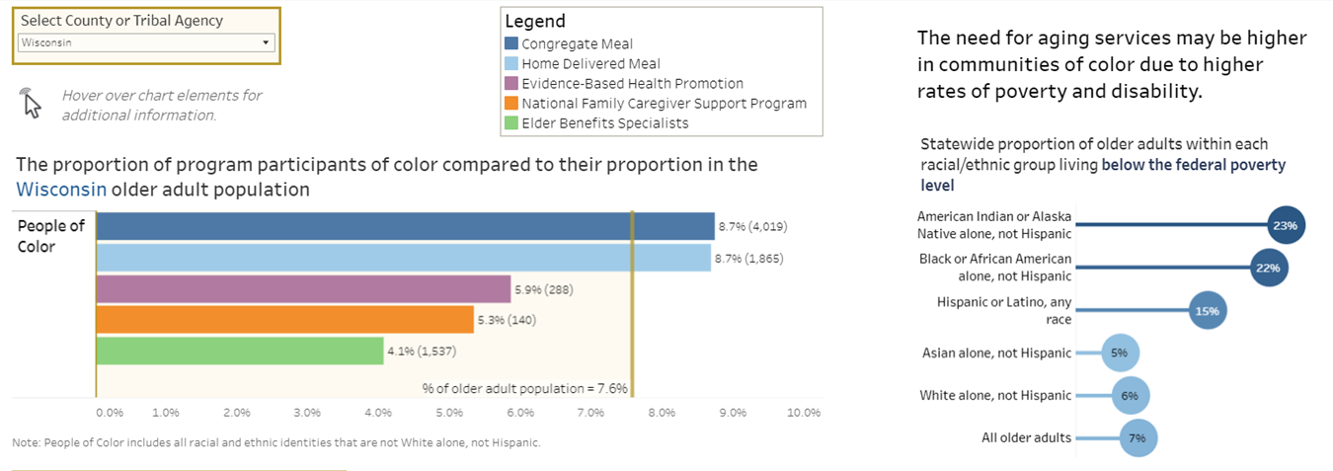
OAA Title III Program Participation by Racial/Ethnic Group, Wisconsin, 2019

Slide 32
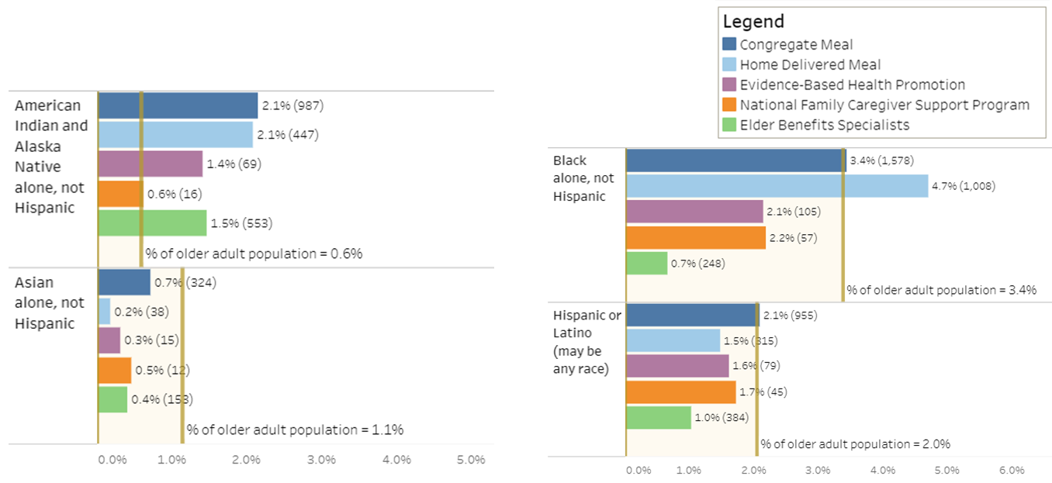
OAA Title III Program Participation by Racial/Ethnic Group, Wisconsin, 2019, cont.

Slide 33
2019 Pre-Pandemic Patterns
Which groups are being served in proportion in Wisconsin’s older adult population?
Native elders: tribal aging units, coordination between Title III and Title VI
Black older adults
Hispanic older adults (Congregate Meals)
Which groups are underserved?
Asian elders
Hispanic older adults (Home-Delivered Meals)

Slide 34
Policies and Practices to Explore
Food Served
Recommended Meal Pattern
Availability of Food Choices
Contracted Food Providers
Dining Environment
Celebrations, Activities, and Invited Speakers
Location of Dining Centers
Meal Service
Administrative Policies
Voluntary Contributions
In-Home Eligibility Assessments
Communication

Slide 35
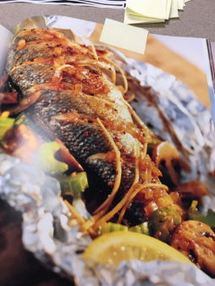
Hmong Dining Center – Manitowoc County
From Hmong Times Online:
“Hmong people have lived in Manitowoc County for more than 40 years. Still, we saw no Hmong elders using the senior center or dining at senior meal sites, none using exercise programs created for senior citizens.
Discussions with Hmong elders made it clear that language, transportation, and cultural barriers were the problem.
After a year of information gathering and planning, Manitowoc County ADRC [began] offering culturally appropriate meals to Hmong seniors along with interpreters and activities.”

Slide 36
2020: COVID-19’s Changing Landscape
Home-delivered meal participation by all groups increased (number and proportion) compared to 2019, except Hispanic/Latin-X
Number of older adults served increased approximately 125% for Black and Native elders.
Number of Asian elders served was six times higher! However, this group remains underserved in proportion to the population.
Hispanic/Latin-X older adults served DECREASED during the pandemic. This group remains underserved in proportion to the population.
Carryout meal participation also resulted in new patterns…

Slide 37
Congregate vs. Carryout Meal Participation April 1 – December 31

Slide 38
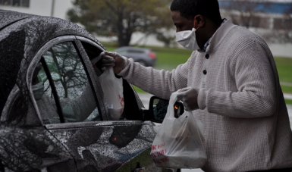
Next Steps…

Slide 39
Equity Resources
County Health Rankings—Robert Wood Johnson Foundation
Mobilizing Action Toward Community Health (MATCH)
Policy Evaluation Tool
Race Forward’s Racial Equity Impact Assessment Tool
Government Alliance on Race & Equity (GARE) Racial Equity Toolkit
Milwaukee County Racial Equity Framework

Slide 40
Addressing food insecurity among older adults during the COVID-19 pandemic
Baltimore City Health Department
Brandon M. Scott
Mayor, Baltimore City
Letitia Dzirasa, M.D.
Commissioner of Health, Baltimore City
@Bmore_Healthy
BaltimoreHealth
https://health.baltimorecity.gov

Slide 41
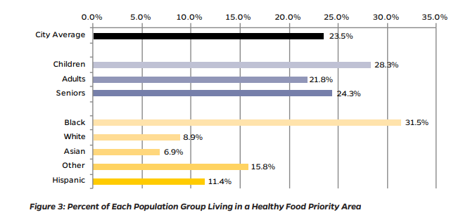
Background
124,000 older adults in Baltimore City
24% live in Healthy Food Priority Areas
31% of Black residents live in HFPAs
9% of white residents live in HFPAs
Baltimore City Food Environment Brief 2018

Slide 42
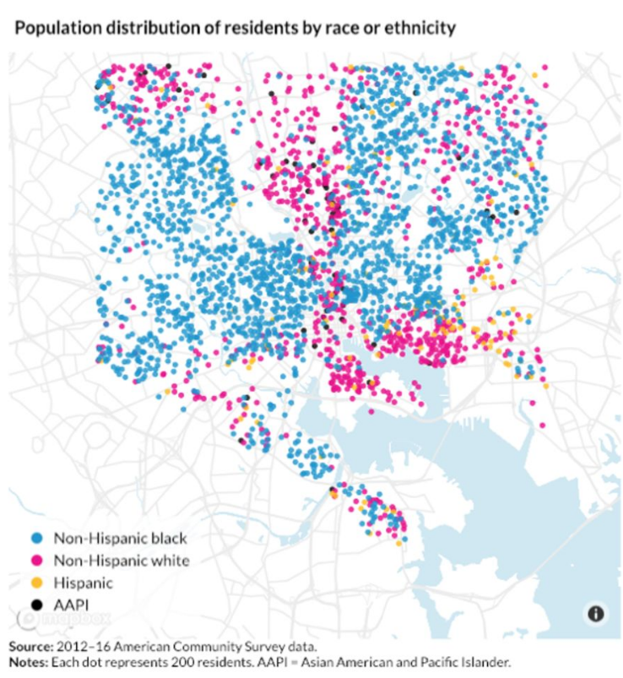
Baltimore Maps

Slide 43
Food Strategy
Goal: implement a citywide effort to mobilize residents to ensure home-based food support for Baltimore City older adults who have no reliable options.
Respond to increased food insecurity due to COVID-19 closures
Mitigate the spread of COVID-19 among older adults by providing home-delivered meals and groceries
BCHD partnered with other City agencies, non-profits, and community-based organizations

Slide 44
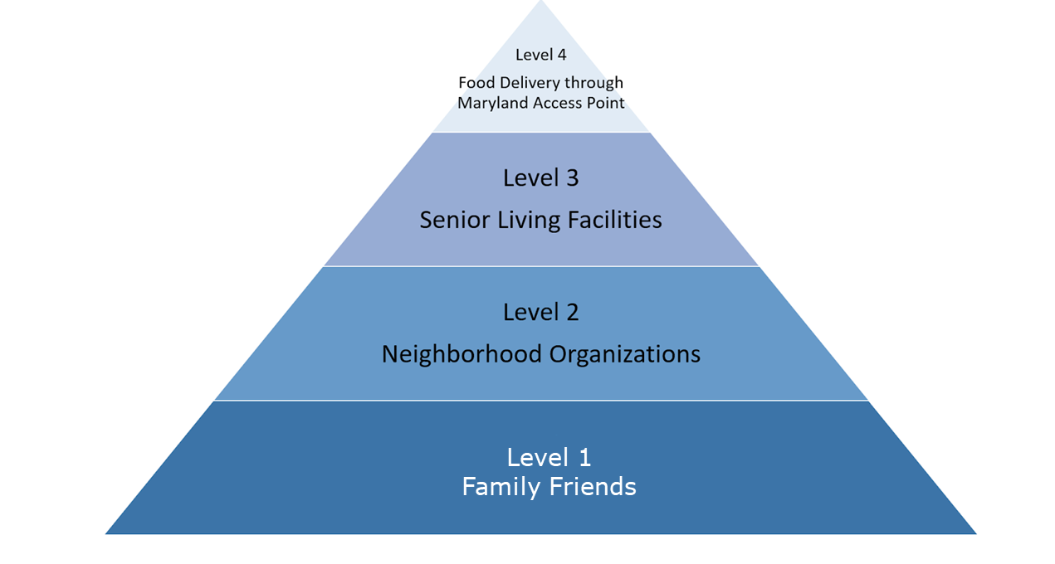
Public Health Impact Model

Slide 45
COVID-19 MAP Calls & Meal Distribution

Slide 46
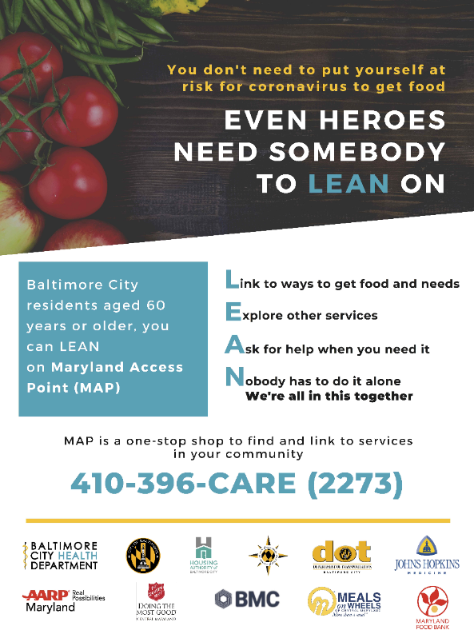
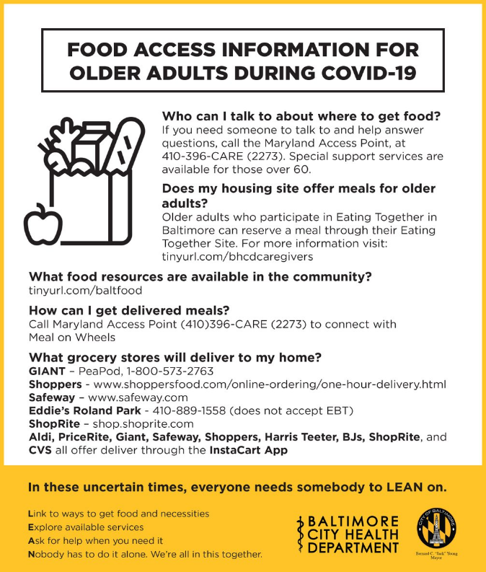
Level 1 and 2 Actions

Slide 47
Level 3 Actions- Meal Delivery to Senior Housing
115 senior housing sites in Baltimore City
Congregate meal sites at senior housing buildings were converted to grab and go meals
BCHD partnered with Salvation Army to deliver meals to the remaining buildings
Assessed needs at senior housing sites with weekly calls and surveys

Slide 48
Level 4 Actions - Home delivered meals and groceries
Maryland Access Point expanded to handle triple the number of calls compared to pre-COVID
Meals on Wheels increased meal delivery from the start of the pandemic response in March 2020
BCHD began grocery box delivery to older adults who requested a box through MAP via partnership with Salvation Army, Maryland Food Bank, and Amazon

Slide 49
Impact
Over 2.2 million meals delivered over the last year
Improved data on and relationships with senior housing sites – basis for flu and COVID-19 vaccination clinics
Assessing zip code level data to evaluate strengths and weaknesses of the current food response

Slide 50
Further Resources
Redlining, Black butterfly and white L
COVID-19 food distribution response in Baltimore City
Baltimore City food environment briefs and maps
Baltimore City neighborhood health profiles

Slide 51
Nutrition Equity for Ethnically & Culturally Diverse Older Adults
The Area Agency on Aging of Suburban Cook County, since 1974

Slide 52
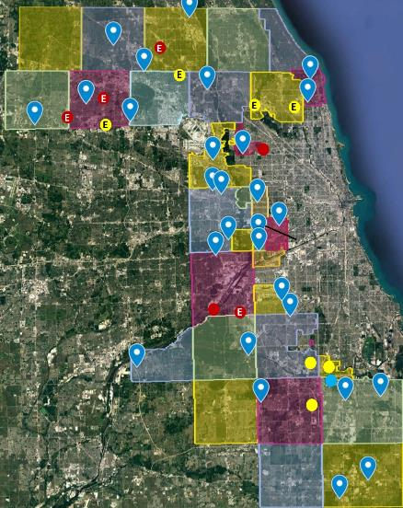
AgeOptions
Area Agency on Aging for Suburban Cook County
Serving > 530,000 older adults
> 2 million meals in FY20

Slide 53
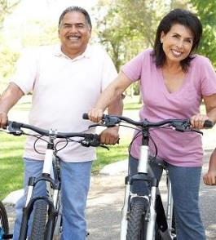
Diversity in suburban Cook County
Nearly 1 in 3 older adults are racially or ethnically diverse!
Increases predicted, 2016 - 2024:
95% for Latin-X
67% for Black
55% for Asian

Slide 54
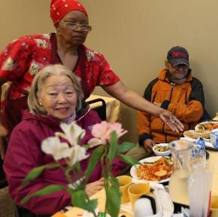
Diversity in suburban Cook County, cont.
Limited-English population has grown 179% since 2009!
20% speak a language other than English at home.
Suburban Cook County has 35% of the LES older adults in Illinois.

Slide 55
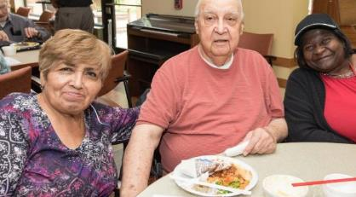
Diversity is not a challenge. It’s an asset!
"The diversity of our organization and communities is a rich asset that strengthens our mission and guides our decisions and direction."

Slide 56
Achieving Nutrition Equity Starts With a Plan
“Choice is becoming more of a factor with meal programs. Food is going to waste if it does not meet dietary needs or is unfamiliar.”
From AgeOptions Current 3-Year Nutrition Plan

Slide 57
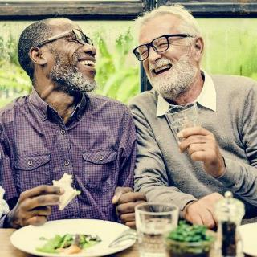
Familiar Food Familiar Culture Familiar Friends

Slide 58
Our Research
82% rated meals and social interaction as the top two reasons for attending a congregate dining site.
> 50% of respondents said they would attend even if meals were not served.
Why: “My friends are here.”

Slide 59
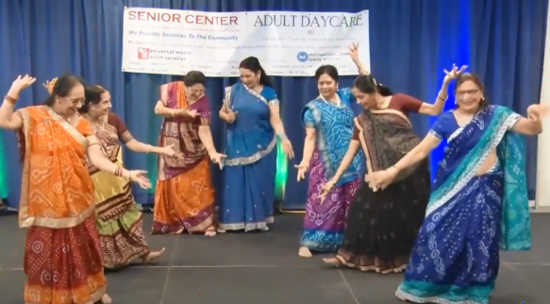
Friends Who Share the Same Food And Culture

Slide 60
AgeOptions TCLIP Program
Established 2002 as part of our strategic plan.
To partner with organizations serving Culturally and Linguistically Isolated Populations.
Foundation for our current nutrition programs serving diverse populations.

Slide 61
The Key to nutrition equity: Culturally Connected Community Partners
American Association of Retired Asians (Halal)
Arab American Family Services (Middle Eastern)
Xilin Association (Chinese)
Our Lady of Mt. Carmel Parish (Hispanic)
Hanul Family Alliance (Korean)
Metropolitan Asian Family Services (Vegetarian)
CJE SeniorLife (Kosher)
Ali Baba Catering (Halal)
Al Bawadi Grill (Middle Eastern)
China & Super China Buffets (Chinese)

Slide 62
Minority Populations Were Hit Hard by the Pandemic
Congregate dining closed
Including seven ethnic meal sites.

Slide 63
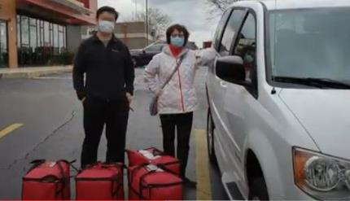
Working for Equity During the Pandemic
Expediting vetting of new ethnic food providers
Idled Adult Day Care service vans and drivers used for home delivered meals program
Kosher and vegetarian shelf-stable meals

Slide 64
Working for Equity During the Pandemic, cont.
Partnership with Top Box Foods, April 2020.
Home-delivered fresh produce, fruits, frozen meats and packaged foods.

Slide 65
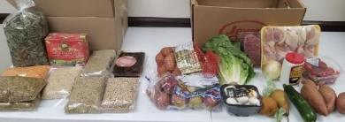
The Ramadan Dilemma
Arab American Family Services' Nutrition Program closes for Ramadan each year.
In 2020, COVID left clients with few other meal options.
"As Ramadan approached, AgeOptions presented us with a chance to have Top Box work with an Arab-American food supplier to create custom boxes for our clients. They loved it!“
- Nareman Taha, Director, AAFS

Slide 66
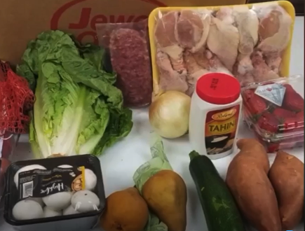
Home-Delivered Food Boxes Tailored to Middle-Eastern Preferences
Lentils
Dates
Fenugreek
Chickpeas
Fava Beans
Tahini Sauce

Slide 67
Could this become a sustainable program?
AgeOptions awarded a 3-year ACL grant to explore:
How home delivered groceries can fit under the Older Americans Act
How program can help meet unmet needs of certain populations

Slide 68
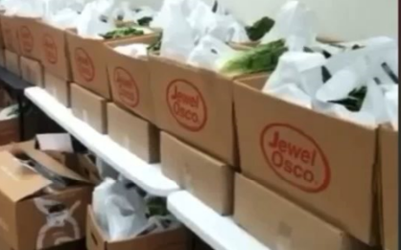
Applying the Model to Expand Nutrition Equity
Start with standard food mix, buying in bulk
Add/subtract items to population preference
Provide recipes tailored to cultural/ethnic population served

Slide 69
Speaker Contact Information
Judy Simon: JUDY.SIMON@ACL.HHS.GOV
Jeanne Ayers: AYERS002@UMN.EDU
Sara Saye Koenig: SARAS.KOENIG@DHS.WISCONSIN.GOV
Raia Contractor: RAIA.CONTRACTOR@BALTIMORECITY.GOV
Phillip Lanier: PHILIP.LANIER@AGEOPTIONS.ORG

