Slide 1

The Caregiver Experience
Smart Innovation for Better Care: AI Solutions to Empower Caregivers
Thursday, May 28, 2026

Slide 2
ACL Caregiver AI Prize Challenge
The Problem: Demand for home care is surging — the US will need almost 800,000 additional direct care workers by 2034. Caregivers face growing physical, emotional, and financial strain, and AI has limited best practices for responsible use as a tool to support caregiving.
The Goal: Drive innovation in affordable, user-centered AI tools that improve care quality, reduce caregiver burden, and extend the direct care workforce — supplementing, not replacing, human connection.
How It Works — Two Tracks, Three Phases:
Track 1: AI Tools for Caregivers
Track 2: AI Tools for Extending the Caregiver Workforce
Each track runs through Phase 1 (Design) → Phase 2 (Implementation & Testing) → Phase 3 (Promise of Sustainability)
Advancement to Phases 2 and 3 requires winning the prior phase

Slide 3
ACL Caregiving AI Prize Challenge Slack Workspace
For interested applicants
What you can do in Slack:
  Connect with other participants across challenge tracks
  Share ideas and explore potential partnerships
  Ask questions and learn from peers
Want to Join? Email CaregiverAI@acl.hhs.gov with:
  A short description of why you are applying for the prize challenge (less than 100 words expected)
  The track(s) you are considering
  Your contact info (and your team members if they want to join as well)
Disclaimers:
Participation is optional and will not be factored into prize award decisions. ACL will not use the information from Slack when making award decisions
ACL is not responsible for participant-generated messages and/or content.
ACL will not participate and will not actively moderate Slack but reserves the right to moderate the conversation or to remove members from the Slack whose participation is not in line with the purpose of the challenge or this community.

Slide 4
Technology Readiness Guide
Overarching Concepts
  Concept Feasibility
  Experimental Validation
  Relevant Environment
  Critical Tech Elements
  Documentation
  Suggested Evidence
  Basic Bench Test Performance Metrics
    F1-Score, Recall/Precision, Overall Accuracy
  Model Evidence
    Actionable Workflow, Human-in-the-Loop Protocol,
  "Smart 40" Validation Logs
More info can be found here: https://acl.gov/caregiver-ai-tech-readiness-guide

Slide 5
Phase 1 Application—Submission Instruction Updates
Applications expected primarily in narrative format
New cover page
Applications must be 508-compliant
  Resources:
    Microsoft Word Accessible Document video series
    PDF Accessible Document video series
Use the exact section headings in the Application Outline page
Option to send test logs that do not count toward the page limit
Submit only one (1) email per solution application to CaregiverAI@acl.hhs.gov
Details available on the Challenge “How to Apply” tab.

Slide 6
Phase 1 Submission Requirements & Evaluation Criteria
Submission Requirements
Cover Page (new)
Abstract
Project Narrative
Section 1: Understanding of Need and Solution Design
Section 2: Implementation Approach
Section 3: Usability and Integration
Section 4: Alignment with Caregiver AI Principles
Section 5: Meritorious Prize Eligibility (Optional)
Appendices (Optional)
Details available on the Challenge page.
Evaluation Criteria
Evaluation criteria is published for each track on the Challenge website.
Categories:
Responsiveness to Need
User-Centered
Implementation
Usability and Integration
Alignment With the Caregiver Challenge AI Principles
Partnerships and Collaboration
Details available linked from the Track Tabs: Track 1 and Track 2

Slide 7
Phase 1 Key Dates & Next Steps
July 31, 2026: Phase 1 Applications Due by 5pm ET
September 2026: Phase 1 Winners Announced
Phase 2 and Phase 3 dates will be announced at a later date.

Slide 8
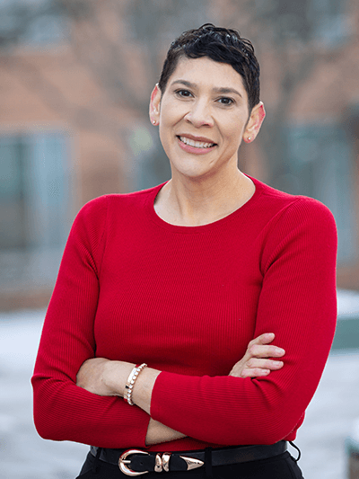

Direct Care Workforce National Trends
Nicole Howell
Director, Direct Care Workforce Development
National Council on Aging

Slide 9
Direct Care Workforce Strategies Center

Slide 10
Building national capacity to support community living
Technical
Assistance
Peer to Peer
Learning
Tools and Resources
Created by the Administration for Community Living in 2022, the Direct Care Workforce Strategies Center (Strategies Center) provides technical assistance to help states identify, implement, and sustain efforts that support direct care workers throughout their careers. ​

Slide 11
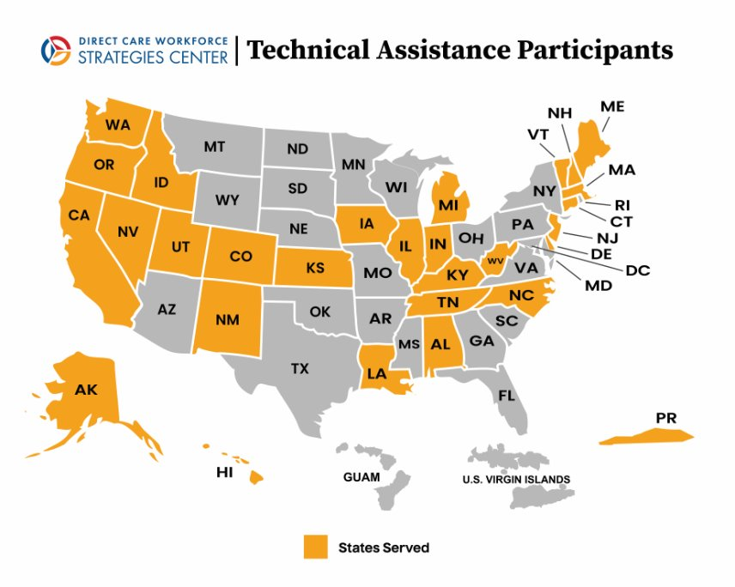
Technical Assistance Participants

Slide 12
The Workforce at the Center of This Conversation
3.2M
9.7M
36%
49%
home care workers nationwide
projected job openings by 2034
live in or near poverty
rely on public benefits to survive
Who They Are:
Personal care aides, home health aides, and direct support professionals (DSPs)
Overwhelmingly female, increasingly older, and economically precarious
Perform complex, high-acuity tasks: bathing, medication, mobility, emotional support, emergency response
High turnover driven by poverty wages — competing with retail and fast food
Without them, millions of older adults and people with disabilities could not live at home

Slide 13
The Families at the Center of this Crisis
63M
51 Y/O
27 Hours
50%
family caregivers
average Age
average number of hours spent caregiving per week
one negative financial impact
Who They Are:
• The majority are women (61%), often in the “sandwich generation” balancing work and caregiving for both aging parents and children
• Provide complex, high-acuity care: managing medications, medical appointments, personal care, mobility, financial management, and emotional support
• Provide an estimated $600 billion in unpaid care each year — a critical but undervalued part of our care system

Slide 14

A New Era of Care: Reimagining Home Care Work with Artificial Intelligence
Read the
Full Series
1
Report 1: Foundations of AI in Home Care
What AI is, how it evolved, and why it matters for HCBS. Introduces the three-tier continuum framework. Expert interviews, survey data, and desk research.
[QR CODE]
2
Report 2: Technology with a Human Touch
40 core responsibilities — 20 worker, 20 agency. Concrete vendor examples, peer-reviewed evidence, and honest 'What to Watch For' sections throughout.
3
Report 3: Beyond the Algorithm
Forthcoming. Centers worker, client, and community voices. What do the people closest to care think, need, and fear? What guardrails are non-negotiable?

Slide 15
Responsible AI: What ‘Getting It Right’ Requires
Key considerations from Empowering Care, With Care.
👷
👵
✅
Workers at the Design Table
Client & Community Voice
Research & Real World Evaluation
AI must be designed with — not imposed on — direct care workers. Their expertise is irreplaceable.
Older adults and people with disabilities must have meaningful input. Person-centered care cannot be replaced by algorithms.
Company-reported outcomes are not enough. The field needs to balance real world applications and evaluations and rigorous research.
💲
🔐
🌍
Funding Mechanism(s)
Strong Privacy Protections
Accessibility by Design
These technologies should be financially accessible.
Explicit consent. Clear data governance. Workers and clients must know what is collected, stored, and shared.
AI adoption should expand opportunity across all communities, not concentrate it

Slide 16
What We Hope You Take Home
1
AI is already here — in caregiving and in your pocket. The question isn't whether, it's how.
2
There are 40 documented ways AI intersects with direct care work. This is not science fiction.
3
The potential harms are real: bias, surveillance, privacy, digital equity. Eyes open.
4
Worker and client voice is non-negotiable — not a nice-to-have. Co-design or don't design.
5
No AI replaces the human heart of caregiving. The goal is to free workers for what only humans can do.

Slide 17
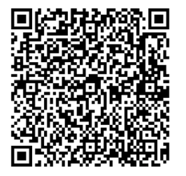
AI and the Direct Care Workforce:
Perspectives on Adoption, Ethics, and What Comes Next
July 22, 2026 | 2:00 – 3:30 PM ET | Webinar
Featured Speakers
Robert Espinoza
Founder & CEO
The CareWorks Project
Gabrielle Sedor
Chief Operations Officer & Foundation Director
ANCOR
Kelly Cronin
Deputy Administrator for Innovation and Partnership
Administration for Community Living (ACL)

Slide 18
Direct Care Workforce Strategies Center.
Nicole Howell
Director, Direct Care Workforce Development-Strategies Center, National Council on Aging
nicole.howell@ncoa.org

Slide 19

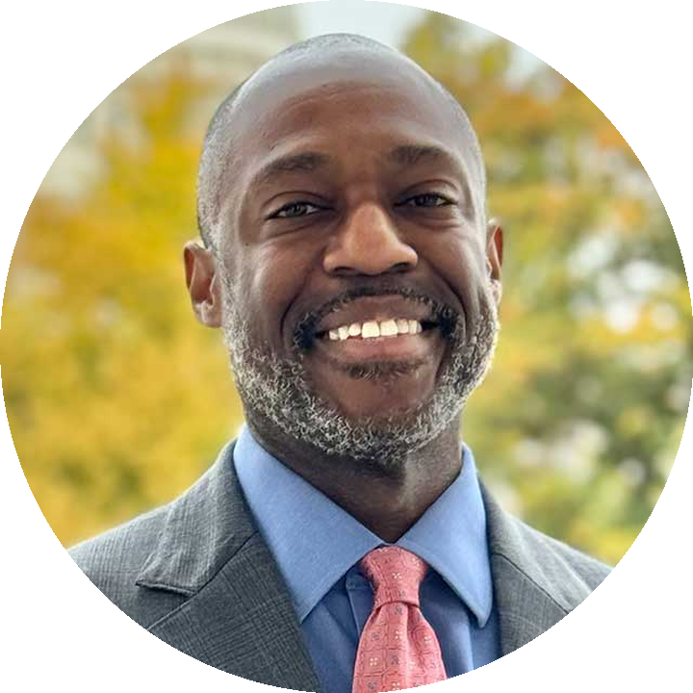



Caregiver Action Network Team
Supporting ACL’s Caregiver AI Prize Challenge
Marvell Adams Jr.
Amera Bilal
Nichole Goble
Tal Shechtman
Chief Executive Officer
Vice President of Programs & Policy
Director of Community Initiatives
Business Development Associate
Caregiver Action Network with over 30 years of experience supports
ACL’s Caregiver AI Prize Challenge with caregiver insight, guidance and actionable knowledge.

Slide 20

Shaping the Future of Caregiving Technology
Caregiver Tech Insights Survey
www.caregiveraction.org/tech-insights-survey/
Findings Report 2026
The survey was conducted via email outreach to CAN's email list. Responses were collected from 272 family caregivers and analyzed across themes of demographics, care burden, technology adoption, AI usage, barriers, and opportunities
The survey reveals a caregiver community that is already digitally engaged, increasingly open to emerging technologies like AI, and actively searching for trusted solutions to reduce their substantial coordination burden. At the same time, significant barriers - particularly cost, lack of trust, and privacy concerns - continue to limit broader adoption.
272
59%
Survey respondents
of respondents have tried or use AI regularly

Slide 21
Time Burden of Care Coordination
37%
of respondents spend 11 or more hours per week just on care coordination tasks
Equivalent to nearly a full day's work every week -- before providing any direct care.
Notes:
Two charts summarize caregiver coordination burden. A donut chart shows weekly hours spent on coordination tasks: 41% of respondents spend 5–10 hours per week, 22% spend fewer than 5 hours, 20% spend 11–20 hours, and 17% spend more than 20 hours. A horizontal bar chart highlights the most time-consuming tasks: managing medications and refills (135 respondents, 50%), scheduling appointments (124, 46%), paperwork and forms (88, 32%), tracking records (81, 30%), calling doctors' offices (80, 29%), following up (77, 28%), finding providers (56, 21%), and calling insurance companies (47, 17%). Overall, the data show that many caregivers spend significant time coordinating care, with medication management and appointment scheduling being the most burdensome activities.

Slide 22
How Organized Does Care Feel?
While the majority of caregivers describe their situation as at least somewhat organized, nearly one in three report feeling fragmented. The most commonly cited challenges were lack of time, information scattered across multiple systems, and too many providers involved in care.
Notes:
Two charts summarize caregivers’ perceptions of care coordination and the challenges they face. A donut chart shows how organized care feels: 47% of respondents describe care as somewhat organized, 21% as very organized, 23% as somewhat fragmented, and 9% as very fragmented. A horizontal bar chart highlights the top coordination challenges: lack of time (130 respondents, 48%), managing information across multiple systems (110, 40%), too many providers involved (82, 30%), insurance complexity (78, 29%), care changes or emergencies (63, 23%), having no single coordinator (60, 22%), and difficulty reaching healthcare offices (56, 21%). Overall, while most caregivers report that care feels at least somewhat organized, many still face significant coordination challenges, particularly time constraints and managing information across different systems.

Slide 23
Technology Currently in Use
Notes:
Horizontal bar chart showing technology currently used by caregivers for care coordination (272 respondents total). The most commonly used tools are smartphone apps (197 respondents, 72%) and online patient portals (185, 68%). Other technologies include telehealth or virtual visits (121, 44%), remote monitoring tools (111, 41%), online support groups (107, 39%), and communication support tools (64, 24%). Ten percent of respondents (27) report using no technology, while 7% (20) have hired a paid care coordinator. Overall, the data indicate that caregivers rely heavily on digital tools, particularly mobile apps and patient portals, to manage care.

Slide 24
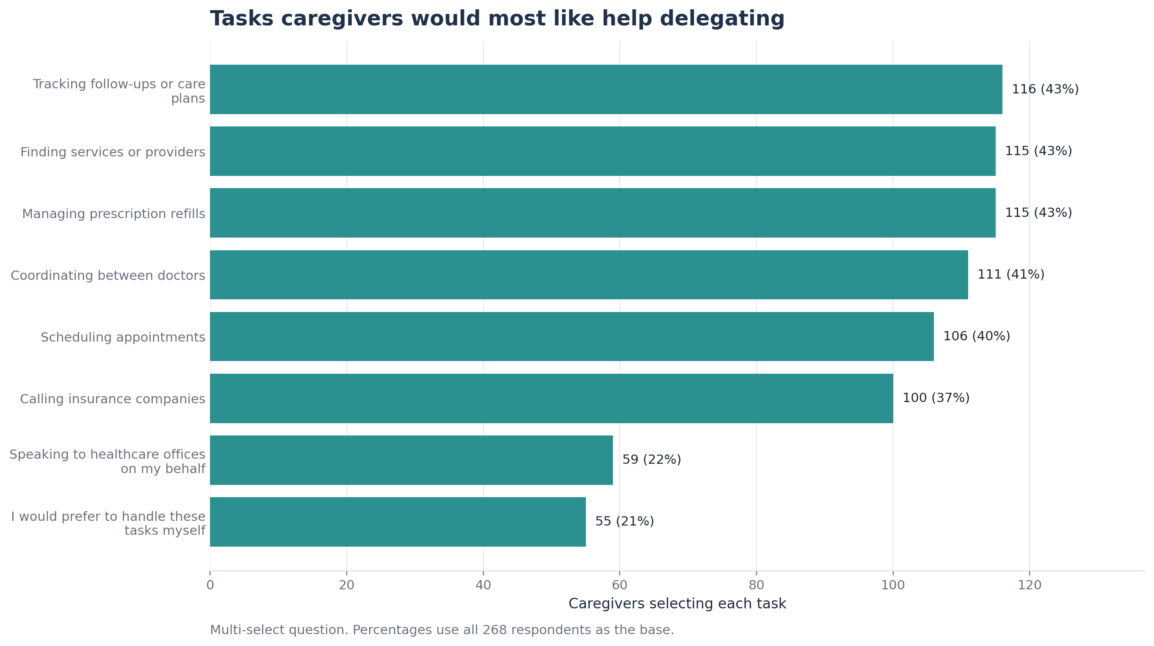
Tasks Caregivers would most like help delegating
“Open to apps, but only if easy to set up and genuinely helpful" 71 respondents (26%)
"Comfortable with multiple apps if each serves a specific purpose" 64 respondents (24%)
"Prefer simple methods like text or email over downloading apps" 62 respondents (23%)
"Prefer having everything in one consolidated app" 60 respondents (22%)
Notes:
Horizontal bar chart showing the care coordination tasks caregivers would most like help delegating. The most frequently selected tasks are tracking follow-ups or care plans (116 respondents, 43%), finding services or providers (115, 43%), managing prescription refills (115, 43%), coordinating between doctors (111, 41%), scheduling appointments (106, 40%), and calling insurance companies (100, 37%). Fewer respondents would like help with speaking to healthcare offices on their behalf (59, 22%). Twenty-one percent (55 respondents) indicated they would prefer to handle these tasks themselves. Overall, caregivers express the greatest interest in delegating administrative and coordination-related responsibilities that require ongoing tracking, communication, and navigation of healthcare systems.

Slide 25
AI Tool Adoption
AI adoption among caregivers is notably high and growing. A third of all respondents use AI tools regularly for caregiving, and an additional 26% have tried them at least once. Understanding a diagnosis or condition was the top use case, followed by preparing questions for doctor visits and organizing medical information.
Notes:
Donut chart showing caregivers’ use of artificial intelligence (AI) for caregiving. Overall, 59% of respondents have used AI in some capacity. One-third of respondents (33%, 91 people) report using AI regularly, while 26% (70 people) have used it once or twice. Among those who have not used AI, 17% (45 people) say they are interested in trying it, and 24% (66 people) are not interested. The chart highlights that a majority of caregivers have already experimented with AI, with regular use being more common than occasional use.
Horizontal bar chart showing how caregivers are using artificial intelligence (AI). The most common use is understanding a diagnosis (121 respondents, 44%), followed by preparing questions for doctors (86, 32%), organizing medical information (73, 27%), receiving emotional support (66, 24%), writing insurance appeals (59, 22%), and obtaining administrative or care coordination assistance (58, 21%). Overall, caregivers most often use AI to better understand health information and prepare for interactions with healthcare providers, with additional use cases focused on organization, support, and navigating administrative tasks.

Slide 26
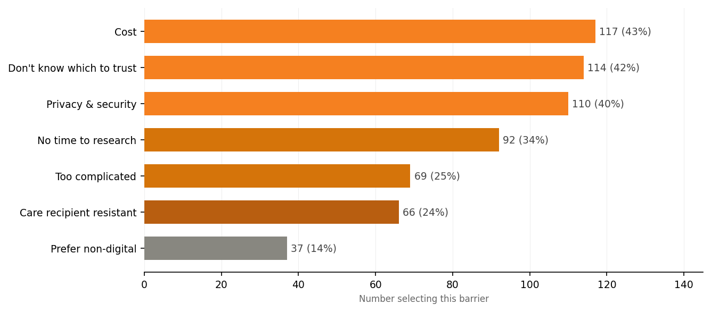
Barriers to Technology Adoption
Despite high overall tech engagement, meaningful barriers remain. Cost was the most frequently cited barrier (43%), nearly tied with uncertainty about which products to trust (42%) and privacy and security concerns (40%). Lack of time to research and set up new tools was also a significant obstacle for 34% respondents.
Notes:
Horizontal bar chart showing barriers to adopting caregiving technology and AI tools. The most commonly reported barriers are cost (117 respondents, 43%), uncertainty about which tools to trust (114, 42%), and privacy and security concerns (110, 40%). Other barriers include not having time to research available options (92, 34%), technology being too complicated to use (69, 25%), resistance from the care recipient (66, 24%), and a preference for non-digital approaches (37, 14%). Overall, caregivers are most concerned about affordability, trustworthiness, and data privacy when considering technology solutions.

Slide 27

Conclusion & Opportunity
The 2026 Caregiver Tech Insights Survey paints a clear picture: family caregivers are ready for better technology solutions, but they need help navigating a fragmented and overwhelming landscape. They are experienced, digitally engaged, and already experimenting with AI -- but they need a trusted source to point them in the right direction.
The data points to a high-impact opportunity:
With 59% of caregivers already using AI and strong interest across multiple use cases, there is real appetite for responsible, caregiver-centered AI tools.

Slide 28
Roundtable:
Caregiver & DSP Perspectives

Slide 29
Thank You For Joining us Today
Special thanks to our caregivers and direct support professionals for sharing their experiences.
Thank you to our partners, including Caregiver Action Network and others supporting this effort.
For more information visit: https://acl.gov/caregiver-ai-competition
        Challenge details, resources, and FAQs
        Slides and recording from today’s webinar will be posted on the website
  Questions?
Email: CaregiverAI@acl.hhs.gov for follow‑up questions about the challenge

Slide 30
Appendix A. Caregiver Coordination Burden Data
Table A1.Weekly Hours Spent on Care Coordination
Weekly Hours | Percent of Respondents
Less than 5 hours | 22%
5–10 hours | 41%
11–20 hours | 20%
More than 20 hours | 17%
Table A2. Most Time-Consuming Care Coordination Tasks
Task | Respondents | Percent
Managing medications and refills | 135 | 50%
Scheduling appointments | 124 | 46%
Paperwork and forms | 88 | 32%
Tracking records | 81 | 30%
Calling doctors' offices | 80 | 29%
Following up | 77 | 28%
Finding providers | 56 | 21%
Calling insurance companies | 47 | 17%

Slide 31
Appendix B. Care Organization and Coordination Challenges Data
Table B1. How Organized Care Feels
Response | Percent
Very organized | 21%
Somewhat organized | 47%
Somewhat fragmented | 23%
Very fragmented | 9%
Table B2. Top Care Coordination Challenges
Challenge | Respondents | Percent
Lack of time | 130 | 48%
Information across multiple systems | 110 | 40%
Too many providers involved | 82 | 30%
Insurance complexity | 78 | 29%
Care changes or emergencies | 63 | 23%
No single coordinator | 60 | 22%
Difficulty reaching healthcare offices | 56 | 21%

Slide 32
Appendix C. Technology Currently Used by Caregivers Data
Table C1. Technology Used for Care Coordination
Technology | Respondents | Percent
Smartphone apps | 197 | 72%
Online patient portals | 185 | 68%
Telehealth/virtual visits | 121 | 44%
Remote monitoring tools | 111 | 41%
Online support groups | 107 | 39%
Communication support tools | 64 | 24%
No technology used | 27 | 10%
Paid care coordinator | 20 | 7%

Slide 33
Appendix D. Technology Preferences and Desired Support
Table D1. Tasks Caregivers Would Most Like Help Delegating
Task | Respondents | Percent
Tracking follow-ups or care plans | 116 | 43%
Finding services or providers | 115 | 43%
Managing prescription refills | 115 | 43%
Coordinating between doctors | 111 | 41%
Scheduling appointments | 106 | 40%
Calling insurance companies | 100 | 37%
Speaking to healthcare offices on my behalf | 59 | 22%
I would prefer to handle these tasks myself | 55 | 21%

Slide 34
Appendix E. Caregiver AI Tool Adoption & Use Cases
Table E1. Have You Used AI for Caregiving?
Response | Respondents | Percent
Yes, regularly | 91 | 33%
Yes, once or twice | 70 | 26%
No, but interested | 45 | 17%
No, not interested | 66 | 24%
Table E2. How Caregivers Use Artificial Intelligence
Use Case | Respondents | Percent
Understanding a diagnosis or condition | 121 | 44%
Preparing questions for doctors | 86 | 32%
Organizing medical information | 73 | 27%
Receiving emotional support | 66 | 24%
Writing insurance appeals | 59 | 22%
Administrative or care coordination assistance | 58 | 21%

Slide 35
Appendix F. Barriers to Technology Adoption
Table F1. Barriers to Technology Adoption
Barrier | Respondents | Percent
Cost | 117 | 43%
Don't know which to trust | 114 | 42%
Privacy and security concerns | 110 | 40%
No time to research | 92 | 34%
Too complicated | 69 | 25%
Care recipient resistant | 66 | 24%
Prefer non-digital solutions | 37 | 14%

