Slide 1

Creating a Campaign: Marketing Strategy to Expand the Direct Care Workforce
Introducing WisCaregiver Careers
March 16, 2026
Notes:
Title slide option 1

Slide 2



Presenters
Hans Pigorsch
President/Creative Director
Pigorsch Media Design
Susan Pigorsch
Vice President
Pigorsch Media Design
www.pigorschmedia.com
Notes:
SSP

Slide 3



WisCaregiver Careers CDCP
Wisconsin State Capitol Building in Madison, WI
Notes:
SSP: introduces H & S. Delighted to have worked with DHS for 8 years on developing WisCaregiver Careers, a professional workforce development initiative in Wisconsin.

Slide 4
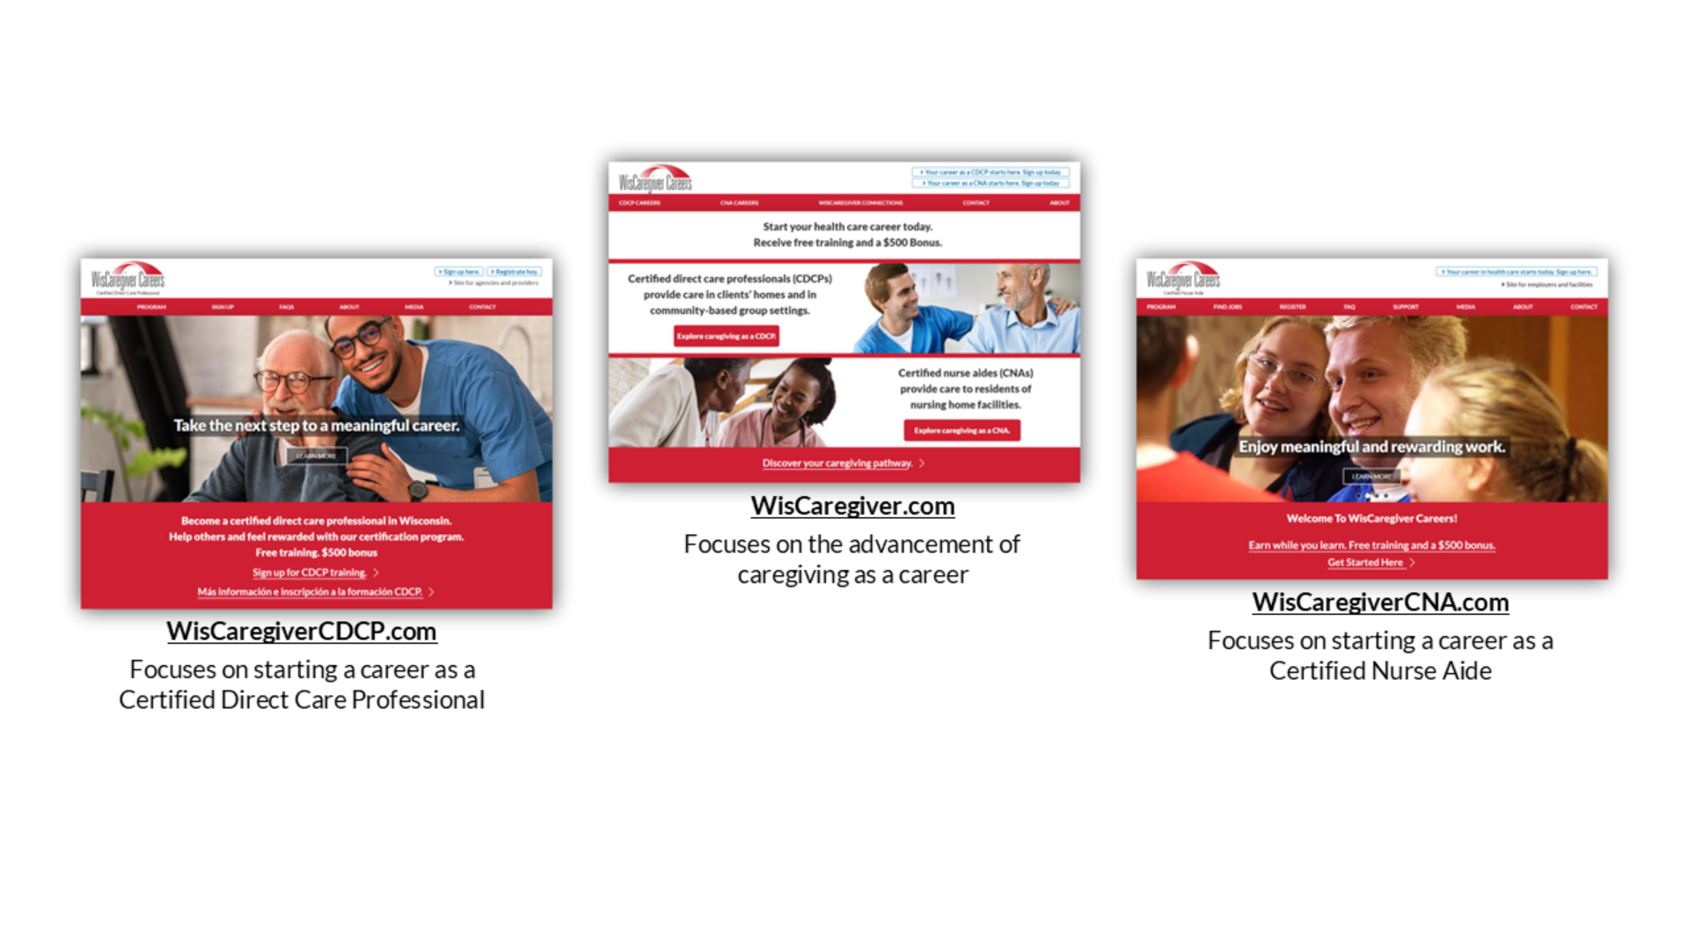
WisCaregiver Careers – House of Brands
Notes:
SSP: introduces H & S. Delighted to have worked with DHS for 8 years on developing WisCaregiver Careers, a professional workforce development initiative in Wisconsin.

Slide 5

TV30/Streaming/Social Media Video:
“Heart Work”
TV30/Streaming/Social Media Video:
“Heart Work”
Notes:
SSP

Slide 6

Heart Work

Slide 7
WisCaregiver Careers – House of Brands 2
Notes:
SSP: introduces H & S. Delighted to have worked with DHS for 8 years on developing WisCaregiver Careers, a professional workforce development initiative in Wisconsin.

Slide 8
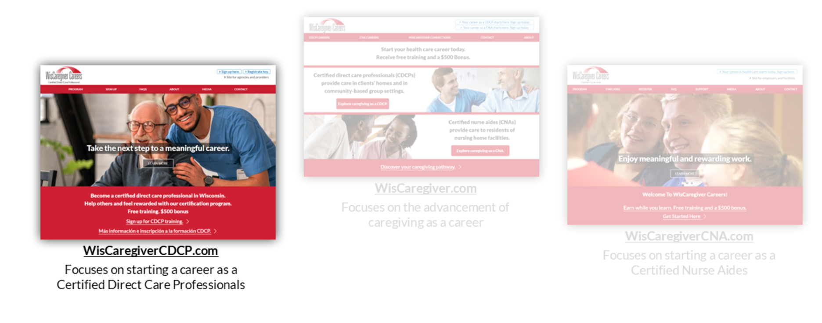
WisCaregiver Careers – House of Brands 3
Notes:
SSP: introduces H & S. Delighted to have worked with DHS for 8 years on developing WisCaregiver Careers, a professional workforce development initiative in Wisconsin.

Slide 9
WisCaregiver Careers CDCP
The WisCaregivers Careers CDCP marketing campaign is based on two main components,
each playing a crucial role in its success.
Brand Building
Brand building establishes the foundation of a brand’s identity and message
Advertising Campaign
Advertising delivers a brand’s identity and message to the public
Notes:
HBP

Slide 10

What is a Brand?

Slide 11
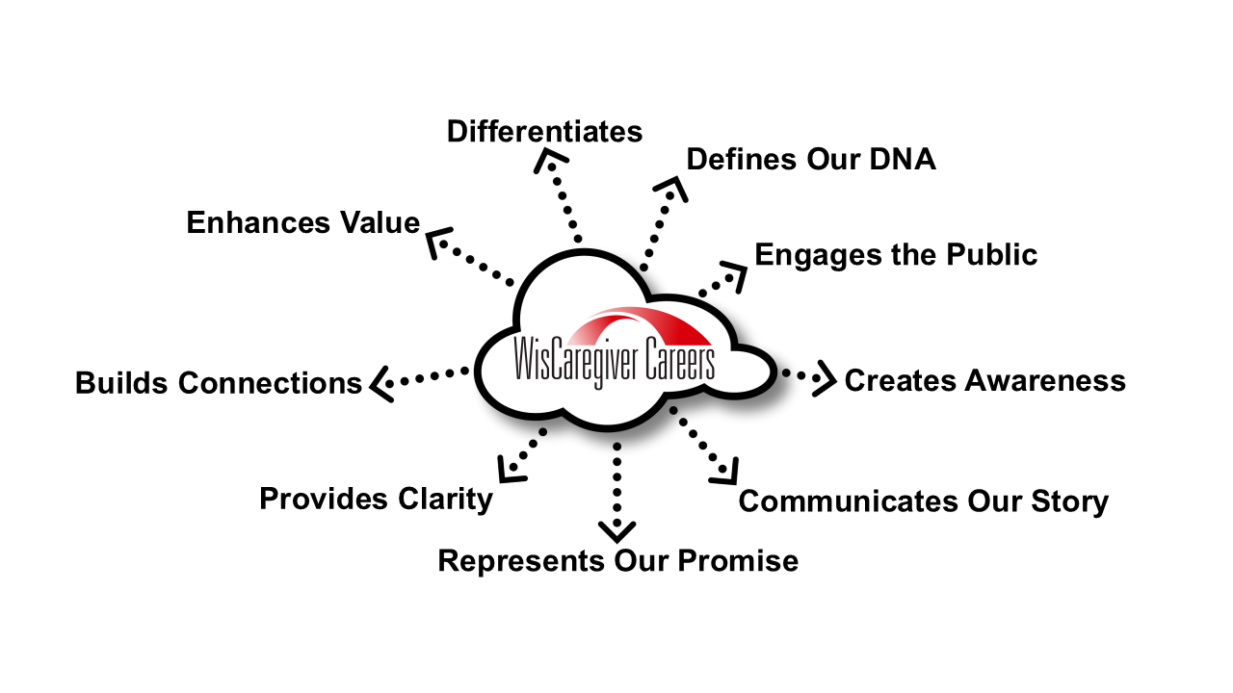
What is a Brand?

Slide 12
Brand Purpose
The brand’s purpose is to make a lasting impression that resonates with caring individuals,
builds an understanding of the program, and drives program success.
Address the critical caregiver shortage
Reframe and elevate the role of professional caregiving
Utilize a multi-language approach
Notes:
HBP

Slide 13
Brand Goal
The brand goal is the essence of what the brand stands for and what it seeks
to deliver consistently to its customers.
Appeal to caring individuals of all ages to start their health care careers for free –
as a Certified Direct Care Professional (CDCP)
Notes:
HBP

Slide 14
Brand Appeal
Brand appeal refers to the ideas, identity, values, and emotions that a brand evokes.
Showcase the flexibility and stability of the caregiving profession
Demonstrate WisCaregiver Careers’ benefits and rewards
Highlight the rewards of a meaningful job
Emphasize Wisconsin’s CDCP registry
Notes:
HBP

Slide 15
Brand Target Audiences
A brand’s target audience includes the breadth of individuals the program is intended to reach.
Individuals who are interested in entering, and/or advancing, in the health care field
Students looking to start health care careers
Mid-career workers motivated to give back
Family and friends who might engage caring individuals
Notes:
HBP

Slide 16
Brand Strengths
A brand’s strengths build recognition across multiple communication channels.
WisCaregiver Careers is: Trusted
WisCaregiver Careers is a trusted resource from the Wisconsin Department of Health Services
WisCaregiver Careers is: Free
WisCaregiver Careers provides free training and a $500 bonus
WisCaregiver Careers is: Accessible
Open to all
CDCPs can access employers statewide
Spanish and Hmong language options
Notes:
SSP

Slide 17
Brand Identity
A strong brand identity communicates the brand's unique attributes and resonates with its audience.
Logo
Colors and typography
Voice
Core messages (Brand Strengths)
Notes:
SSP

Slide 18
Brand Presence - Website
A website serves as a central location where the public can find detailed information about a brand.
Website URL: WisCaregiverCDCP.com
URL is on-message, memorable and promotable
Site content is easily readable on both mobile and desktop browsers
Site content informs and engages the site visitor
Site content reinforces the brand mission
Site content drives program registration
Notes:
HBP

Slide 19
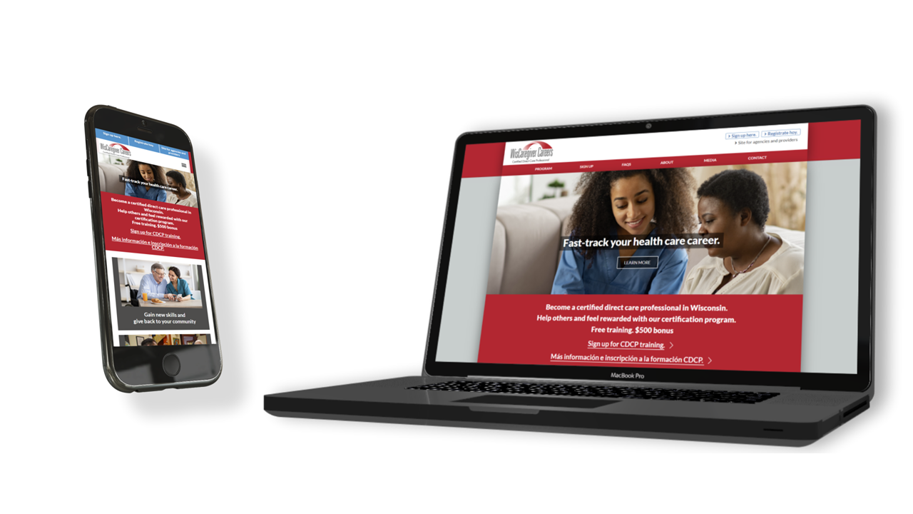
Brand Presence – WisCaregiverCDCP.com
Notes:
HBP

Slide 20
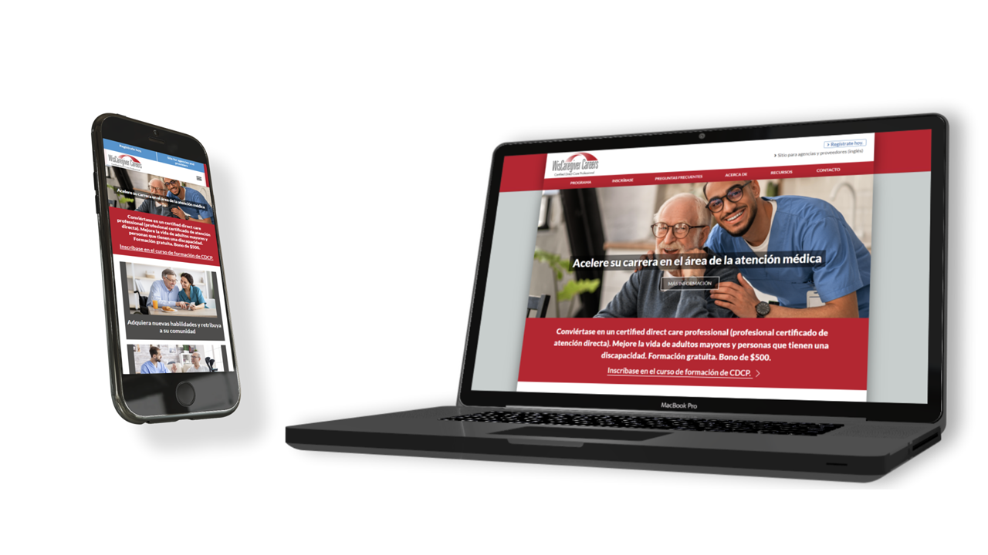
Brand Presence – WisCaregiverCDCP.com/ES
Notes:
HBP

Slide 21
Brand Story – WiscaregiverCDCP.com
A strong brand identity communicates the brand's unique attributes and resonates with its audience.
Videos can elevate your brand story
Video tactics can target diverse audiences
Videos can reinforce brand benefits and rewards
Notes:
HBP

Slide 22
TV30/Streaming/Social Media Video:
“Enjoy the Rewards of a Career in Health Care”
Notes:
HBP

Slide 23
Enjoy the Rewards of a Career in Health Care video

Slide 24
Expanding the Brand: Educators
Introduce a valuable new resource to high school educators.
Showcase a new career pathway for students
Options for health science curriculum
Offer independent study
Earn $250 for each CDDP referral
Notes:
HBP

Slide 25
Promotional Video:
“Educators Help Launch Students’ Health Care Careers”
Notes:
HBP

Slide 26
Educators Help Launch Students’ Health Care Careers
Notes:
03.46

Slide 27
Expanding the Brand: Students
Introduce a valuable new resource to students.
Opportunity for high school and college students to build resume
Gain certification in health care
Connect with employers
Earn $500 bonus
Notes:
SSP

Slide 28
Promotional Video:
“Students Start Your Career as a CDCP”
Notes:
HBP

Slide 29
Students Start your Career as a CDCP video
Notes:
01.45

Slide 30
Advertising/Promotion Goals
Clear and specific goals for advertising are crucial to ensure that resources are used effectively,
and that outcomes are measurable.
Increase awareness
Drive website traffic
Generate CDCP registrations
Educate the market
Notes:
SSP

Slide 31
Strategies and Advertising Channels
A mix of media types is essential for reaching a diverse audience and optimizing resources.
Broadcast Television
Statewide coverage; approximately 45 stations
Broadcast Radio
Statewide coverage; approximately 180 stations
Print
Statewide coverage; 200+ publications
Notes:
SSP

Slide 32
Strategies and Advertising Channels
A mix of media types adapts to audience behavior, maximizing the overall effectiveness of a campaign.
Digital Display
Social Media
Geofencing
Video Pre-Roll
Streaming Audio
Search Engine Marketing
Notes:
SSP

Slide 33

Create and Produce Advertising Assets
Advertising assets should align with the brand and campaign objectives.
Notes:
SSP

Slide 34
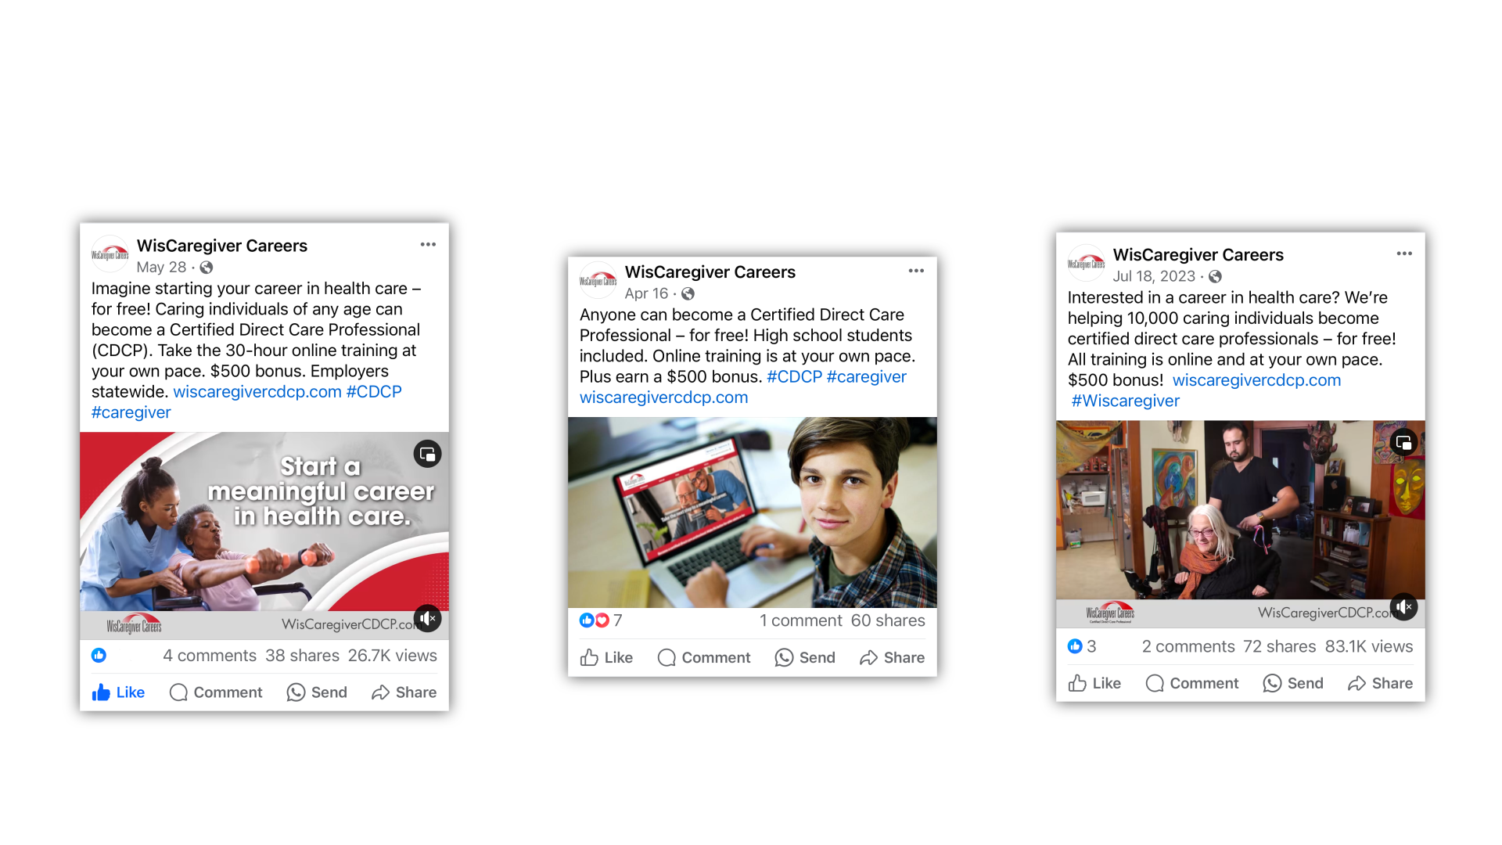
Create and Produce Advertising Assets (Cont’d.)
Advertising assets should resonate with the target audience.
Notes:
SSP

Slide 35
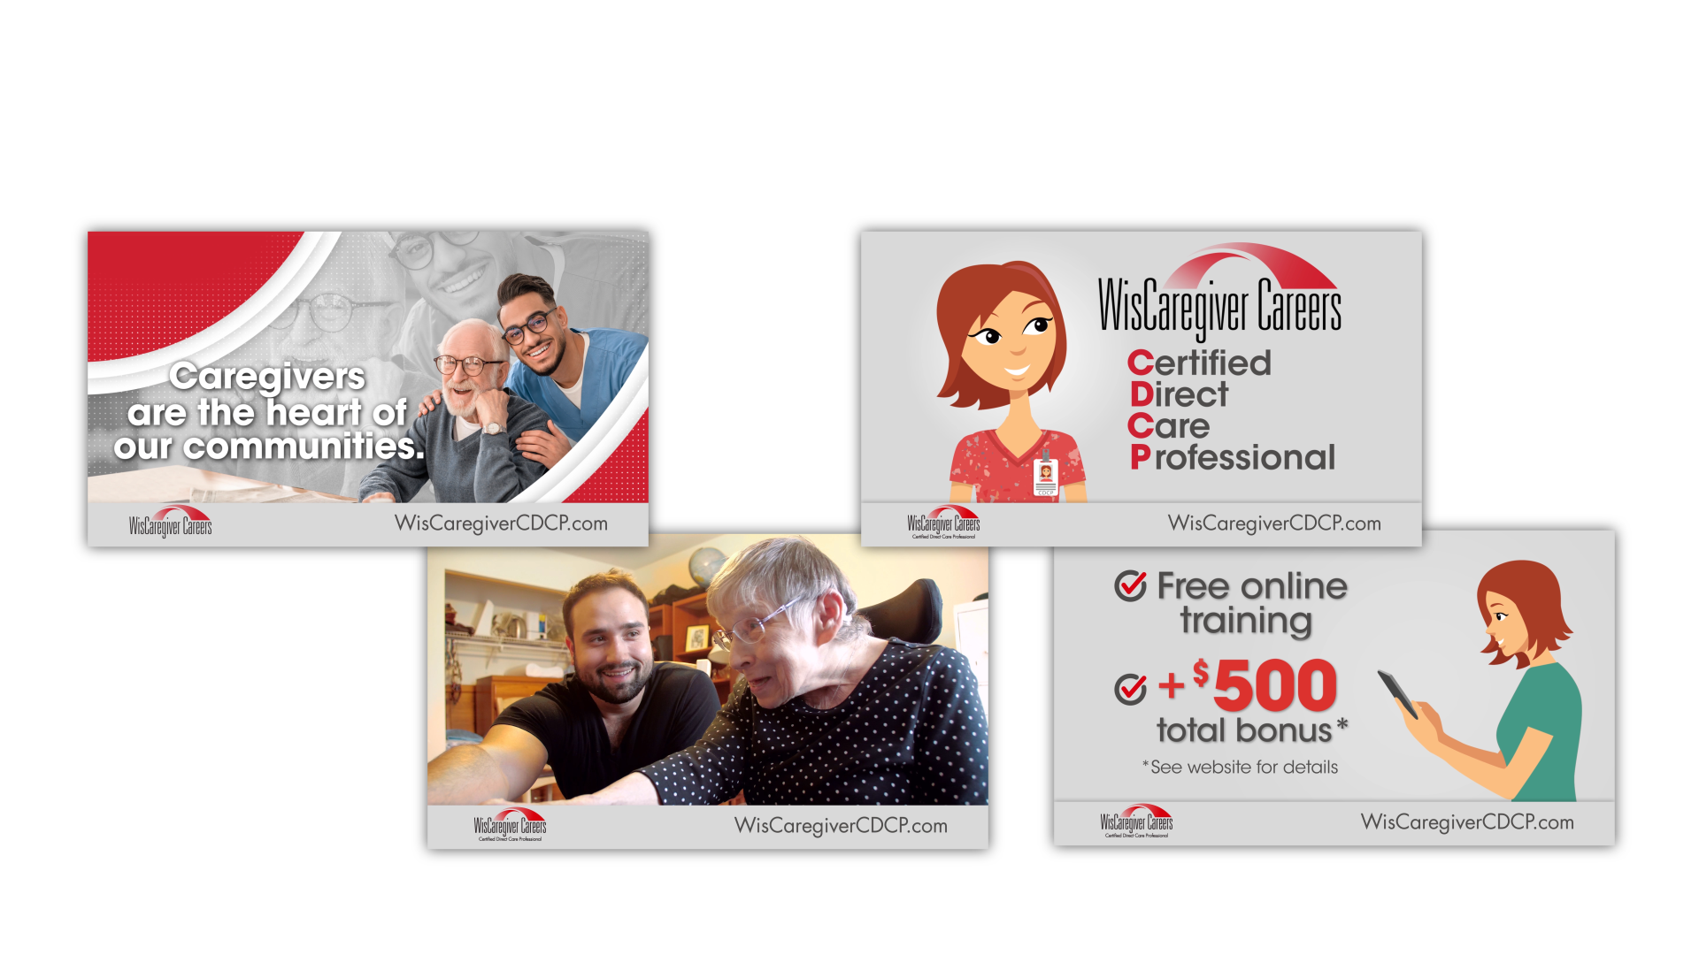
Create and Produce Advertising Assets (Cont’d. 2)
Advertising assets should produce measurable outcomes.
Notes:
SSP

Slide 36
Launching the Campaign
Advertising and public relations work collaboratively at the program launch to maximize
visibility, credibility, and public engagement.
Soft Launch
A limited release of the program, prior to a full-scale hard launch to the general public,
with no advertising or PR support
Hard Launch
The full-scale hard launch to the general public, with full advertising and PR support
Public Relations
Coordinated PR activities
Advertising
Maximize visibility and create demand
Notes:
HBP

Slide 37
TV30/Streaming/Social Media Video:
“Become a Certified Direct Care Professional”
Notes:
HBP

Slide 38
Become a Certified Direct Care Professional video
Notes:
:30

Slide 39
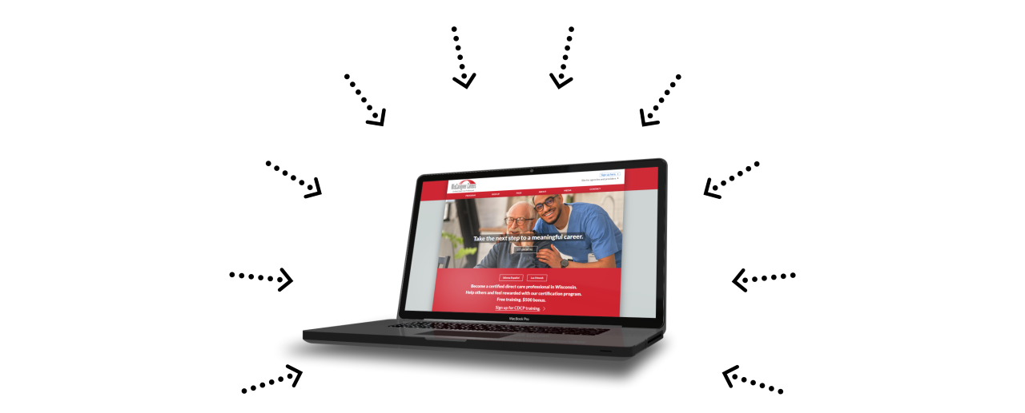
Amplifying the Message Across Media
Media Toolkits
Streaming Video
TV Spots/PSAs
Radio Spots/PSAs
Streaming Audio
Collateral Print
Social Media
Web Videos
Email Marketing
Digital Display

Slide 40
Campaign Metrics/Performance
Important considerations for measuring, evaluating, optimizing, and demonstrating the
success of an advertising campaign.
Performance Evaluation
Examine what is working well and what needs improvement
Optimization Opportunities
Adjust campaign elements such as targeting criteria, ad creative, messaging, and media channels
Budget Allocation
Decide what are the most effective channels and creative
Alignment with Objectives
Determine if the campaign is meeting branding and advertising objectives
Continuous Improvement
Refine strategies and tactics to enhance overall program effectiveness
Notes:
SSP

Slide 41
Campaign Metrics/Perfomance
WisCaregiverCDCP.com site user metrics: July 9, 2023 – Dec. 16, 2025.
353, 641 users
650,342 views
1,979,417 events
18,474 CDCP registrants
Conversion rate: ≈ 5.22%
(Indicates good traffic volume, active user engagement and healthy conversion funnel,
especially if registrations are a primary goal)
Notes:
HBP

Slide 42

Provided by:
Notes:
HBP

Slide 43

The end
Notes:
HBP

