Slide 1

From Numbers to Action: Using Data to Strengthen the HCBS Direct Care Workforce
November 19, 2025
Presentation contains speaker notes
Notes:
Title slide option 3

Slide 2

Welcome & Overview
Nicole Howell, BA
Director, DCW Strategies Center

Slide 3
Building national capacity to support community living
Provide tools and training to assist
state systems and service providers
Facilitate peer-to-
peer sharing of lessons learned and promising systems-change practices
Created by the Administration for Community Living in 2022, the Direct Care Workforce Strategies Center (Strategies Center) provides technical assistance to states and service providers and facilitates collaboration with stakeholders to improve the recruitment, retention, training, and professional development of members of the direct care workforce.
Maintain a clearinghouse of resources and promising practices
Notes:
Brief description of the Center option 1

Slide 4
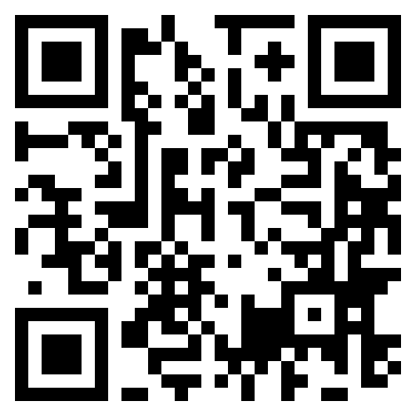
Direct Care Workforce Strategies Center – Overview
Created by the Administration for Community Living in 2022, the Direct Care Workforce Strategies Center (DCW) provides technical assistance to states, service providers, and stakeholders to improve the recruitment, retention, training, and professional development of direct care workers providing home and community-based services (HCBS).
QR code link to the Direct Care Workforce Strategies Center homepage
Resource Hub
A one-stop digital stop of informational resources highlighting state innovations and proven practices ready for broader adoption
Technical Assistance
Tiered opportunities for state cross-systems teams to receive technical support aimed at strengthening their HCBS Direct Care Workforce systems-change efforts
Advisory Committee
A national group of advisers to ensure the experiences of direct care workers, care recipients and family caregivers inform the Center’s priorities and products
Self-led Training Opportunities
Expert-led webinars, mini-labs, and workshops for states and stakeholders highlighting actionable tools and replicable models to strengthen the HCBS direct care workforce
Notes:
https://acl.gov/DCWcenter

Slide 5











Strategies Center Partners
Notes:
DCW Partner slide

Slide 6
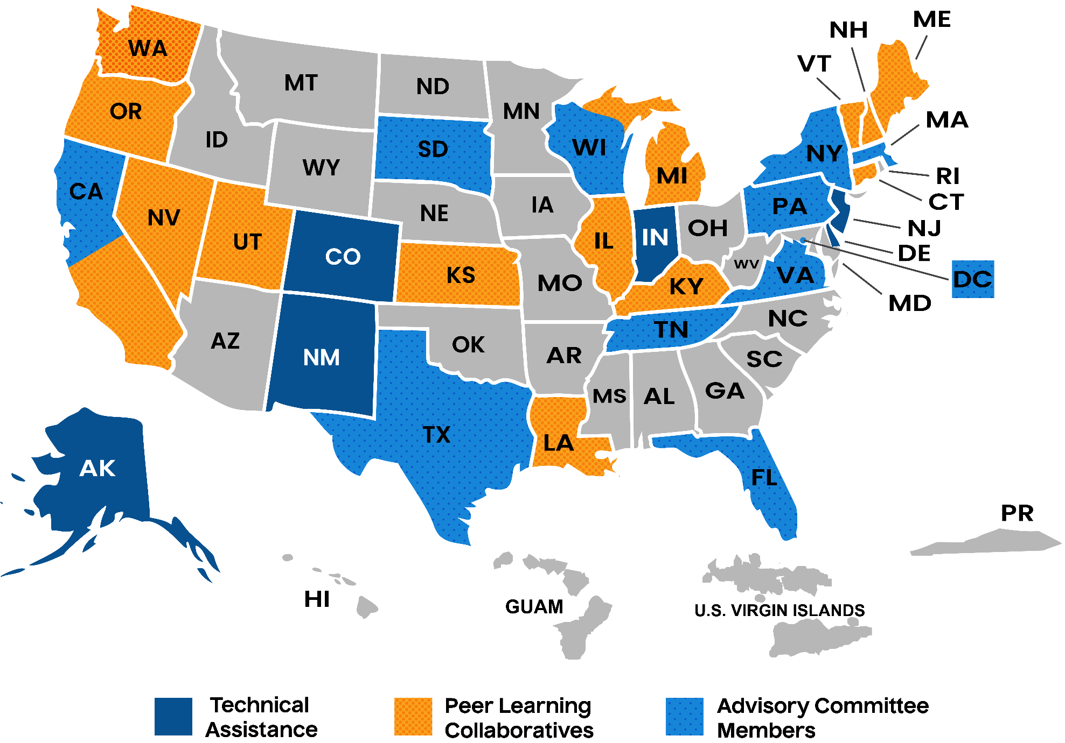
2024 State Representation Across Workstreams

Slide 7
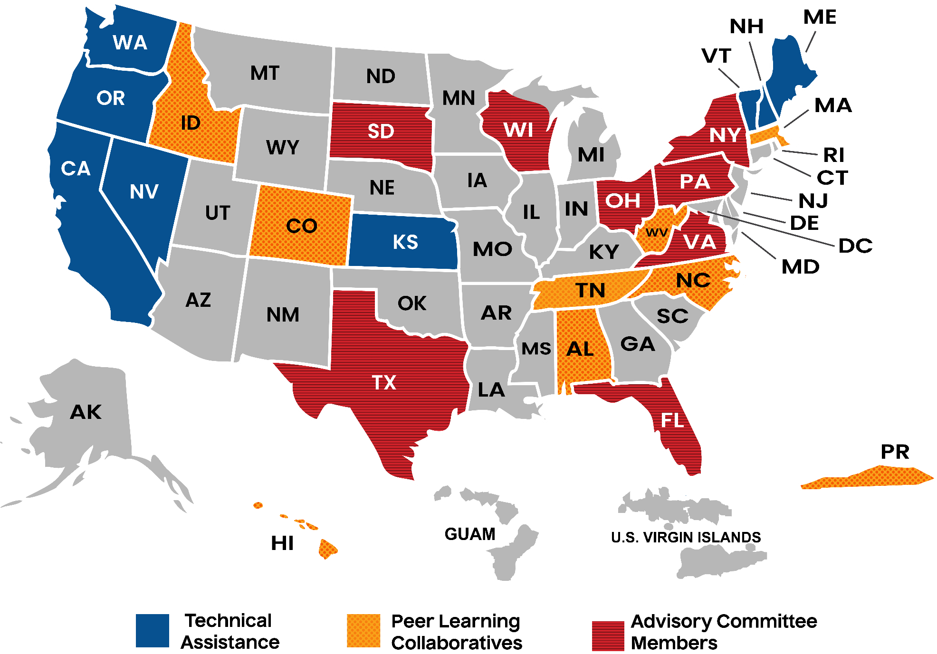
2025 State Representation Across Workstreams
Notes:
The 2025 version of the State Representation workstream shows a map of the United States and territories with states highlighted which are members of one of three workstreams. The following states California Nevada, Oregon, Washington, Kansas, Vermont, New Hampshire and Maine are members of Technical Assistance. The following states Texas, Florida, Wisconsin, South Dakota, Virginia, Ohio, Pennsylvania, and New York, are Advisory Committee members. The following states and territory Idaho, Colorado, Tennessee, Alabama, North Carolina, West Virginia, Puerto Rico, Hawaii, and Massachusetts are part of the Peer Learning Collaborating workstream

Slide 8
Agenda
The Critical Importance of Data in Informing Direct Care Workforce Development Strategy -- Dr. Julie Berdshasky, University of Minnesota-Institute for Community Inclusion
Using Data to Monitor and Evaluate Investments in the Direct Care Workforce – Dr. Kezia Scales, Vice President of Research and Evaluation, PHI
Strengthening the Direct Care Workforce: A Framework for Leveraging the Role of MLTSS MCOs to Address the Workforce Crisis – Mary Kaschak, Executive Director, MLTSS Health Plan Association
Advancing the Direct Care Workforce: Experiences of the Community Provider Network of Rhode Island –Tina Spears, Executive Director, Community Provider Network of Rhode Island
Efforts to Leverage Data Across Systems to Inform DCW Systems Change Efforts: State Perspectives from New Jersey & Tennessee – Jack Teters, Aging & Disability Services Policy Adviser, NJ Department of Human Services; Jordan Allen, Assistant Commissioner and Alex Gaughan, Director of Program Alignment, TN Department of Intellectual and Developmental Disabilities
Moderated by Nicole Howell, Director, DCW Strategies Center
Notes:
Agenda slide, fill as needed

Slide 9


The Critical Importance of Data in Informing Direct Care Workforce Development Strategy
Dr. Julie Berdshasky
Director, Community Living and Employment
Research and Training Center on Community Living (RTC-CL)
Institute on Community Integration, University of Minnesota
Notes:
https://ici.umn.edu/projects/6

Slide 10
Importance of Workforce Data
Working with States and Employers (Provider Organizations)
More recognition of workforce data necessity and needs – by both
National Core Indicators© (NCI) State of the Workforce data
    NCI-IDD SoTW 2023 report – 26 states participating
    NCI-AD SoTW 2023 report – 6 states participating
Standard Occupational Classification (SOC) revision
Need for self-direction workforce data
Providers have additional (and different) data needs
Notes:
Enhancing and expanding the data infrastructure related to the DCW workforce is essential for building a sustainable and responsive care system. Robust, comprehensive data is the foundation for truly understanding the needs, challenges, and contributions of DCWs. Without reliable data, it is difficult to accurately assess the size and scope of the workforce, identify workforce shortages, or track turnover and retention trends. Improved data systems are necessary not only for effective workforce planning, but also for informing policies that aim to recruit, train, support, and retain DCWs over time.
Workforce development programs cannot succeed without reliable, timely, and comprehensive data. Data is essential for tracking workforce trends, such as turnover rates, job vacancies, compensation levels, and geographic disparities. It allows stakeholders to identify where interventions are most needed and to target resources accordingly—for example, by focusing training efforts in areas with the greatest shortages or by identifying specific factors contributing to worker attrition. Data also enables the evaluation of different strategies and programs, helping policymakers and employers understand what’s working and what isn’t, so they can refine approaches and scale up successful models. In addition, having accessible, well-organized data allows for better communication and collaboration among stakeholders, including state agencies, service providers, educational institutions, and community organizations.
Policymakers need hard data to help them do three things: accurately identify the gaps in their systems, choose and employ the most appropriate tools to address these gaps, and measure the effectiveness of these tools over time.

Slide 11
Basic Principles
Make sure you consider who will use the data.
Make sure you consider how they will use the data.
Make sure the data will answer questions of interest.
Do not reinvent the wheel.
Make sure the data is interpretable.
Be cognizant of data burden.
Include stakeholders in development and implementation.
Make sure you use the data collected – don’t just collect data for the sake of collecting.
Share results broadly.

Slide 12
Identify Key Questions
Identify what policymakers, providers, and advocates need to know to guide action (at both the system and program levels)
  Who the workforce is, where they work, wages, benefits, training, stability
  Retention, job satisfaction, career pathways, links to quality of care
Translate questions into measurable indicators
  Each key question should have associated clear, measurable, interpretable metrics
    Can show progress or lack thereof
    Consistent and standardized as much as possible
Goals and Core Elements of a Minimum Workforce Dataset:
  Include data on workforce size (full-/part-time, by setting and role)
  Track stability indicators—retention, turnover, tenure, and vacancies
  Capture compensation and training data to inform workforce investments
  Collect data directly from DCWs on satisfaction, intent to stay, and challenges
  Enable monitoring of workforce initiatives and policy impact over time
  Support long-term planning, coordination, and cross-state comparison
Consider Self-Direction workforce data needs

Slide 13
Align Existing Data Systems
Workforce data are often siloed across programs, agencies, and departments.
Fragmented systems limit visibility and hinder coordinated workforce planning.
Strategic integration of existing data systems enables stronger, system-wide insights.
Catalog and align existing workforce data sources, elements, and initiatives.
Include administrative, claims, and survey data to capture a full workforce picture.
Document how data are collected, stored, shared, and any integrity or timing issues.
Build strong coalitions to align data priorities, coordinate efforts, and drive shared accountability for workforce outcomes.

Slide 14
Use Available Data as Effectively as Possible
Often, workforce data is collected but not analyzed or shared effectively
Build a unified “umbrella” workforce data infrastructure to connect systems and reduce duplication
Make data accessible to all stakeholders—agencies, providers, MCOs, FIs, DCWs, advocates, and consumers
Tailor data presentation to audience needs (e.g., real-time data for providers, summaries for advocates)
Shift focus from data compliance to meaningful use, communication, and shared impact
Participate in national efforts (e.g., NCI-IDD, NCI-AD SoTW) and use results for planning and policy

Slide 15
Identify Gaps and Strategies for Collecting Data in the Future
Build on and enhance existing data systems before creating new ones.
Augment reporting, strengthen surveys, and standardize data collection.
Expand data to include additional populations and provider types.
Ensure new systems align with existing definitions and methods to avoid duplication.
Minimize provider burden—collect additional data only when necessary or supported (e.g., compensated).
    Give providers the tools (e.g., SupportWise data portal).
Engage stakeholders. Make it an ongoing, structured process.
Learn from other states (e.g., TN MLTSS requirements)

Slide 16

Using Data to Monitor and Evaluate Investments in the Direct Care Workforce
Dr. Kezia Scales
Vice President, Research & Evaluation
PHI
Notes:
Transition slide

Slide 17
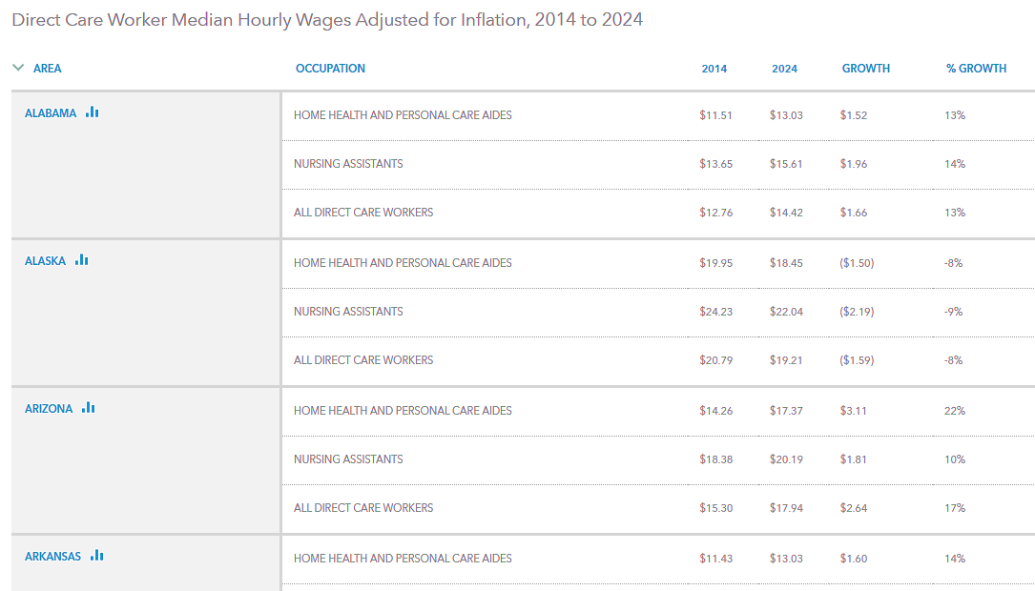
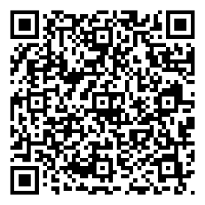
Case Example: Wages
Compare across states, occupations/industry, and over time
Check your state’s
data in the PHI
Workforce Data Center
Notes:
https://www.phinational.org/policy-research/workforce-data-center/#var=Wage+Trends

Slide 18
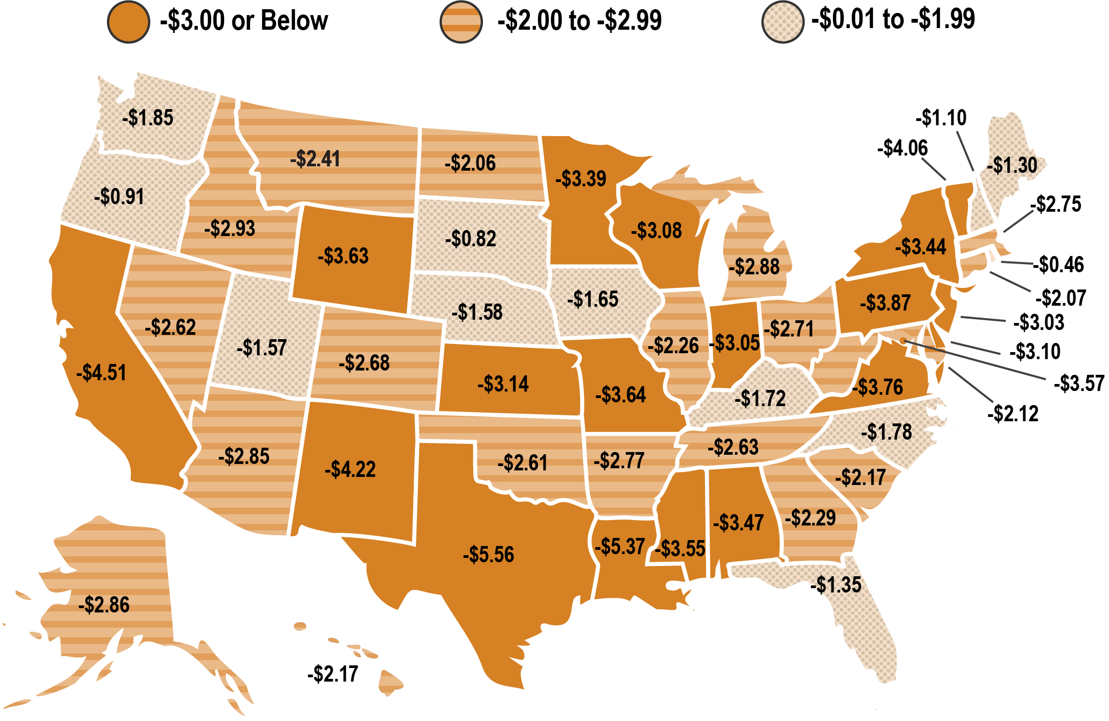
Case Example: Wages
Compare against median wages in competitive sectors
Wage gap between median wages for direct care workers and occupations with similar or lower entry-level requirements by state in 2023.
Direct care worker median wages are lower than median wages for comparable occupations in every state.
Competitive Disadvantage: Direct Care Wages Are Lagging Behind—2024 Update
Notes:
A map of the united states categorizing states into one of 3 categories relating to the wage. The states with a wage gap of -3$ or Below are: California, Texas, Wyoming, Nevada, Kansas, Missouri, Minnesota, Wisconsin, Indiana, Louisiana, Mississippi, Alabama, Virginia, Pennsylvania, The District of Columbia, Delaware, New Jersey, New York, and Vermont. States with a wage gap of -$2 to -$2.99 are: Nevada, Idaho, Arizona, Montana, North Dakota, Colorado, Oklahoma, Arkansas, Illinois, Tennessee, Michigan, Ohio, West Virginia, Georgia, South Carolina, Maryland, Connecticut, Massachusetts, Alaska, and Hawaii. And states with a wage gap of -$0.01 to -$1.99 are; Washington, Oregon, Utah, South Dakota, Nebraska, Iowa, Kentucky, North Carolina, Florida, Rhode Island, New Hampshire, and Maine.
https://www.phinational.org/resource/competitive-disadvantage-direct-care-wages-are-lagging-behind-2024-update/

Slide 19
Case Example: Wages
Triangulate data points to tell a bigger story
Low wages lead to economic precarity among direct care workers…
  Median annual earnings ~$26,000
  37% live in or near poverty; nearly 50% rely on public assistance (31% Medicaid)
Which exacerbates direct care workforce instability overall…
  Median turnover: 79% home care workers; 99% CNAs in nursing homes, 40% direct support professionals (DSPs)
Which creates barriers to care across settings.
  Every state reporting a shortage of home care workers; most (43) report permanent home care service closures within the past year
  46% of nursing homes report limiting admissions due to staffing; 66% concerned about closure
  90% of I/DD providers report moderate to severe staffing challenges; 69% turning away referrals

Slide 20

Case Example: Wages
What else do we need to know?
What is the average starting wage across direct care occupations in a given state? What is the wage range?
What employment benefits are direct care workers receiving as part of their full compensation package (if any)?
How do median wages vary by geographic region, setting, program, employer type, and other factors?
Are there systematic differences in wages between different demographic segments of the workforce?
How do wages change year-over-year?
What are the impacts of wage-related policies (wage floors, wage pass-throughs, hazard pay, bonus pay) on wages and benefits, workforce supply and stability, and consumers’ access to care?

Slide 21

Systemic Challenges to Direct Care Workforce Data Collection, Monitoring, and Evaluation
Fragmented LTSS landscape characterized by a wide array of policies, payment streams, programs, and service delivery models
Dynamic workforce: part-time and part-year employment, multiple job holding, employer-level and occupational churn
Inconsistent training, registration/certification, and regulation of workforce
Uneven integration of long-term services and supports with other health
and social care services
Existing survey data valuable but limited by:
  Timeliness, comparability
  Ability to distinguish direct care roles, especially DSPs
  Sample sizes (e.g., to compare rural versus urban regions)
  Exclusion (for the most part) of independent providers paid through consumer direction or employed in the “gray market”`
  Gaps in relevant data, e.g. American Community Survey (ACS) covers Medicaid and SNAP enrollment but not many other public benefit programs

Slide 22
Direct Care Workforce Data Challenges are
Shared Across States
Exploratory study conducted by PHI and the Institute on Community Integration at the University of Minnesota for the Direct Care Workforce Strategies Center in 2023-2024.
Summary findings:
  There is widespread agreement across states about the need for direct
  care workforce data collection, tracking, analyzing, and reporting.
  Priority areas for better data include workforce size, compensation, stability/turnover, vacancies/shortages, and training/credentialing.
  Current data are especially needed to inform workforce planning and interventions.
  No workforce indicator is collected uniformly across states, nor is any state collecting comprehensive data across all direct care occupations, programs, or services.
  There are data sources available and promising practices underway, e.g. BLS and Census surveys, NCI SOTW, administrative/payer data.
“Without better data, there is nothing for us to say, no problems to solve, no recommendations to make.”
“The data that you need now, not the data you needed two years ago.”
“We've been in meetings, literally where the first step is trying to define the workforce. I think that is a really big barrier for our state.”

Slide 23
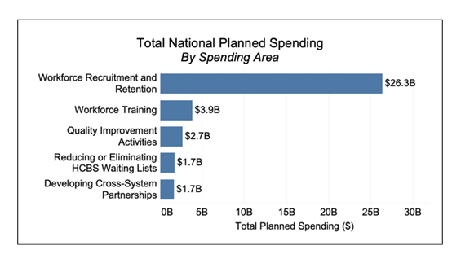


Evaluation Opportunities and Challenges: American Rescue Plan Act HCBS Initiatives
Total National Spending Across Top 5 Areas of Total Planned Spending from The Overview of State Spending under American Rescue Plan Act of 2021 (ARP) Section 9817, as of the Quarter Ending December 31, 2023, published July 2024
Efforts to Evaluate the Impact of ARPA HCBS Investments
State Implementation of ARPA HCBS Spending Plans: Lessons Learned, April 2024
Notes:
https://www.medicaid.gov/medicaid/home-community-based-services/downloads/arp-sec9817-overview-infographic.pdf#page=5
https://www.advancingstates.org/state-technical-assistance/arpa-hcbs-initiative/efforts-evaluate-impact-arpa-hcbs-investments
https://www.advancingstates.org/sites/default/files/ARPA HCBS State Implementation Report April 2024.pdf

Slide 24
Breaking it Down: Proposed Minimum Data Set
VOLUME
STABILITY
COMPENSATION
# of workers by setting, role, and service model
# full-time workers, # part-time workers
# separations in 12 months
average # employed in year
# of vacancies and # employed on given date
Mean hourly wages
Health insurance coverage (by type)
# with paid leave benefits
Calculations: Total # of DCWs by setting and by job title; total # full-time versus part-time
Calculations: Average annual turnover and vacancy rates
Calculations: Hourly wages, health insurance by type, percentage with paid leave
The Need for Monitoring the Long-Term Care Direct Service Workforce and Recommendations for Data Collection
Notes:
https://www.phinational.org/resource/the-need-for-monitoring-the-long-term-care-direct-service-workforce-and-recommendations-for-data-collection-2/

Slide 25

What Questions Would These Data Help Answer?
Where is the greatest need for workforce investment and innovation? What problem should be prioritized?
How should workforce resources be allocated to address the problem? A statewide recruitment campaign, wage increase/bonus payment, new training program or career pathway, or other workforce development or job quality initiative?
What will be the scope of a chosen workforce intervention or policy change? How big is the target group? How much will it cost?
How successful is the intervention or policy change? (Consider that success can be defined and therefore measured in a range of different ways.)
How do outcomes differ for different members of the workforce, employers, care recipients, and/or family caregivers?

Slide 26

Opportunities to Build Direct Care Workforce Data Collection, Monitoring, and Evaluation
1. Maximize the collection of comparable workforce data/ common data elements across settings, roles, and individual interventions.
Example: The NCI State of the Workforce surveys produce comparable data across aging and disability and I/DD services; several states are now implementing both.
NCI State of the Workforce survey results
NCI AD State of the Workforce - Aging and Disabilities
Notes:
`https://idd.nationalcoreindicators.org/staff-providers/
https://nci-ad.org/sotw-ad/

Slide 27
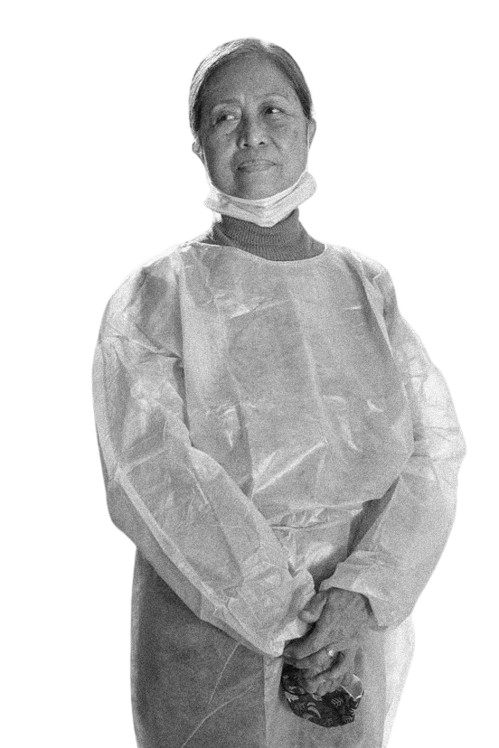
Opportunities to Build Direct Care Workforce Data Collection, Monitoring, and Evaluation
2. Build data collection expectations into contracts with providers, managed care organizations, and vendors.
Example: Texas Health and Human Services (HHS) collected a range of direct care workforce indicators through LTSS cost reports and billing data, summarizing the findings in a strategic plan. HHS conducted a direct care worker survey as a follow-up step.
Community Attendant Workforce Development Strategic Plan, Texas Health and Human Services Commission, November 2020
Community Attendant Survey Report, Texas Health and Human Services Commission, February 2023
Notes:
https://www.hhs.texas.gov/sites/default/files/documents/laws-regulations/reports-presentations/2020/rider-157-ca-workforce-dev-strat-plan-nov-2020.pdf
https://www.hhs.texas.gov/sites/default/files/documents/community-attendant-survey-report-2023.pdf

Slide 28

Opportunities to Build Direct Care Workforce Data Collection, Monitoring, and Evaluation
3. Develop sustainable systems to monitor, analyze, and report workforce data over time.
Example: Through contracting requirements with the Division of TennCare and in partnership with ICI, MCOs in Tennessee have administered an annual workforce survey since 2018. The longitudinal results have informed workforce investments and evaluations.
TennCare Workforce Initiative Toolkit
Notes:
https://tenncare.ici.umn.edu/

Slide 29
Additional Considerations re: Data Collection, Monitoring, and Evaluation
State funding and capacity
Privacy and security
Disaggregation and differences
Consumer outcomes
Stakeholder engagement

Slide 30
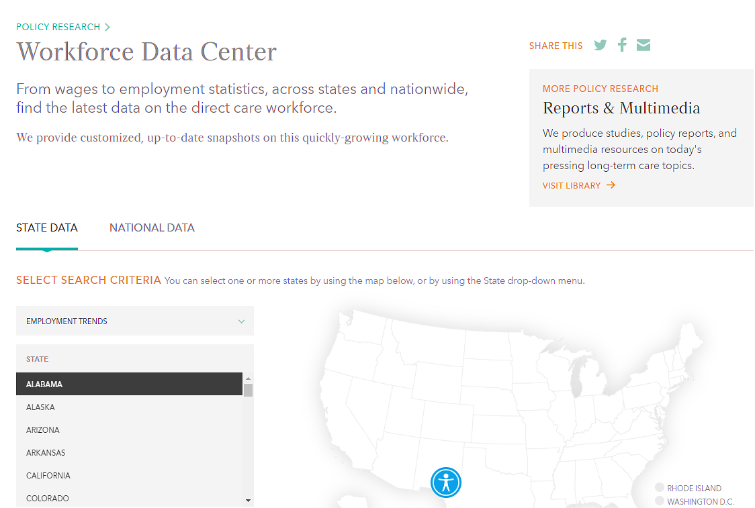
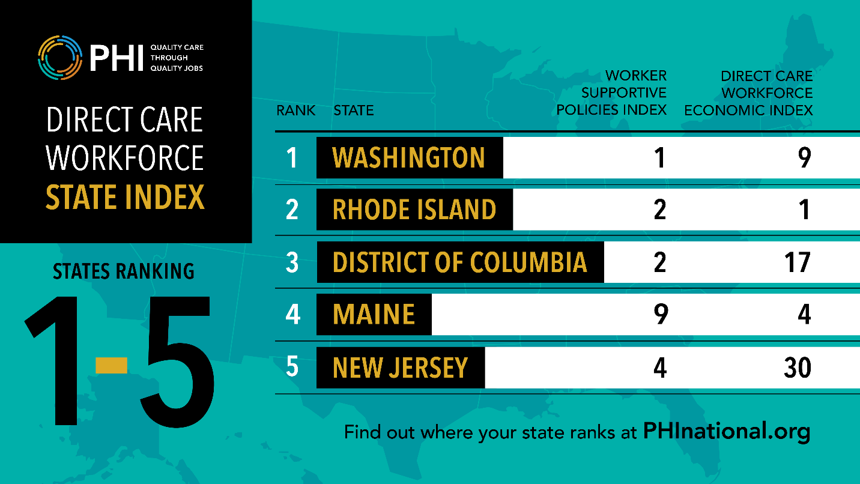
Data-Driven Direct Care Workforce Resources
PHI Direct Care Workforce State Index
PHI Workforce Data Center
Notes:
https://www.phinational.org/policy-research/workforce-data-center/
https://www.phinational.org/state-index-tool/

Slide 31
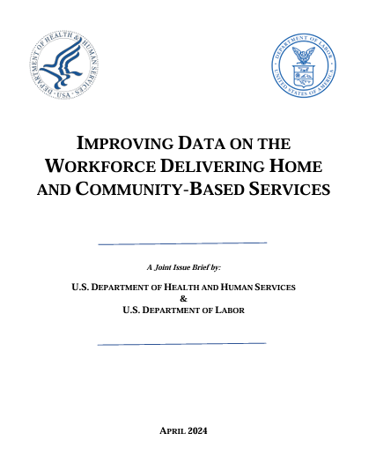
HCBS Forward Report with Recommendations
Recommendations:
Establish and regularly field a nationally representative survey of the HCBS workforce
Establish and regularly field a nationally representative survey of adults with disabilities (ages 18-64) about their need for, and receipt of, services and supports
Enhance consistent and systematic state data collection efforts and share evidence-informed best practices of state data collection on the HCBS workforce
Maximize the availability of existing federal data sources to produce additional information on the HCBS workforce
Maximize existing administrative data sources to provide information on the HCBS workforce
Improving Data on the Workforce delivering home and community-based services, a joint issue brief by U.S. Department of Health and Human Services and U.S. Department of Labor, April 2024
Notes:
https://acl.gov/sites/default/files/Direct Care Workforce/improving-hcbs-workforce-data-issue-brief.pdf

Slide 32

Strengthening the Direct Care Workforce: A Framework for Leveraging the Role of MLTSS MCOs to Address the Workforce Crisis
Mary Kaschak
Executive Director
National MLTSS Health Plan Association
Notes:
Transition slide

Slide 33
Strengthening the
Direct Care
Workforce:
A Framework for Leveraging the Role of
MLTSS MCOs to Address the Workforce Crisis

Slide 34

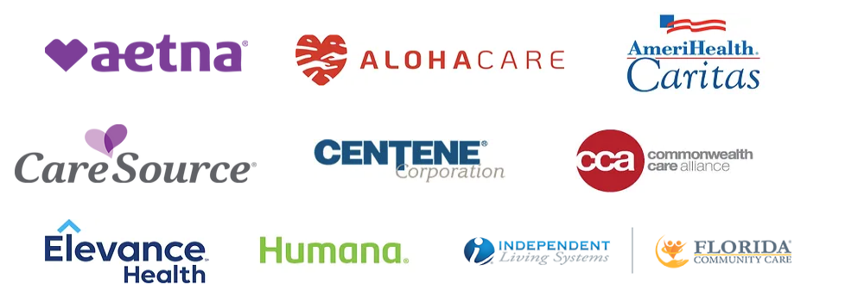






About the MLTSS Association
The National MLTSS Health Plan Association is a national trade association of the leading managed care organizations that deliver high-value, quality managed long-term services and supports (MLTSS) for state Medicaid programs and beneficiaries. Our members also provide Integrated Plans for Dually Eligible Individuals.
Our members serve almost 2 million individuals who receive Medicaid Long-Term Services and Supports, and almost 5 million individuals who are dually eligible for both Medicaid and Medicare through Integrated Care Plans.
Learn more at www.mltss.org

Slide 35
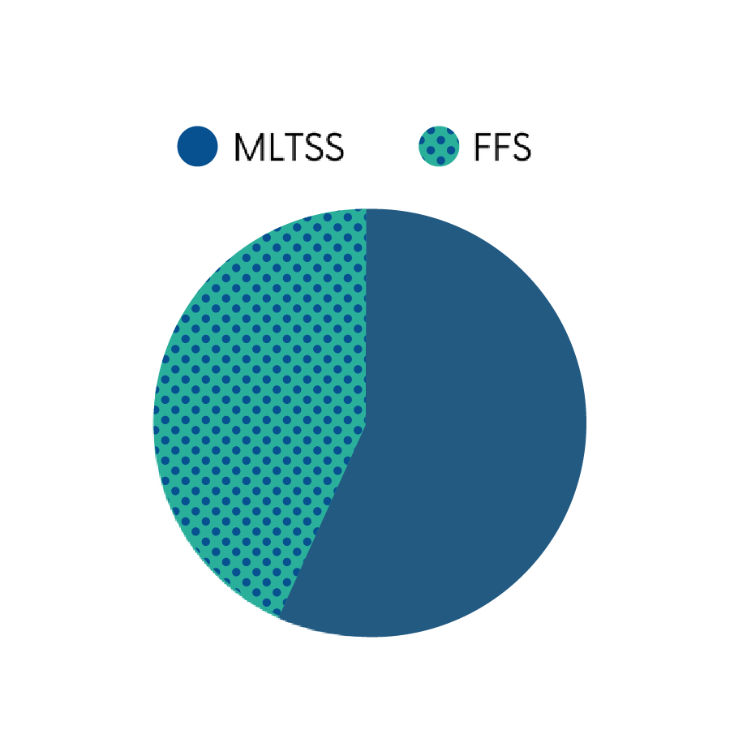
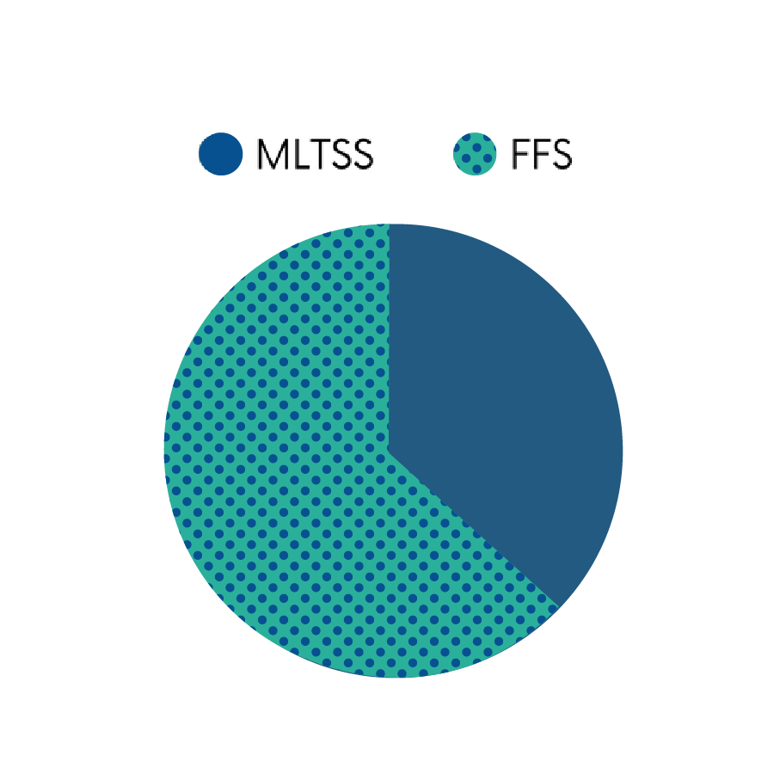
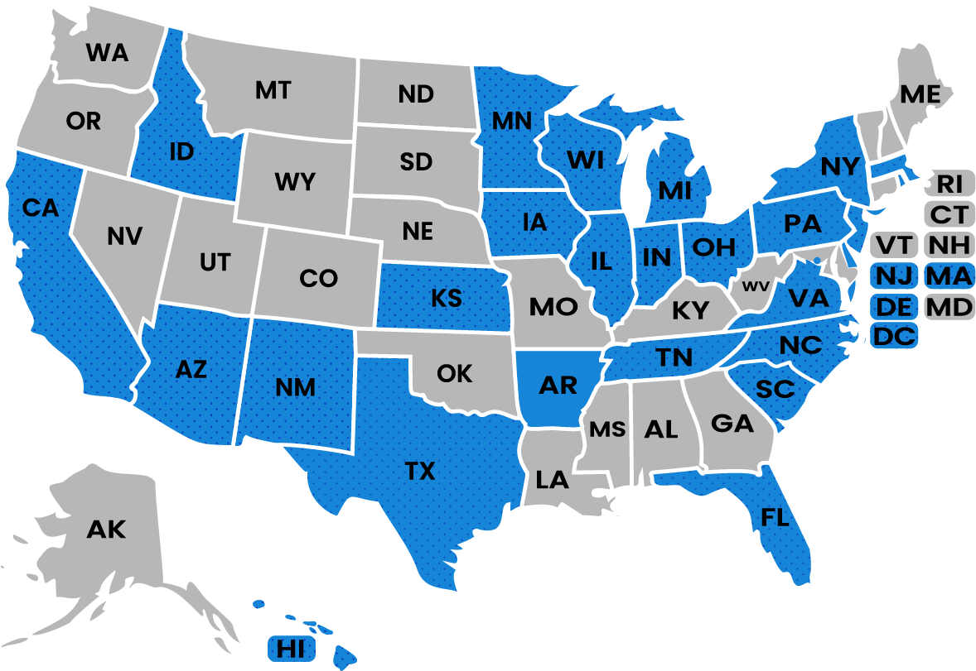


About MLTSS
BY THE NUMBERS
STATES WITH MLTSS
States with MLTSS vary widely in their program structure and benefits.
These states enter into risk-based contracts with Managed Care Organizations (MCOs) to deliver high-quality care at a lower cost than traditional fee-for-service.
MLTSS accounts for over 60% of LTSS users
But only 37% of LTSS expenditures
About half of states have regional or statewide MLTSS programs in 2025.
States with MLTSS programs
States without MLTSS programs
Medicaid Long-Term Services and Supports Users and Expenditures by Service Category, 2022
Notes:
https://www.medicaid.gov/medicaid/long-term-services-supports/downloads/ltss-users-expenditures-category-brief-2022.pdf
A map of the United States highlighting states with MLTSS: California, Idaho, Arizona, New Mexico, Texas, Kansas, Arkansas, Iowa, Minnesota, Wisconsin, Illinois, Indiana, Michigan, Ohio, Tennessee, Florida, South Carolina, North Carolina, Virginia, District of Columbia, Delaware, New Jersey, Massachusetts, Pennsylvania, New York, and Hawaii

Slide 36








  Key Principles
Collaboration & Shared Responsibility
Person-Centered Planning
Alignment with Local, State, and Federal Initiatives
Informal Caregivers
Centering the DCW Voice
Technology
Equity
Flexible Funding Models
Notes:
As such, we are issuing a call to action for MCOs to collaborate on new and innovative solutions to support the workforce in partnership with state and provider partners. Meaningful action to address direct care workforce shortages requires partnership and collaboration between states, health plans, and providers. As more states move to MLTSS, MCOs are increasingly responsible for developing a network of providers that have the capacity to support the growing population of people who need LTSS. The states with the greatest success in addressing direct care workforce challenges have been those that have emphasized strong collaboration between the state and MCOs, such as Tennessee, whose model we will hear more about during our panel discussion.
Before we dive into the details of our framework and recommendations for plans and policymakers, I want to first ground us in the 7 major principles that have guided our work:
First, collaboration & shared responsibility. While managed care is a highly competitive space, given the close alignment of provider networks across MCOs, there is collective value for MCOs to collaborate to invest in and develop the DCW. MCOs are stronger in our efforts to bolster the workforce when we are aligned and coordinated in our approaches. At the same time that we underscore the critical role MCOs can and should play, we also recognize there is a shared responsibility across the system – all stakeholders have a specific role to play to make changes. For example, some initiatives are better if led by states or the federal government, and MCOs are better positioned to support those broader efforts.
Which leads us to our second principle – MCOs should ensure they are informed of and aligned with other initiatives driven by government, provider, and advocacy organizations. For instance, states may have workforce development plans in place, and plans should be aware of these efforts and how they can align their own activities to supplement existing efforts.
Third, we want to underscore the importance of centering the direct care worker’s voice in workforce development initiatives. Governments, plans, and providers should all ensure that they are proactively seeking the perspectives of DCW themselves in designing solutions, and including them at the table.
Fourth, workforce solutions should advance equity – as I noted in the background, DCWs often come from historically marginalized groups, and solutions to support this profession should consider and seek to help alleviate the SDOH and other equity-related challenges they face. For example, increasing training standards may unintentionally present additional burden to workers if they must then self-fund the costs of transportation and childcare during the training hours.
Fifth, robust person-centered planning can improve plans’ ability to be good stewards of existing resources and to support the DCW in supporting the beneficiary’s unique goals and preferences. Through person-centered planning, plans can identify the beneficiary’s natural supports and any preferences around workforce alternatives that can support their independence, such as technology.
Which leads us to our last two principles, informal caregivers and technology. Early on in our process, we identified these two as cross-cutting themes that are important to consider across our other key domains and to layer onto our workforce-focused solutions. I’ll flip to our next slide to show how they fit into our overarching framework.

Slide 37
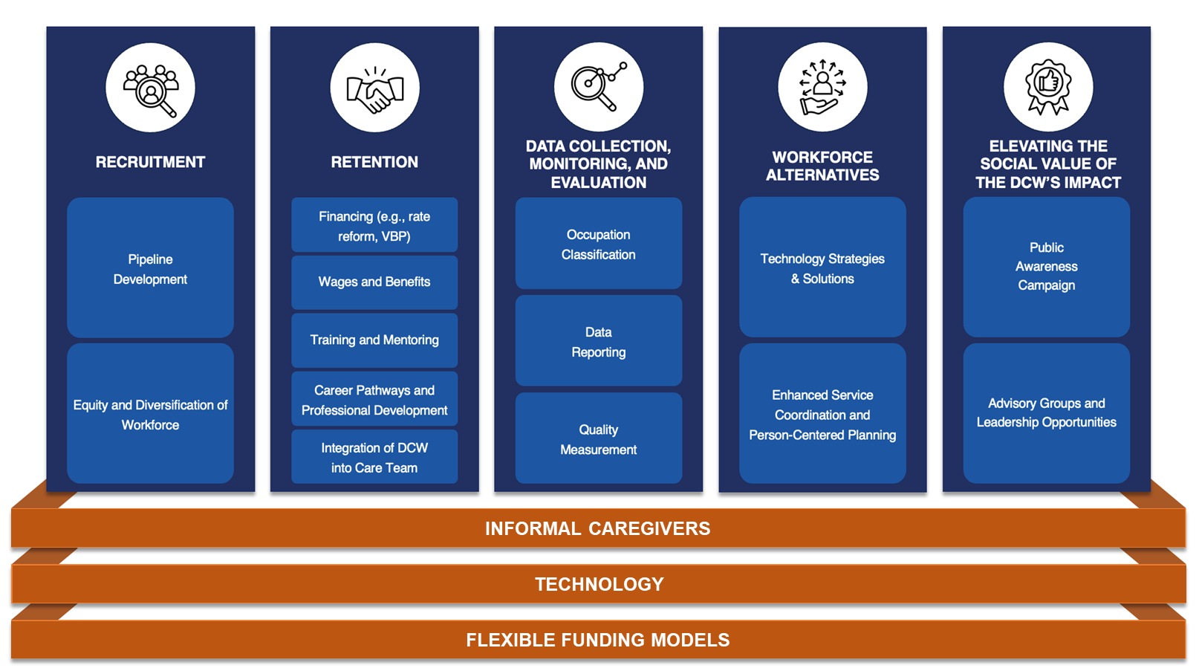
  Framework for the MCO Role in Supporting the DCW
Notes:
Framework illustration: the base of the image has three supports of INFORMAL CAREGIVERS, TECHNOLOGY, and FLEXIBLE FUNDING MODELS. Above the base are 5 pillars with supporting subjects . The first pillar is RECRUITMENT: Pipeline Development, and Equity and Diversification of Workforce. The second Pillar is; RETENTION
Financing (e.g., rate reform, VBP), Wages and Benefits, Training and Mentoring, Career Pathways and Professional Development, and Integration of DCW into Care Team. The third pillar is: DATA COLLECTION, MONITORING, AND EVALUATION; Occupation Classification, Data Reporting, and Quality Measurement. The fourth pillar is: WORKFORCE ALTERNATIVES; Technology Strategies & Solutions and Enhanced Service Coordination and Person-Centered Planning. And the 5th pillar is: ELEVATING THE SOCIAL VALUE OF THE DCW'S IMPACT; Public Awareness Campaign and Advisory Groups and Leadership Opportunities

Slide 38






Data Collection, Monitoring, and Evaluation
Problem Statement
Fundamental system and data constraints – including insufficient data collection infrastructure to collect employer-level data, imprecise federal industry and occupational classification codes, and limited implementation of workforce quality measures – limit ability of MCOs and providers to collect, analyze, and report on workforce metrics
Better data collection infrastructure is needed to track financial data and bolster efforts to advocate for living wages for DCWs
Limited data on DCWs’ SDOH hinders analysis of how these factors impact workers’ ability to participate in the profession
MCO Call to Action:
Leverage existing data sources (e.g., EVV, provider and beneficiary reports) to collect data on workforce capacity and identify gaps and trends
Help advise on inputs for cost studies
Advocate for federal occupational classification codes that better reflect DCW core competencies, settings, and populations served
Help collect data on self-directed workers and informal caregivers supporting their members

Slide 39


Data Collection, Monitoring, and Evaluation (2 of 3)
MCO Recommendations
State & Federal Recommendations
Leverage existing data sources (e.g., EVV, provider/beneficiary reports) to collect data on workforce capacity and identify gaps and trends
State Recs: (1) Develop bidirectional data repositories for states, MCO, and providers to use to input and report on workforce data
(2) Consider including additional requirements in EVV reporting to capture data to reflect workforce capacity
Federal Rec: Develop standardized workforce capacity metrics
MCO Recommendations
State & Federal Recommendations
Help collect data on self-directed workers and informal caregivers
Federal Rec: Direct MACPAC to conduct a study to compile definitions of DCWs across states to inform future revisions to federal occupational classification codes

Slide 40



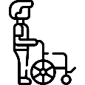
Data Collection, Monitoring, and Evaluation (3 of 3)
MCO Best Practices & State/Federal Recommendations
MCOs are leveraging existing data sources (e.g., EVV, provider and beneficiary reports) to collect data on workforce capacity and identify gaps and trends
State Recs: Develop bidirectional data repository for states, MCOs, and providers to use to input and report on workforce data; adopt NCI State of the Workforce survey across all populations; add requirements around workforce data in EVV
Federal Recs: Congress to require or incentivize states to develop bidirectional data repositories; CMS to develop standard workforce capacity metrics; Congress to direct HHS to study best practices across EVV systems in different states
MCOs can help advise on inputs for cost studies
State Recs: Identify inputs needed for cost studies to support analyses of providers’ projected costs
Federal Recs: CMS to work with states to develop and concurrently release guidance; CMS to study impact of using ARPA funds to support DCW wage increases
MCOs can advocate for federal occupational classification codes that better and more comprehensively reflect DCW core competencies, settings, and populations served
Federal Recs: Congress to direct MACPAC to conduct study to compile definitions of DCWs across states to inform revisions to federal occupational classification codes
MCOs can help collect data on self-directed workers and informal caregivers supporting their members
State Recs: Collect data on self-directed workers and “gray market”; incentivize plans to support caregiver self-identification during needs assessment; create standard identifiers that differentiate between self-directed and agency-directed supports
Federal Recs: CMS to require states to collect data on self-directed workers and “gray market”; CMS to provide guidance on including caregiver self-identification as part of needs assessment; CMS to require states to use standard identifiers

Slide 41

Thank you! Questions?
Read the full report:
National MLTSS Health Plan Association Report on Strengthening the Direct Care Workforce 2023
Targeted Briefs:
National MLTSS Health Plan Association Recommendations for Congress, CMS, ACL, and States on Strengthening the Direct Care Workforce
Mary Kaschak
mkschak@mltss.org
Notes:
https://www.mltss.org/post/report-on-strengthening-the-direct-care-workforce
https://www.mltss.org/post/recommendations-for-congress-cms-acl-and-states-on-strengthening-the-direct-care-workforce

Slide 42

Advancing the Direct Care Workforce as a Key Component of HCBS Systems Change: Providers’ Perspective
Tina Spears
Executive Director
The Community Provider Network of Rhode Island
Notes:
Transition slide

Slide 43

Advancing the Direct Care Workforce
Community Provider Network of RI
Notes:
Nick

Slide 44
What we Implemented
What we learned
What’s Next
✓ Developed a uniform reporting and data collection system (UMN/DLT Partnership) Support Wise
✓ Prepared and designed the database with the providers
✓ Provided technical support
✓ Continuous learning and revisions
✓ Defining data was critical
✓ Support to providers was essential
✓ “Seeing” data within organizations and across the state was
✓ How to respond to
✓ Onboard children’s services
✓ Utilize data to design interventions
✓ Use data to inform state leaders on industry workforce data
✓ Add to data set
Notes:
2022 Work began- We identified 1,000 DSP vacancies
Designed in 2023
Launched 2024
Standardized in 2025 and expand reporters
Our database can tell us # of employees, DSPs/FLS, vacancy rates, overtime rates, turnover rates, etc.
We use this information to inform the Networks work to respond and improve our workforce
Continuous improvements

Slide 45
Perspectives of State Leaders
Moderated Panel Discussion of State Leaders Engaged in Data Collection & Analysis Reforms to Support DCW Development Strategy
Notes:
Transition slide

Slide 46
New Jersey Department of Human Services – Direct Care Workforce Strategic Planning
Jack Teters – Aging and Disability Services Policy Advisor

Slide 47
New Jersey Department of Human Services
The Department of Human Services offers a broad range of services and supports to New Jersey residents, including food security programs, mental health and substance use disorder treatment, services for aging residents, and health insurance for over 2.2 million New Jerseyans
The Department supports access to direct care services through a number of programs, including:
    Jersey Assistance for Community Caregiving (JACC)
    Personal Assistance Services Program (PASP)
    NJ FamilyCare (Medicaid)/Personal Preference Program (PPP)
    Community Care Program (CCP)/Supports Program (SP)
    Community programs in the Division of Mental Health and Addiction Services

Slide 48
Key Themes
Public Data and the Direct Care Workforce Strategic Plan
Filling Data Gaps in New Jersey
New Agency Data Sources
Centralizing Direct Care Data Analysis
DCW Strategic Plan Data Recommendations

Slide 49
Public Data and the Direct Care Workforce (DCW) Strategic Plan
American Community Survey
US Bureau of Labor Statistics
Lightcast
PHI National Workforce Data
National Core Indicators I/DD State of the Workforce Survey Report
Medicaid Data

Slide 50


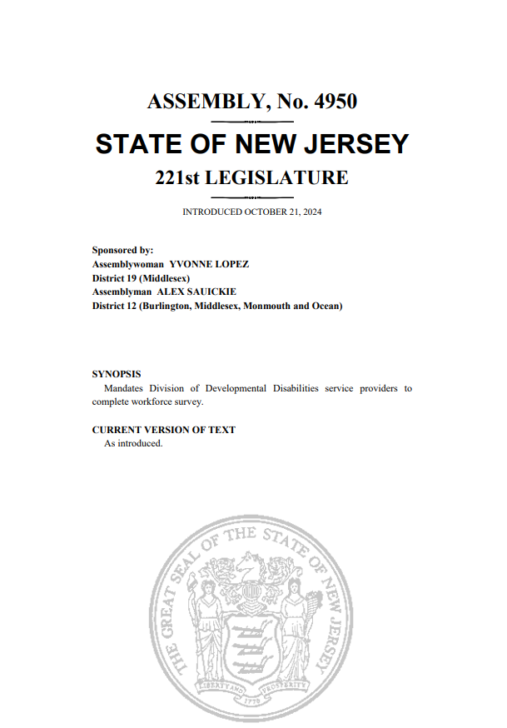
Filling Data Gaps in New Jersey

Slide 51
Departments and Divisions
Department of Human Services
  Division of Developmental Disabilities CCP/SP data
  Medicaid data
  Program specific data (JACC, PASP, etc.)
Department of Labor and Workforce Development
  Office of Research and Information
  Office of the Care Workforce Needs Assessment and Survey
  Lightcast
  Program specific data (GAINS, UPSKILL, etc.)
Department of Education
  Career and Technical Education Programs
Office of the Secretary of Higher Education
  Graduation/Course of Study Data
Department of Health
  CNA Certification Data
  Nursing Facility Staffing Data
Division of Consumer Affairs
  CHHA Certification Data
Higher Education Student Assistance Authority
  HCBS Loan Redemption Program

Slide 52
Centralizing Direct Care Data Analysis
New Jersey Statewide Data System
Office of the Care Workforce
Standardized Data Collection Tool
  DOL Data: employer information, UI claims data, wages
  HESAA: student enrollment and course of study
  DOE: teacher/staff characteristics
  OSHE: degrees, CIP, completions, enrollment, high school information, institution data, FIPS
  Utilizes DOL data to inform actions supporting early childhood, direct care, and maternal and infant health workforces
  Conducting needs assessment to inform its work, including a survey of care workers and government support staff
  Direct Care Workforce Strategic Plan outlines data gaps in New Jersey regarding the direct care workforce
  Data can be used to develop a standardized evaluation for any program supporting direct care workers

Slide 53
DCW Strategic Plan Data Recommendations
Host ongoing listening sessions for direct care workers, employers, consumers, and other stakeholders
Incentivize greater participation by direct care employers and workers in existing survey and data collection efforts
Establish Direct Care Worker Advisory Board
Create ongoing touchpoints with industry stakeholders, such as trade associations, advocacy organizations, and coalitions that represent direct care workers
Continue monitoring activities for providers that are required to pass funding through to direct care worker wages
Conduct additional surveys, focus groups, and other data collection efforts to fill data gaps and learn more about the thoughts, opinions, and challenges of direct care workers
Incorporate standard direct care workforce impact evaluation into existing programs and initiatives
Provide technical assistance and training to providers on how to collect and analyze their own data
Centralize data collection efforts
Advocate for the inclusion of Direct Support Professionals in the US Bureau of Labor Statistics Standard
Occupational Classification (SOC) system

Slide 54

ARCHITECTS of
INNOVATION
USING DATA TO BUILD CREATIVE SOLUTIONS TO HELP PEOPLE LIVE THEIR BEST LIVES
(AND SIMULTANEOUSLY ADDRESS WORKFORCE CHALLENGES]

Slide 55
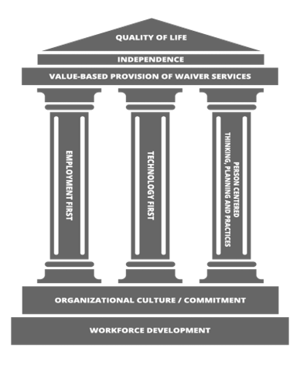
DRIVING A PEOPLE-CENTERED WORKFORCE FUTURE
What if we measured success not by the hours we bill, but by how fully people are living their lives?

Slide 56

INNOVATION FOCUS: Enabling Technology
Provides opportunities for people to achieve new levels of desired independence or regain lost levels of individual control in their lives.
Allows for more personalized service delivery through person-centered planning, and more flexibility with staffing patterns.
Avails new tools and resources to service providers allowing greater programming quality while also addressing workforce deficits.
Allows providers to efficiently grow their operations while recognizing cost efficiencies that can quickly be redistributed to address mounting wage pressures.

Slide 57

INNOVATION FOCUS: FLEX MODEL
People supported are able to select the hours they want paid staff support vs. when they would rather rely on ET, remote support, or family and friends.
The cost difference between the traditional and Flex Model reimbursement rates are shared between the State and providers in the form of shared savings incentives.
Staff can be deployed strategically, instead of 24/7 or "just in case".
Allows more time for professional development and promotional opportunities for staff.

Slide 58
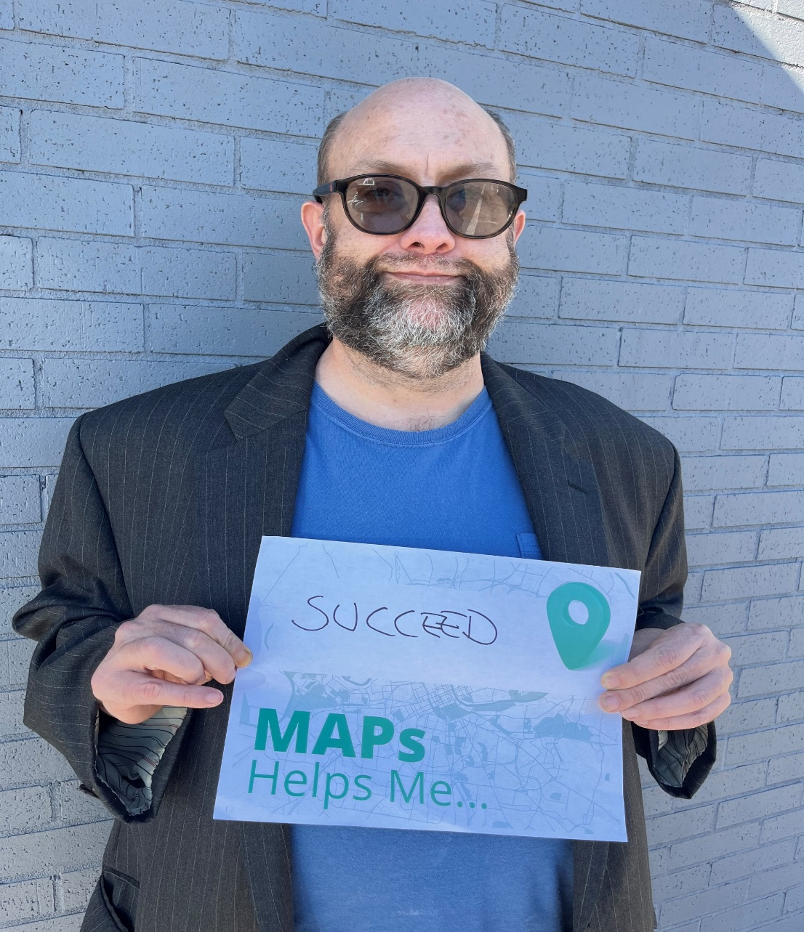
INNOVATION FOCUS: MAPs
What is MAPs?
MAPs is a 3-year program that gives people the tools, technology, and support to become more independent at home, at work, and in their community.
What makes MAPs unique?
100% Value-based payment methodology
Virtual Community Resource Mapping
Curriculum of independence milestones
Customizable person-centered supports using a life skills assessment
Innovative supports promoting technology and fading support to reduce learned dependence

Slide 59

A WINNING INVESTMENT: ENABLING TECHNOLOGY
There is a 13.5-to-1 return on investment during the first year of someone using Enabling Technology.
There is an annual Medicaid waiver cost reduction of $1.83 million, based on current utilization.

Slide 60

A WINNING INVESTMENT: FLEX MODEL
The Flex Model saves the State $24,000/user annually.
Early adopters of the Flex Model have already saved the State $829k, with $250k of that going back to providers as shared savings incentives.

Slide 61

A WINNING INVESTMENT: MAPs
      Every $1 invested in MAPs is projected to generate nearly $2 in savings over 5 years, a 2:1 return on investment. At current enrollment, this amounts to $8.1 million in projected annual net cost avoidance.
      Projected cost avoidance over 5 years
      1 diverted MAPs graduate: $114k
      10 diverted MAPs graduates: $1.14 million
      100 diverted MAPs graduates: $11.4 million

Slide 62

A WINNING INVESTMENT: ORGANIZATIONAL TRANSFORMATION
People are 2.6 times more likely to be using Enabling Technology when supported by a SHIFT Tech 1st accredited provider.
People are 2 times more likely to be employed if they use Enabling Technology.
People are 2.5 times more likely to use Enabling Technology when they are employed.
People are 1.8 times more likely to be employed when supported by a CQL accredited provider.
Organizationally accredited providers make up more than 80% of the network for MAPs

Slide 63
A WINNING INVESTMENT: ORGANIZATIONAL TRANSFORMATION – PROVIDER EXPERIENCE
CORE SERVICES OF NORTHEAST TN:
CQL WITH DISTINCTION, SHIFT TECH FIRST & SHIFT EMPLOYMENT FIRST
People Impacts
30% of people are employed
53% actively choose their type of support
31% self-administer their own medication with ET
Over 50% utilize enabling technology
25% utilize ET to reduce staff reliance
Workforce Impacts
DSP vacancy rate below 3%
Average tenure up to 7.2 years
Approximately 70% of all employees hold at least one professional certification
EMORY VALLEY CENTER:
CQL AND SHIFT TECH FIRST
People Impacts
77% reduction in crisis events for people receiving behavioral health supports
25% reduction in Human Rights restrictions
36% of people employed utilizing ET to reduce staff support
Workforce Impacts
Lower staff turnover
Rising net income
Staff are more equipped to support people, monitor needs remotely and respond promptly

Slide 64
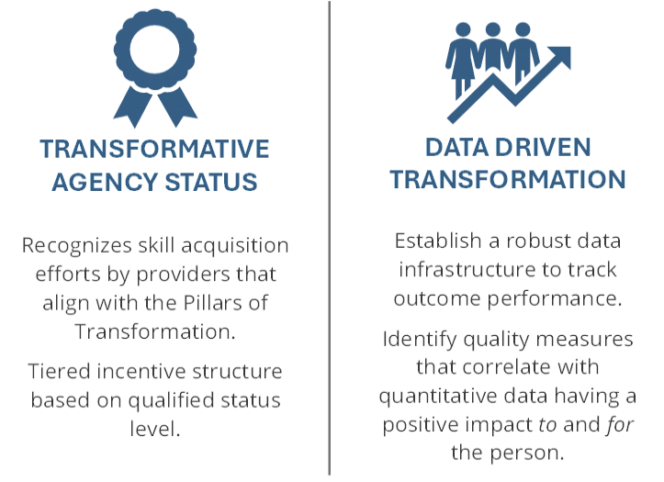
REINVEST IN SUCCESS: VALUE BASED PAYMENT REFORM
Phase 1 of VBP implementation will address the foundation for moving forward into further phases.
Phase 2 will ensure the methodology for measuring outcome achievement meets the need.
In future phases of VBP implementation DDA will explore the following:
  Transition of Transformative Agency Status from recognized skill acquisition to measures of outcome achievement;
  Refine tiered criteria that supports outcome benchmarks based on the makeup of the population and/or location-based trends;
  Expansion or revision of the outcome metrics to be more inclusive of and appropriate for the entire network.

Slide 65
Interactive Discussion
Q&A with Audience & Presenters
Notes:
Transition slide

Slide 66
Presenter Contact Information:
Dr. Julie Bershadsky
Jack Teter
bers0017@umn.edu
jack.teters@dhs.nj.gov
Dr. Kezia Scales
Jordan Allen
kscales@phinational.org
Jordan.allen@tn.gov
Mary Kaschak
Alex Gaughan
mkaschak@mltss.org
alex.gaughan@tn.gov
Tina Spears
tspears@cpnri.org

Slide 67
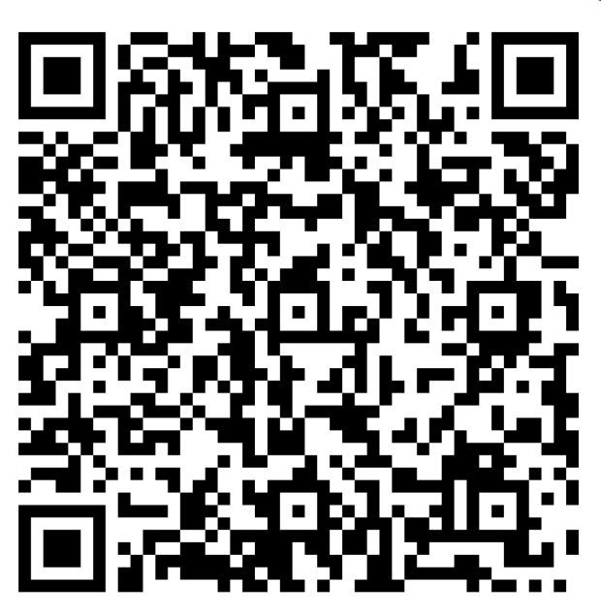
Final Reminders
Check out resources on our website and sign up for Center updates
Stay on the lookout for the roll-out of new technical assistance and training opportunities for State government leaders and HCBS providers this spring!
Please complete the post-webinar survey
Or Scan QR code
QR code link to post webinar survey
Notes:
https://acl.gov/DCWcenter
https://forms.office.com/r/Yv30gLgsth

Slide 68
Looking Ahead:
Delve Deeper into the Topic of Data Collection & Analysis to Improve HCBS Direct Care Workforce
Register for the DCW Strategies Center 3-Part Workshop Series (Jan-Feb 2026)
  Session 1: Getting Started
  Understanding what you need to know about your direct care workforce
  Taking stock of the data you have today and leveraging it to inform investments in the HCBS direct care workforce
Session 2: Building Collaborative Cross-Systems Data Partnerships
Identifying Data Gaps
Conjoining various data across systems to inform workforce development strategies
Establishing Expectations for System Partners
  Session 3: Using Data to Evaluate the Impact of our Investments in Workforce Development Over Time

