Slide 1
Aging in the United States: A Strategic Framework for a National Plan on Aging
Interagency Coordinating Committee on Healthy Aging and Age-Friendly Communities

Slide 2
Agenda
Welcome and Housekeeping
Aging in the United States: A Strategic Framework for a National Plan on Aging
The Interagency Coordinating Committee on Healthy Aging and Age-Friendly Communities
Engagement and Next Steps

Slide 3
Housekeeping
Recording – This webinar is being recorded. A recording of the webinar will be posted online. Continued participation on this webinar constitutes your consent to record.
Captioning – Press the show captions button to view captions during today’s meeting.
ASL Interpretation – Press the interpretation button to enable the interpreter view.
Q&A – Use the Q&A window to reach out for help with technical difficulties or to submit questions during today’s session.
Chat – Moderators will use chat to send broadcast messages to all participants.
Audio – Participant microphones are muted.

Slide 4
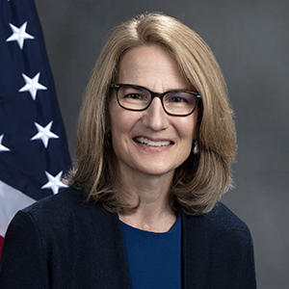
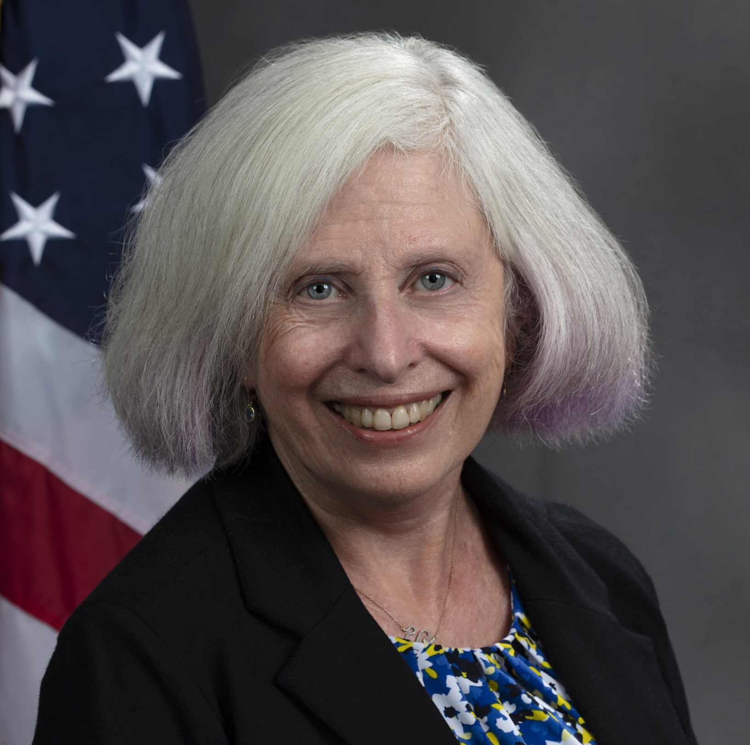
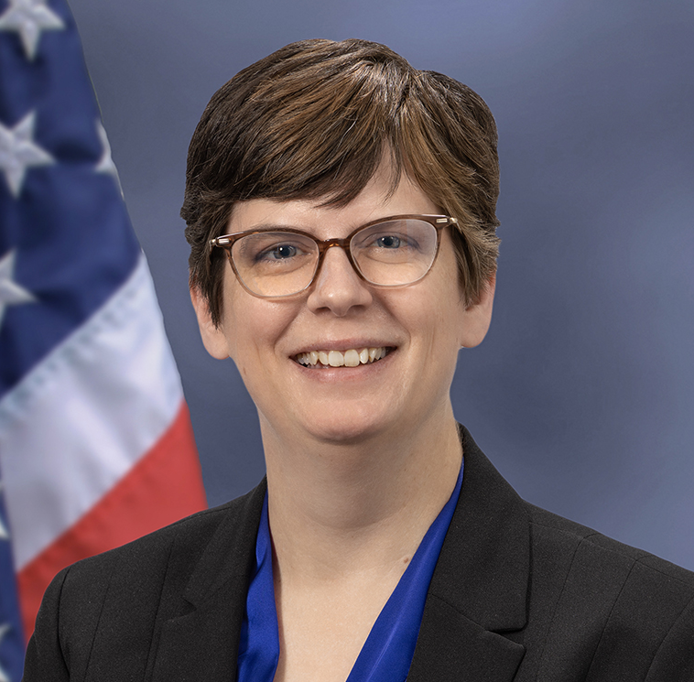
Today’s Presenters
Alison Barkoff
Performing the duties of the ACL Administrator and the Assistant Secretary for Aging
Kelly Cronin
ACL
Deputy Administrator for Innovation and Partnership
Emily Rosenoff
ASPE
Director for the Division of Long-Term Services and Supports Policy.
Vicki Gottlich
ACL
Deputy Administrator for Policy and Evaluation
Kari Benson
ACL
Deputy Assistant Secretary for Aging

Slide 5
Overview: Interagency Coordinating Committee on Healthy Aging and Age Friendly Communities
Led by the Administration for Community Living, the Interagency Coordinating Committee on Healthy Aging and Age-Friendly Communities was established under the Older Americans Act to foster coordination across the federal government and to develop a national set of recommendations on key aging issues.
As a part of the ICC, ACL convenes leaders and experts across 16 federal agencies and departments.

Slide 6
Overview: Interagency Coordinating Committee on Healthy Aging and Age-Friendly Communities
March 2020
FY 2023
May 2024
June 2024 +
TBD
Older American’s Act Reauthorization Creates ICC
ICC Inaugural Appropriation & Launch of the Committee
Strategic Framework Release & Listening Session
National Plan on Aging Development
Possible White House Conference on Aging

Slide 7
Our Vision
Our vision is an America that values older adults, embraces aging, and recognizes that all people have the right to live with dignity, make their own choices, and participate fully in society.
We want to be a nation that prioritizes independence, inclusion, well-being, and health across the lifespan.

Slide 8
Cross-Cutting Values
Person-Centeredness
The preferences, needs, and voices of older adults drive the services and supports that enable them to live the lives they want.
Inclusion
All people regardless of age, disability, or life experience, should be able to live independently and participate fully in their communities.
Respect
All people have the right to live their lives with dignity and respect, free from abuse of any kind.
Collaboration and Innovation
All sectors should work together to streamline access to programs; avoid duplicative work and efficiently leverage resources; share lessons learned; and develop new, effective approaches to meeting the needs of older adults.

Slide 9
Strategic Framework for a National Plan on Aging
Age-Friendly Communities
All older adults live in communities that respect and include them and are designed to encourage health, well-being, engagement, and connection.
1
Purpose and Engagement
Social Connection​
Accessibility​ and Universal Design
Transportation​
​Economic and Financial Security​
Employment​
Age-Friendly Health Systems
Vision
Our vision is an America that values older adults, embraces aging, and recognizes that all people have the right to live with dignity, make their own choices, and participate fully in society.
We want to be a nation that prioritizes independence, inclusion, well-being, and health across the lifespan.
Coordinated Housing and Supportive Services
All older adults have access to housing and the services they need to maintain their independence at home and thrive in their community.
2
Affordable Housing
Accessible Quality Housing
Preventing and Addressing
​Homelessness
Housing Stability through Coordinated Services
Increased Access to Long-Term Services and Supports
All older adults can easily access affordable, high-quality services and supports that promote their independence and goals.
3
Paid and Unpaid Caregiving
Whole Person Health Financing
Elder Justice
Person-Centered Access System “No Wrong Door” and Other Statewide Access Systems
Cross Cutting Values
Person-Centeredness
Inclusion
Respect
Collaboration and Innovation
Aligned Health Care and Supportive Services
All older adults maximize their health and reduce preventable disease and injury through comprehensive care that includes health and social services in the home or in the community
4
Benefits Access
Optimize Health, Well-Being, and Functioning
Align Health and Human Services

Slide 10
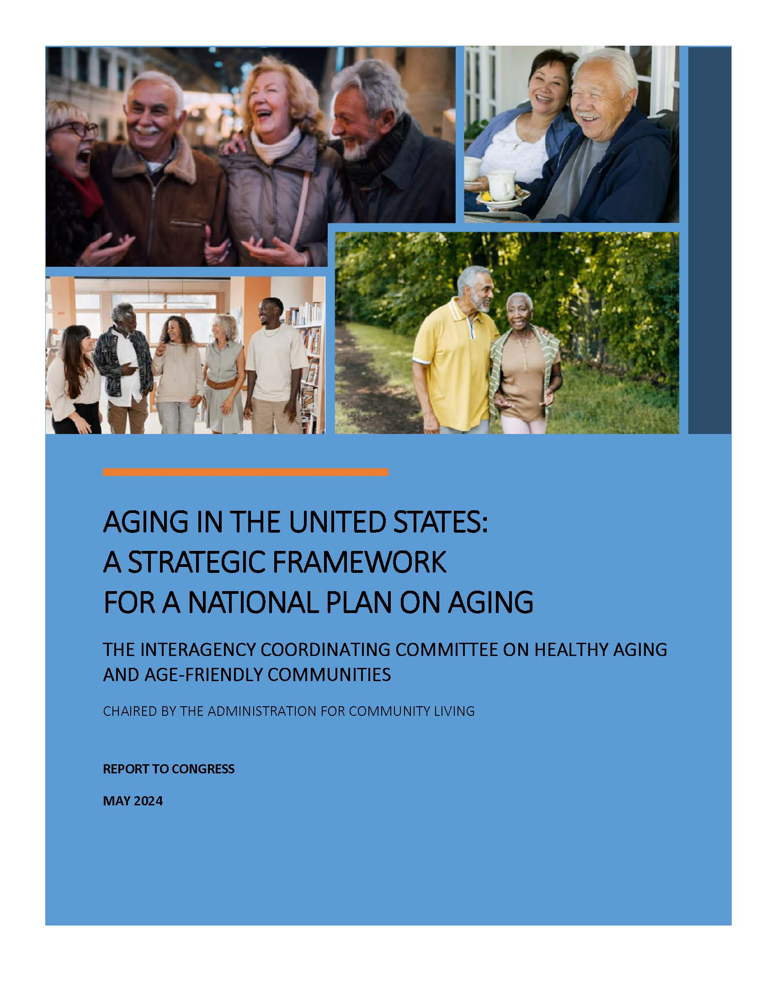
REPORT
Aging in the United States: A Strategic Framework for a National Plan on Aging
Submitted 5/30/24

Slide 11
Strategic Framework for a National Plan on Aging Introduction
More than 55 million people living in the United States are 65 years old or older. They represent over 16 percent of our country’s population, and their numbers will continue to grow over the next thirty years.¹
Purpose: Outlines the approach to prepare our nation for the future. It is the initial step in the development of a national plan on aging to improve the experience of aging in America.
Key Components: Vision, cross-cutting values, and four domains with goals and associated focus areas, appendix focused on falls-prevention.
1: https://www.census.gov/library/stories/2023/05/2020-census-united-states-older-population-grew.html

Slide 12
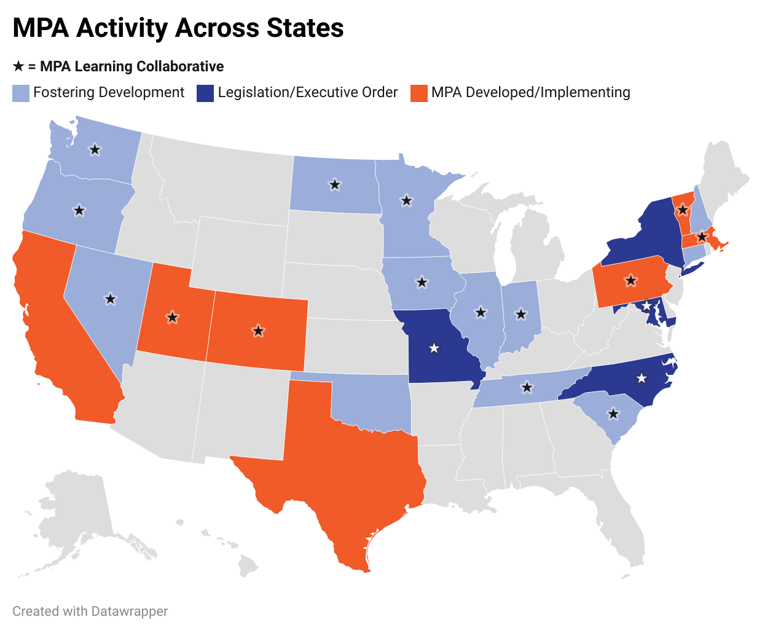
Building on Momentum
We are intentionally working in coordination with local, state, and global planning efforts.
The ICC recognizes the importance of state plans on aging and Multisector Plans on Aging.
The ICC champions existing coordination efforts among federal partners on aligned areas (e.g., mobility, homelessness, HRSNs).
The ICC’s work is a multi-year collaborative process embracing the best of public and private sector action.

Slide 13
Multisector Plans on Aging
ICC Domain | Domain Focus Areas | Percent of MPAs with Aligning Actions
Domain 1: Age-Friendly Communities | Purpose and Engagement | 100%
 | Social Connection | 100%
 | Accessibility and Universal Design | 86%
 | Transportation | 86%
 | Economic and Financial Security | 57%
 | Employment | 86%
 | Age-Friendly Health Systems | 29%
Domain 2: Coordinated Housing and Services | Housing Stability through Coordinated Services | 57%
 | Affordable Housing | 86%
 | Accessible Quality Housing | 43%
 | Homelessness Prevention | 43%
Domain 3: Increased Access to Long-Term Services and Supports | Paid and Unpaid Caregivers | 100%
 | Whole-Person Health Financing | 43%
 | Elder Justice | 100%
 | Person-Centered Access System - “No Wrong Door” and Other Statewide Access Systems | 100%
Domain 4: Aligned Health Care & Supportive Services | Benefits Access | 71%
 | Optimize Health, Well-Being, and Functioning | 100%
 | Aligning Health and Human Services | 29%

Slide 14
Domains that Address Key Aging Issues
Age-Friendly Communities
Coordinated Housing and Supportive Services
Increased Access to Long-Term Services and Supports
Aligned Health Care and Supportive Services
The domains harmonize with priorities in existing local, state, and global plans on aging. They will guide national plan development and recommendations, allowing for benchmarking future progress.

Slide 15
Age-Friendly Communities
Goal Statement
Focus Areas
All older adults live in communities that respect and include them and are designed to encourage health, well-being, engagement, and connection.
Purpose and Engagement
Social Connection​
Accessibility​ and Universal Design
Transportation​
​Economic and Financial Security​
Employment​
Age-Friendly Health Systems

Slide 16
Age-Friendly Communities, Continued (Cont.) 1
Each Focus Area has an action statement
Purpose and Engagement
Action Statement: Coordinate across sectors to cultivate opportunities for all older adults to participate in their communities in meaningful ways that align with their individual goals.
The Foster Grandparent Program connects older adults to young people to support healthy futures and successes through mentorship and tutoring.
And examples of current projects that work toward the desired action

Slide 17
Age-Friendly Communities, Cont. 2
Social Connection
Action Statement: Facilitate opportunities for the development and maintenance of quality social networks and relationships for all older adults.
The Bipartisan Infrastructure Law advances provisions to support accessible public transportation options for older adults and expand broadband access.
Accessibility and Universal Design
Action Statement: Prioritize activity-friendly and inclusive environments that support all older adults in participating in everyday activities through community-engaged design and implementation.
The comprehensive May 2024 update to section 504 of the Rehabilitation Act of 1973 strengthens anti-discrimination protections and ensures equal opportunity for people with disabilities.
Transportation
Action Statement: Collaborate to improve transportation availability and affordability to support older adults in safely accessing everyday destinations and in maintaining their independence.
The Innovative Coordinated Access and Mobility pilot program funds projects that improve the coordination of transportation services and non-emergency medical transportation services
Economic & Financial Security
Action Statement: Promoting economic stability for all older adults by building financial knowledge and streamlining access to benefits and services.
The Inflation Reduction Act (IRA) supports economic security among older adults by expanding the low-income subsidy program under Medicare Part D to 150% of the federal poverty level, reducing drug plan premiums and plan deductibles to $0, and reducing cost sharing for prescriptions.

Slide 18
Age-Friendly Communities, Cont. 3
Employment
Action Statement: Expand employment opportunities that recognize the expertise of all older workers by promoting work environments that are safe, flexible, accessible, and promote intergenerational exchange.
The Equal Employment Opportunity Commission (EEOC) Strategic Enforcement Plan for 2024-2028 highlights age discrimination as a priority enforcement area.
Age-Friendly Health Systems
Action Statement: Ensure providers coordinate across sectors to support the whole health care needs of older adults, with a focus on individual strengths, needs, and outcomes.
The launch of the Department of Veterans Affairs (VA) Age-Friendly Health Systems Initiative, a movement led by the John A. Hartford Foundation and the Institute for Healthcare Improvement (IHI), will improve health care for older veterans.
Promoting communities that are responsive to the needs, values, and preferences of older adults requires an understanding of aging as a process shaped by individuals interacting with their environment. People of all ages benefit when they live in places that are designed to encourage health, well-being, engagement, and connection

Slide 19
Coordinated Housing and Supportive Services
Goal Statement
Focus Areas
All older adults have access to housing and the services they need to maintain their independence at home and thrive in their community.
Affordable Housing
Accessible Quality Housing
Preventing and Addressing Homelessness
Housing Stability through Coordinated Services

Slide 20
Coordinated Housing and Supportive Services, Cont. 1
Affordable Housing
Action Statement: Increase the supply of accessible, affordable rental and homeownership opportunities for older adults by expanding and streamlining federal, state, and local funding, policy, and cross-sector partnerships.
HUD’s Pathways to Removing Obstacles to Housing (PRO Housing) program provides funding to communities for planning and policy activities related to zoning, mixed-use housing, and reduction of land use restrictions.
Accessible Quality Housing
Action Statement: Improve opportunities for older adults to have access to and maintain accessible, quality housing across their lifespan that is healthy, safe, and climate resilient.
Efforts focused on ways to increase the health and safety of older adults in their own homes: Department of Energy’s Weatherization Assistance Program, HUD’s Healthy Homes Program, the Department of Agriculture’s Housing Programs, and ACL’s Falls Prevention Programs.
Preventing and Addressing Homelessness
Action Statement: Prevent homelessness among older adults by fostering intentional coordination across federal, state, and community levels.
The USICH, made up of 19 federal agencies, coordinates the federal response to homelessness with an aim to create a national partnership at every level of government and with the private sector to reduce and end homelessness.

Slide 21
Coordinated Housing and Supportive Services, Cont. 2
Housing Stability through Coordinated Services
Action Statement: Foster federal, state, and local collaboration to improve access to housing assistance and related services to help older adults remain stably housed, live independently, and thrive in their communities.
As of November 2023, the Centers for Medicare & Medicaid Services (CMS) has approved section 1115 demonstration projects that cover certain evidence-based housing-related supports and services in seven States.
Nearly all older adults want to remain in their homes as they age. Accessible, stable, and affordable housing is essential for people to age in place in their communities. Communities that are age-friendly and support healthy aging must offer a range of housing options across the lifespan, regardless of income and functional ability. Stable housing often requires a continuum of services to support older adults with daily living needs so they can live well and safely in communities and avoid unnecessary hospitalizations and long-term nursing home care.

Slide 22
Increased Access to Long-Term Services and Supports
Goal Statement
Focus Areas
All older adults can easily access affordable, high-quality services and supports that promote their independence and goals.
Paid and Unpaid Caregiving
Whole Person Health Financing
Elder Justice
Person-Centered Access System “No Wrong Door” and Other Statewide Access Systems

Slide 23
Increased Access to Long-Term Services and Supports, Cont. 1
Paid and Unpaid Caregiving
Action Statement: Build on existing momentum to support a well-trained, well-paid LTSS workforce, enhance collaboration between paid and unpaid caregivers, with the goal of promoting the needs of caregivers, those receiving care and their families.
ACL’s DCW Strategies Center provides technical assistance to 20 states as well as service providers and facilitates collaboration with stakeholders to improve the recruitment, retention, training, and professional development of members of the direct care workforce.
Whole Person Health Financing
Action Statement: Build upon existing efforts to promote coordination across health systems, improved access to Medicaid LTSS for people who are eligible, as well as state-based innovations that facilitate financing and programs.
CMS recently issued new regulations to strengthen Medicaid-funded HCBS. The Ensuring Access to Medicaid Services rule includes important new requirements related to improving access to Medicaid HCBS, including by creating a grievance process for people who believe they were denied services inappropriately.
Elder Justice
Action Statement: Promote the rights of older adults, including those who need LTSS, and prevent adult maltreatment.
The Elder Justice Coordinating Council (EJCC) coordinates federal activities related to elder abuse, neglect, and exploitation to better serve victims of maltreatment and hold perpetrators accountable.

Slide 24
Increased Access to Long-Term Services and Supports, Cont. 2
Person-Centered Access System - “No Wrong Door” and Other Statewide Access Systems
Action Statement: Build upon and advance outreach, information and referral, assistance, and person-centered planning through federal and state collaboration including optimal IT infrastructure, workforce development, and public awareness that seek to expand upon existing efforts to promote approaches to LTSS that take into consideration the goals, preferences, and needs of the person.
The Substance Abuse and Mental Health Services Administration’s 988 Suicide and Crisis Lifeline offers 24/7 call, text and chat access to trained crisis counselors People can also call, text, or chat 988 if they are worried about a loved one who may need crisis support.
"Family members are the key support. It takes too long to get the paperwork in order to get people the services they need.” - Participant at listening session held at the Deanwood Community Center in Washington, DC.

Slide 25
Aligned Health Care and Supportive Services
Goal Statement
Focus Areas
All older adults maximize their health and reduce preventable disease and injury through comprehensive care that includes health and social services in the home or in the community
Benefits Access
Optimize Health, Well-Being, and Functioning
Align Health and Human Services

Slide 26
Aligned Health Care and Supportive Services, Cont. 1
Benefits Access
Action Statement: Increase timely access to benefits by enhancing affordability, availability, and awareness through increased coordination across governmental agencies and community-based organizations.
CMS is working to streamline access to the Medicare Savings Program (MSP) that will increase the number of older adults enrolled in the program, which helps to reduce beneficiary costs.
Optimize Health, Well-Being, and Functioning
Action Statement: Promote and increase utilization of services, programs, and supports to maximize the physical and behavioral health of older adults.
The Center for Disease Control and Prevention (CDC) and ACL collaborate on several national and community-oriented programs, such as efforts to reduce falls and fall related injuries, promote vaccine access and increase vaccinations among older adults and people with disabilities, and empower those with and at risk for chronic disease – particularly individuals with diabetes.

Slide 27
Aligned Health Care and Supportive Services, Cont. 2
Align Health and Human Services
Action Statement: Improve seamless coordination of services that address health-related social needs through multi-sector partnerships inclusive of health care, community organizations, and individuals with lived experience.
The White House's U.S. Playbook to Address Social Determinants of Health and the HHS Call to Action: Addressing Health-Related Social Needs in Communities Across the Nation identify organizations such as care hubs that are designed to manage partnerships across sectors to improve the health and well-being of individuals and communities. Both ACL and CDC support the development and enhancement of hubs.
The Older Americans Act and the ICC envision a nation where all older adults can achieve “the best possible physical and mental health.” By working together at the federal, state, and local levels to better align health care and supportive services, such as nutrition, transportation, and legal assistance, across private and public sectors, older adults can realize improved health and well-being across the lifespan.

Slide 28
Next Steps
Build a national movement that inspires tangible actions and makes a difference.
The promise embedded in the Strategic Framework extends beyond government coordination. Its vision, values, goals, and actions are intended to create and strengthen cross-sector partnerships and for the betterment of older adults nationwide.
Hear from individuals, communities, and service/advocacy leaders in partnership with the National Plan on Aging Community Engagement Collaborative.
Create dialogue at the community, state, and federal level on leveraging our collective strengths toward our vision.
Create recommendations in alignment with each domain.

Slide 29
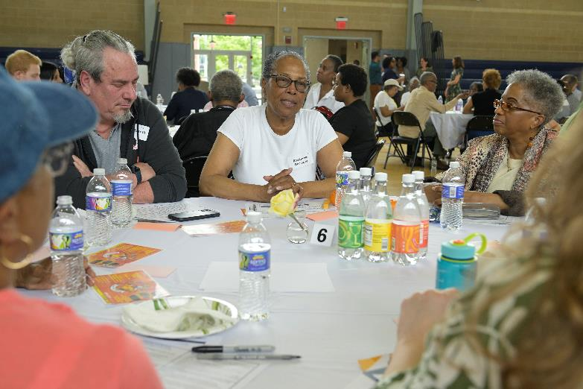
Engagement
Ensuring the perspectives of older adults and community partners inform our work.
National Plan on Aging Community Engagement Collaborative
Stakeholder Interviews
Listening Sessions and National Input
Stakeholder Engagement
Nearly 75 older adults gathered at the Deanwood Community Center in Washington, D.C., to share their perspectives and experiences on May 3, 2024.

Slide 30
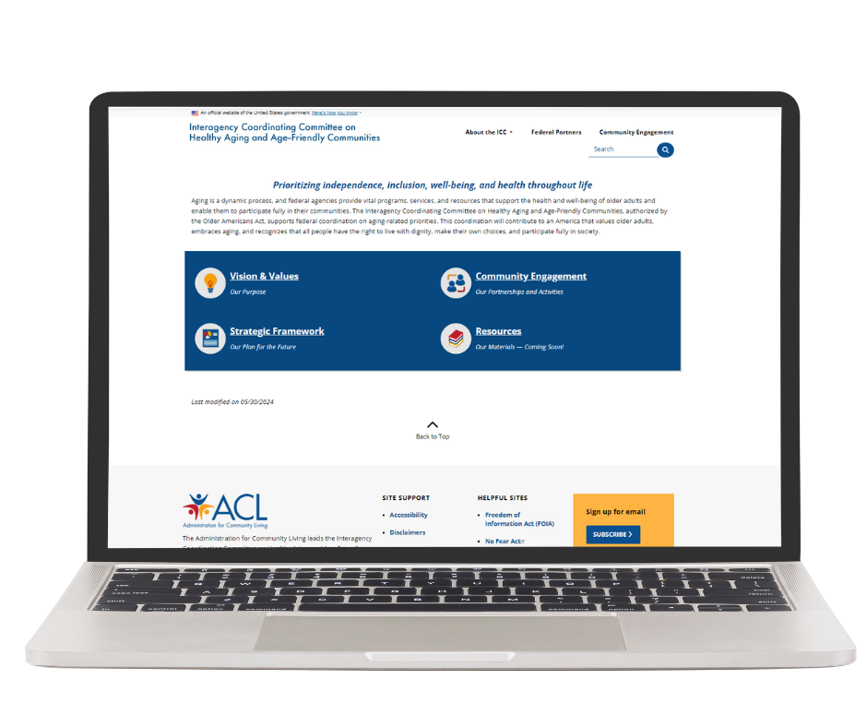
Engage With Our Work
Read the Framework
Follow our future progress
acl.gov/ICC-Aging
Notes:
https://acl.gov/ICC-Aging

Slide 31
Be Part of the Pro-Aging Dialogue
The Strategic Framework also seeks to break the patterns of ageism and ableism that serve as preventable barriers to older adults thriving in their communities.
It is intended to spark dialogue and innovation and provide a foundation for developing a national plan on aging for systems change to ensure that all Americans can age well and thrive throughout their lives.​
Participate in the Aging in the United States input process hosted by the National Plan on Aging Community Engagement Collaborative.
Consider how you or your organization can help to break down patterns of ageism and ableism.
westhealth.org/nationalplanonagingsurvey
https://www.reframingaging.org/
Notes:
https://westhealth.org/nationalplanonagingsurvey
https://www.reframingaging.org/

Slide 32
Thank you!

