Slide 1
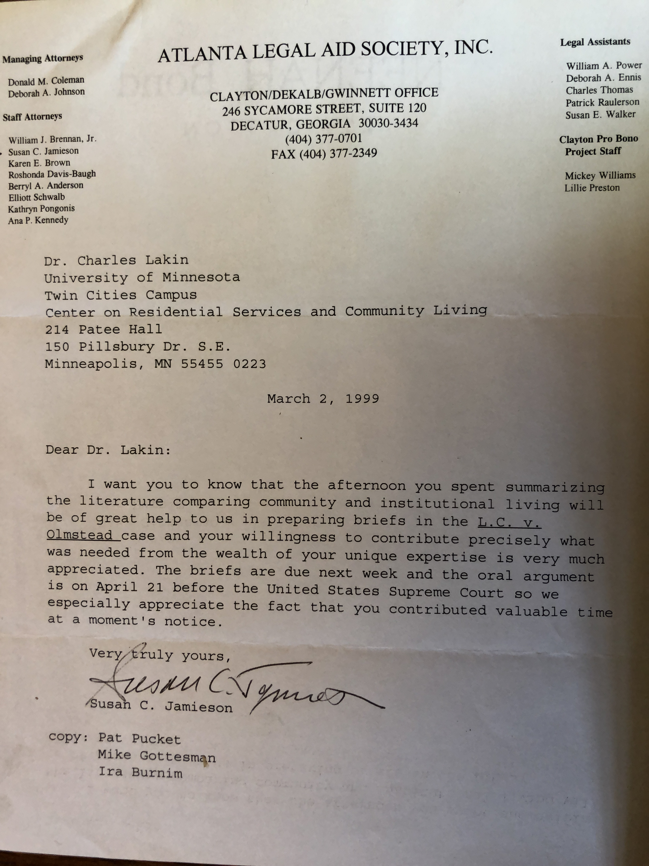
System Collaboration and Data
Networks that work together with intention
Longitudinal data programs that can show impact
DOJ enforcement
Notes:
Olmstead and the many state level “Olmstead Plans” throughout the country have brought about important systems collaboration, where advocates, people with disabilities and families, researchers, providers and states systems are working together to improve community supports and the infrastructures needed to maintain them. Sustained longitudinal data sets and research efforts are also available and being used to help describe the impact of decisions like Olmstead and DOJ settlement enforcement.
This case involved collaboration between protection and advocacy and advocates. It used key research from important data sets to argue its points. One of those data sets is the Residential Information Systems Project which we have been fortunate to develop and sustain at the University of Minnesota (with funding support from the Administration on Intellectual and Developmental Disabilities). The letter on this slide is written from one of the attorneys, Susan Jamieson, who worked at the Atlanta Legal Aid Society on the Olmstead case. It was sent to Charlie Lakin, who at the time worked at the UMN (and was my boss BTW), and provided data to the attorneys about trends in where people with intellectual and developmental disabilities lived in the United States by state. In the letter she thanks Charlie for providing….”precisely what was needed….in a moments notice….” I think this is such a great example of “research in action,” and how investments in longitudinal data sets make a difference in our communities and can influence policy and practice.

Slide 2
Effective Policies
Put in place
Money Follows the Person (MFP)
Balancing Incentives Program
Home and Community Based Settings Rule
Workforce Innovation and Opportunities Act (WIOA)
Proposed
The Disability Integration Act (DIA) (S.117 and HR. 555)
The Transformation to Competitive Employment Act (S.260 and H. 863)
Access to Free Speech for All Act (AFSFA) (S.1836)
Notes:
Certainly, since Olmstead we have seen numerous public policies that are designed to align with the intent of Olmstead by providing direction, and in some cases incentives, to states to shift systems toward community living and participation.

Slide 3
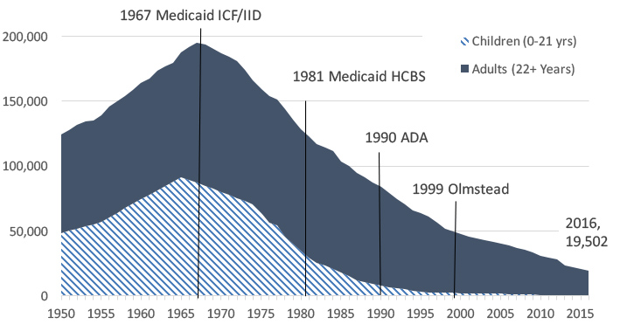
Children and Adults In Large State IDD Facilities of 16 or More People 1950-2016
Source: RISP - Larson et al, 2018
Notes:
I often say that systems change takes decades. If you look at this trend line which shows institution populations for people with intellectual and developmental disabilities, by decade you can see the progress, starting with the introduction of Medicaid funded intermediate care group homes, the introduction of Medicaid Home and Community Based Services, ADA and Olmstead. Certainly, since Olmstead the trend continues and I would argue that since Olmstead people with the most complex disabilities were freed in greater numbers from institutions.

Slide 4
Large State Institutions/Units Closed, Downsized, or Converted to Non-IDD Use or Operation by 5-Year Intervals
Source: RISP - Larson et al, 2018
Notes:
Since 1960, 248 institutions have or are projected to close by 2019 and an additional 2 are in process for near future closure. Of those, 99 (or 40%) in the period since Olmstead.

Slide 5
Non-Family Homes of People with IDD Getting Publicly Funded Services
Source: RISP - Larson et al, 2018
Notes:
Institutional closures are not the only data point to look at and to celebrate. Since Olmstead there is a clear trend toward an increase in people with disabilities living in their own home (that they rent or own) and in smaller Group homes in which fewer than 6 people live. Equally obvious is a trend away from group homes with more than 7 people living in them.

