Slide 1
DASH Dietary Approaches to Stop Hypertension
By: Glenis George-Alexander
Notes:
DASH stands for Dietary Approaches to Stop Hypertension.

Slide 2
What is the goal of the DASH eating plan?
Help lower blood pressure
Reduce risk factors of chronic diseases including:
Heart disease.
Stroke.
Notes:
.

Slide 3
How does the DASH eating plan help to lower blood pressure?
DASH eating plan encourages you to
Reduce the sodium in your diet.
Eat a variety of foods rich in nutrients that help lower blood pressure, such as potassium, calcium, and magnesium.
Notes:
DASH eating focuses on eating more foods rich in nutrients that can lower your BP, mainly minerals like potassium, Ca, and magnesium.
Potassium lowers blood pressure by helping the kidney get rid of extra fluid and sodium through urine.
Studies show by following the DASH eating plan you may be able to reduce your blood pressure by a few points in just two weeks.

Slide 4
What are the recommendations of the DASH eating plan?
Eat more vegetables, fruits, whole grains, fat-free or low-fat dairy products, lean meats, fish, poultry, beans, nuts, and seeds.
Limit foods that are high in fats, especially saturated and trans fats.
Limit sugar, sugar sweetened beverages, and sweets.
Limit foods that are high in salt (sodium) to 2300mg or less per day.
Notes:
This eating plan does not take away foods from your diet but gives you a variety of healthy options of foods to choose from. -----(To eat foods that are rich in potassium, magnesium, calcium, protein and fiber)
DASH eating plan is a lifestyle adjustment to help you reduce the risk of cardiovascular diseases

Slide 5
Activity: Demonstrations of Serving Sizes
Notes:
The DASH (Dietary Approaches to Stop Hypertension) diet has been shown to help lower blood pressure and prevent heart disease, stroke, diabetes and even some forms of cancer. It focuses on eating more fresh fruits and vegetables. Plate is divided into 8 segments showing recommended servings per day: 6-8 of whole grain, 4-5 of vegetables, 4-5 of fruits, 2-3 of fat-free or low-fat dairy, 4-5 of nuts, seed, and legumes, <6 of lean meat, poultry or fish, <5 of sweets, 2-3 of fats and oils. UK Health Care logo.
Examples of 1 cup portions and ½ cup portions of fruits and vegetables
Foods familiar to the participants, foods that are in season and/or affordable on a tight budget.
Whole, raw fruit and vegetables that equal about 1 cup, such as a small apple or a carrot.
A variety to include canned, fresh, and frozen foods
A variety of colorful fruits and vegetables.
Foods like apple sauce that are easily measured
Raw leafy greens (1 cups raw and ½ cut-up raw or cooked vegetables)
Dried fruits ( ¼ cup of dried fruit and ½ cup fresh, frozen or canned fruits)

Slide 6
Grains
Each picture shows 1 serving
Recommendation: Aim for 6 servings per day
Notes:
Grains include rice, pasta, breads and cereals
One serving of grains include ½ cup cooked rice or pasta, 1 slice bread, 1oz dry cereal
“whole grain” are recommended as a good source of fiber and nutrients
Choose brown rice instead of white rice, whole wheat pasta instead of regular pasta, whole grain bread instead of white bread.
Are there bowls available in the facilities? It may be nice to use these bowls to demonstrate what a serving of grains looks like in a vessel that is familar to them.
Can also compare bread slice with CD or make a circle with fingers to show what a serving size should look like.

Slide 7
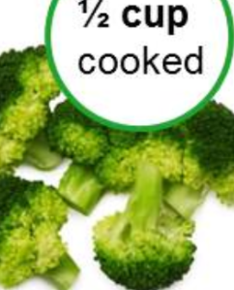
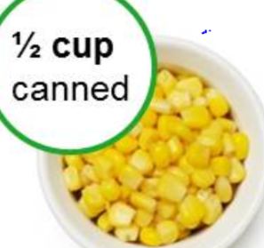
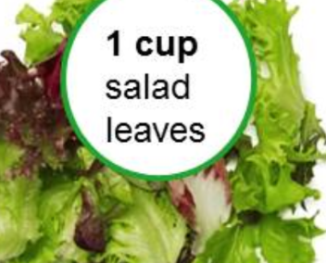
Vegetables
Each picture shows 1 serving
Recommendation: Aim for 4 servings per day
Notes:
One serving is 1 cup green leafy vegetable, ½ cup raw, cooked or frozen vegetable. (demonstration serving sizes)
Prepare in advance: chop a vegetable and have a whole vegetable. Compare the two with the audience. Put the chopped amount in your hands to show what that looks like. Pass the samples around.
Buy vegetables in season because they may be less expensive and at their peak flavor.
Buy Fresh, frozen or canned vegetables as they are all good choices – when buying canned or frozen – choose low sodium or without added salt
(read the Nutrition Facts label)

Slide 8
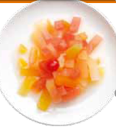
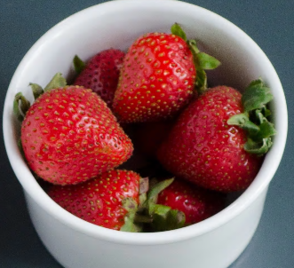
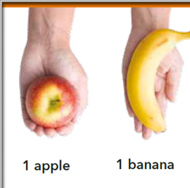
Fruits
Each picture shows 1 serving
Recommendation: Aim for 4 servings per day
Notes:
One serving of fruits is 1 medium fruit, ¼ cup dried fruit, ½ cup fresh, frozen, or canned fruits (demonstration of fruit serving size- example large apple is 2 servings of fruit)
It’s best to buy fruits in season because they may be less expensive and at peak flavor.
It’s ok to buy frozen, dried, or canned (in water or its own juice) so you will always have a supply available.
What surprises you about these serving sizes?
What did you expect 1 cup of fruit to look like?

Slide 9
Dairy
Each picture shows 1 serving
Recommendation: Aim for 2 servings per day
Notes:
Dairy include milk, yogurt and cheeses
One serving is 1 cup milk or yogurt, 1 ½ oz. cheese
Choose Low or no fat to avoid excessive amount of fats; Saturated fats

Slide 10
Lean meats, poultry, and fish
Each picture shows portions of 3 ounces = 3 servings of fish, beef, and chicken
Recommendation: Aim for 6 servings or 6 ounces or less per day
Notes:
One serving is 1 oz. cooked meats, poultry, or fish, or 1 egg
Typically we eat 3- 4 oz. portion of meat, poultry or fish per meal (about the size of a deck of cards)
Fish such as salmon (canned), herring, and tuna (canned in water) are healthy choices – high in omega-3 fatty acids

Slide 11
Nuts, seeds, and legumes
Each picture shows 1 serving
Recommendation: Aim for 4 servings per week
Notes:
One serving is ½ cup cooked lentils, peas, ¼ cup baked beans.
Examples are kidney beans, lentils, split peas
Legumes are excellent source of protein
Legumes can be added to rice, salads, and stews.
Examples of nuts are; almonds, mixed nuts, peanuts, walnuts, peanut butter.
Examples of seeds are; sunflower seeds, chia seeds, flax seeds, sesame seeds.
One serving nuts is 1/3 cup or 1 ½ ounce (unsalted), 2 Tbsp. peanut butter,
One serving seeds is ½ oz. or 2 Tbsp.
One serving cooked legumes (dried beans and peas) ½ cup

Slide 12
Fats and oils
Each picture shows 1 serving
Recommendation: Aim for 2 servings per day
Notes:
One serving is 1 tsp soft margarine, 1 tablespoon low fat mayonnaise, 1teaspoon vegetable oil, 2 Tbsp. salad dressing
Fatty meats, full fat dairy products i.e. whole milk, butter or cream, Tropical oils, i.e. palm oil, coconut oil – Are foods that are high in saturated fats
Avoid trans fats, mostly found in crackers, baked foods and some fried foods.

Slide 13
Additional Recommendations (Sugar)
Sweets and sugars
Aim for 5 or fewer servings per week.
Sweets should be fat free or low in fat.
Notes:
Serving sizes are: 1 Tbsp. sugar, 1 Tbsp. jam or jelly, ½ cup gelatin
Examples of sweets are: fruit punch, sorbet and ices, fruit flavored gelatin, hard candy, maple syrup, sugar.
Cut back on added sugar; has no nutritional value but adds calories.

Slide 14
Additional Recommendations (Salt)
Salt
Limit salt intake to 2300mg or less per day.
Notes:
AHA recommends no more than 2300mg sodium a day and an ideal limit of <1500mg for most adults, especially for those w/high BP.
Avoid adding salt in cooking. Use herbs, spices, lemon juice, vinegar, to replace salt.
Rinse canned foods to remove some of the sodium, choose ones with lower sodium levels.
What are other ways you can lower your salt intake? --Discussion

Slide 15
Activity: Reading a Nutrition Facts label.
Notes:
Do you read the Nutrition Facts Label?
What do you look for when you read the nutrition fact label?
It is important to read the Nutrition Facts label to make sure the packaged food is low in added sugar, sodium, fat, saturated fats, and has no trans fat.
And has a good amount of calcium, potassium, fiber, and protein
What are hidden sources of salt?
Name ways you can reduce your salt intake.

Slide 16
Menu Changes – What to Expect
Fresh fruit instead of fruit juice.
Smart Balance spread instead of butter.
Use herbs, spices, lemon juice, vinegar, to replace salt.
Whole wheat pasta instead of white pasta.
Flavored water instead of juice.
Increase servings of vegetables and fruits.
Increase servings of nuts, seeds, and dry beans.
Notes:
The Lunch menu changes include: addition of extra serving of vegetable and fruit, smart balance spread to replace butter etc.

Slide 17
Discussion: What challenges do you see in making these changes at home?
Notes:
What are some meal ideas you can think of that incorporate a few food groups from the DASH plan?

Slide 18
How can you meet your goal?
Goal Setting.
Notes:
What are some meal ideas you can think of that incorporate a few food groups from the DASH plan?

Slide 19
References
https://www.healthyfoodguide.com.au/resources/portion-size-guide NHLBI Website: http://www.nhlbi.nih.gov
Kristie J. Lancaster, Ph.D., RD Helen Smiciklas-Wright, PhD., Lindsay B. Weitzel, M.S. Diane C Mitchell, M.S. R.D., Janet M. Friedmann, PhD., R.D., and Gordon L. Jensen, M.D., PhD Hypertension-related patterns of rural older adults
https:// dashdiet.org/what is the dash diet asp.
www.nia.nih.gov/health/reading-food-labels
Denise Webb, PhD, R.D. www.todays dietitian.com. The Celebrated DASH Diet.
https://www.fda.gov/Food/LabelingNutrition/ucm114155.htm
www.mayoclinic.org/healthy-lifestyle/nutrition-and healthy-and-eating/in-depth/dash-diet

