Slide 1
Celebrating the Senior Nutrition Program
Looking Back and Counting Down
Hosted by the Office of Nutrition and Health Promotion Programs
January 25, 2023
Please select the CC Live Transcription button in the toolbar at the bottom of the screen to enable closed captioning.

Slide 2
Agenda
Opening Comments
2022: A Look Back
Nutrition & Aging Resource Center
2023: Looking Forward
Q&A
SNP Anniversary Celebration

Slide 3
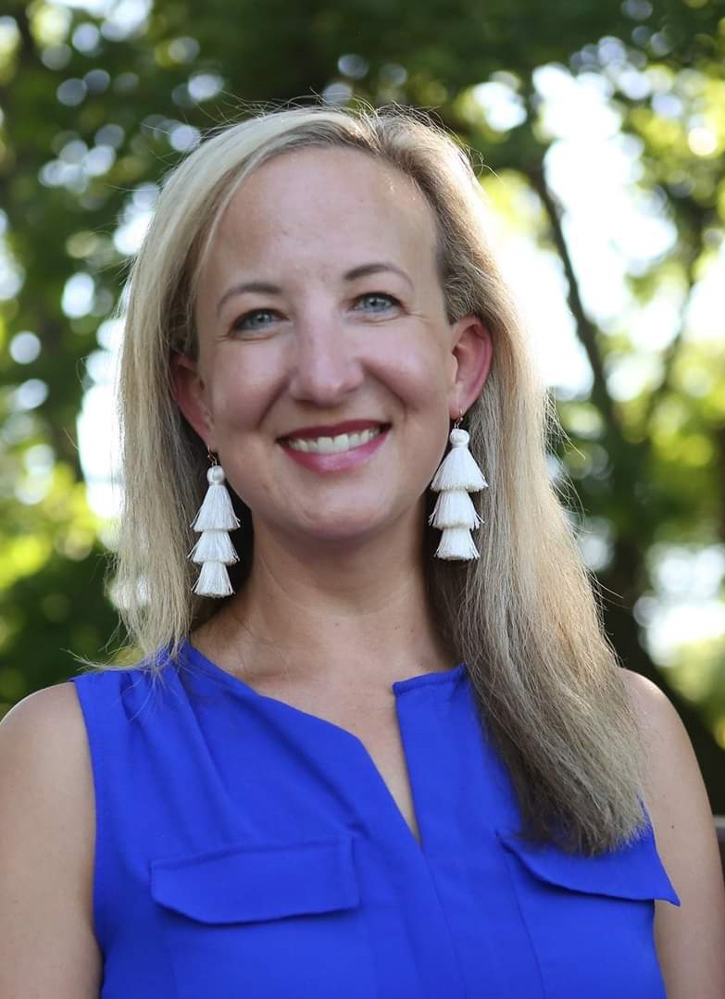
Today’s Speakers
Keri Lipperini, MPA
Director
ONHPP, ACL
Erin Hoisington, RDN, LD
Content Director
Nutrition & Aging Resource Center
Kathryn Tucker, MS, RDN, LD
Senior Nutrition Consultant
ONHPP, ACL

Slide 4
History and a Look Back at 2022

Slide 5
The Older Americans Act (OAA)
1965
OAA is first federal-level initiative aimed at providing comprehensive services for older adults
1969
White House Conference on Food, Nutrition, & Health + OAA amendments allow model demonstration projects
1972
Congress amends the OAA with Title VII authorizing “Nutrition Program for the Elderly”

Slide 6
2022: A Look Back
Celebrate
50th SNP Celebration
Social media presence
Network resources created/updated
Social Security Administration engagement
Nutrition research agenda
Innovate
Restaurant partnership engagements
Webinar series
Innovation grants and grantee engagements
Senate Special Committee on Aging recognizes SNP
Educate
Notes:
2022: A Look Back:
Celebrate:
50th SNP Celebration
Social media presence
Senate Special Committee on Aging recognizes SNP
Innovate:
Restaurant partnership engagements
Nutrition research agenda
Innovation grants and grantee engagements
Educate:
Social Security Administration engagement
Webinar series
Network resources created/updated

Slide 7
The Resource Center Looks Back
Celebrate
Year 1 communication report
Innovate
INNU grantee capstone reports
Educate
Ageism webinar series
Inaugural INNU grantee conference
Needs assessment
Updated TA resources
Website update
Notes:
The Resource Center Looks Back:
Celebrate:
Year 1 communication report
Inaugural INNU grantee conference
Innovate:
INNU grantee capstone reports
Website update
Educate:
Ageism webinar series
Need assessment
Updated TA resources

Slide 8
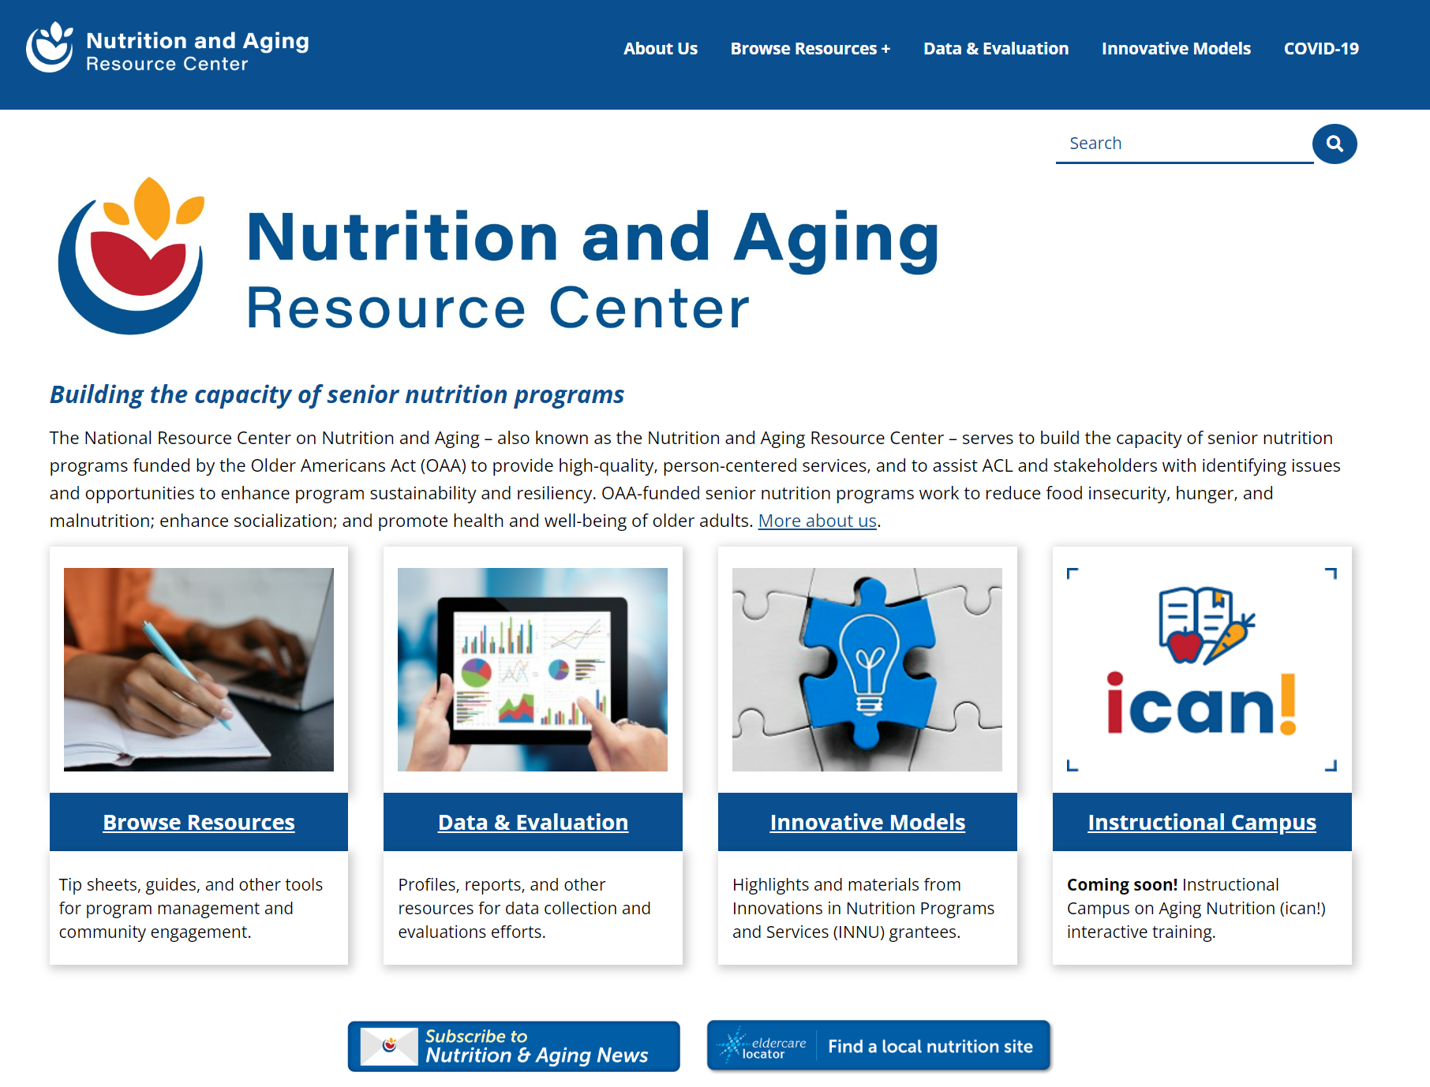
Webpage Redesign
acl.gov/senior-nutrition
Notes:
Erin to add comments

Slide 9
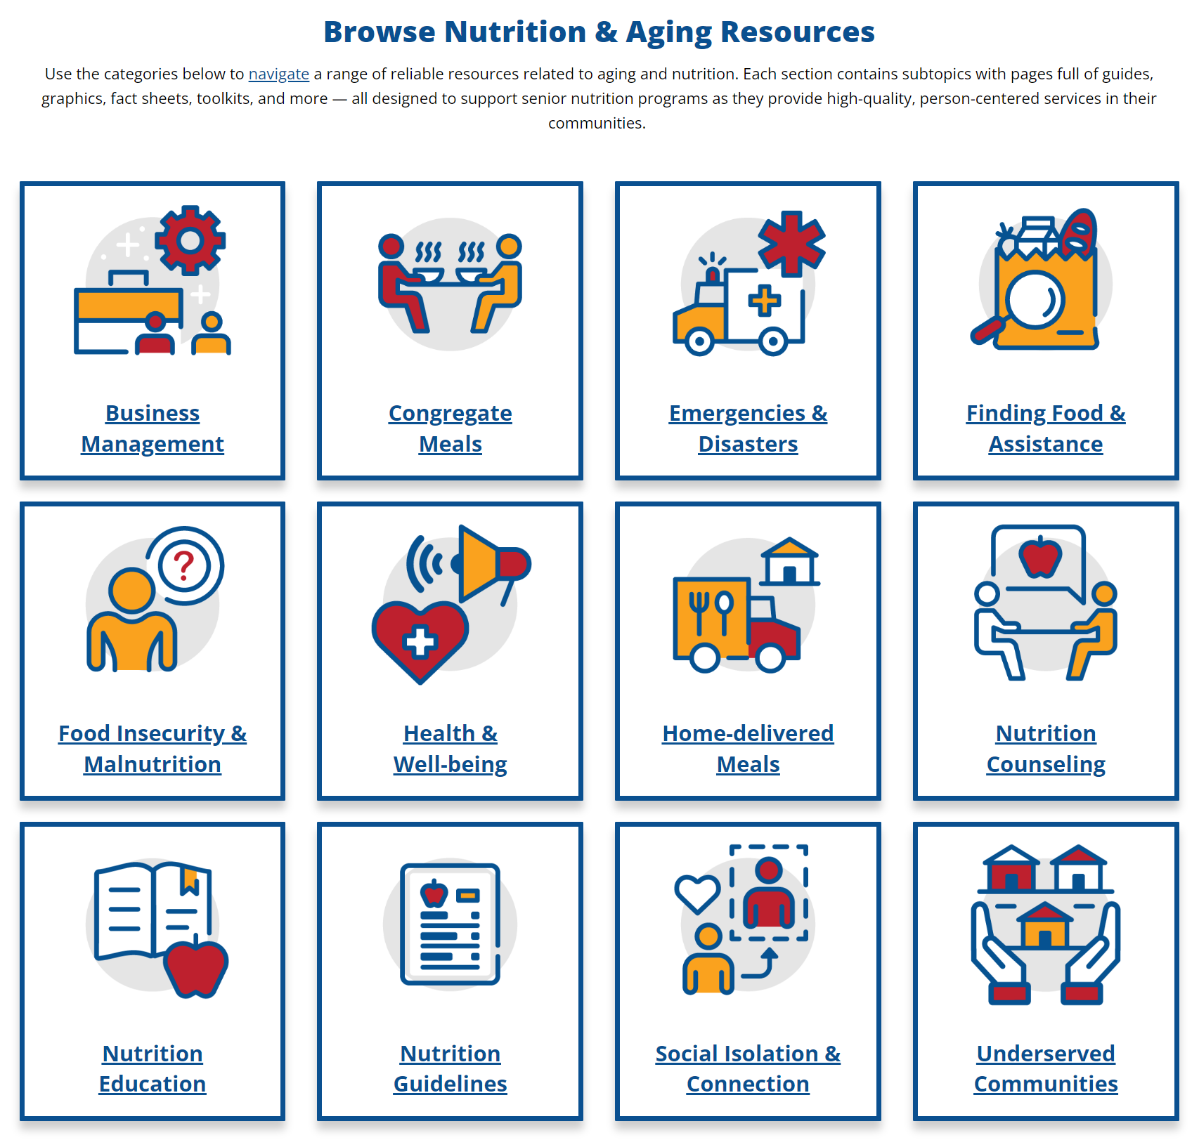
Browsing the New Resources Section

Slide 10
Partner Engagements and Highlights
Federal engagement
Food and Drug Administration
Social Security Administration
Dietary Guidelines for Americans
Internal partner engagement
Community Preventive Services Task Force

Slide 11
Looking Forward
Recipes for Success
Resource Center website work
SNP Solutions Forum
Research Agenda
SNP Celebration
Power Up Congregate webinar

Slide 12
Senior Nutrition Program Anniversary
Let’s celebrate!
March 2023

Slide 13
Trivia
What food was introduced in 1972?
a. Hostess Pudding Pie
b. McDonald’s Egg McMuffin
c. Chips Ahoy
d. Big Mac

Slide 14
2023 Theme and Logos

Slide 15
SNP Celebration Materials
Logos
Event information
Buttons/banners
Quotes
Coming soon:
Social media tools
Sample article/news release
Idea and tip sheets

Slide 16
Celebration Page
acl.gov/snp/celebrate

Slide 17
March Celebration Event
Wednesday, March 22
2:00-3:00 PM ET

Slide 18
What are you planning?
Cake and ice cream
Guest speaker
Virtual party
Social media
Proclamation
Something else

Slide 19
Next Steps
Bookmark acl.gov/snp/celebrate
Register for our March 22 event
Celebrate in your community
Use our tag #SeniorNutritionProgram
Follow @ACLgov and @AgingNutrition

Slide 20
Questions
Have a question now?
Type it in the Q&A section.
Think of something later?
Email Kathryn.Tucker@acl.hhs.gov

