Slide 1
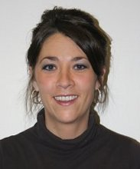
Stacie Noble
Associate Director of Aging Services Kentucky River Area Development District

Slide 2
Kentucky River Area Agency on Aging
1 of 15 Area Development Districts in Kentucky
Mission: Improve the quality of life for the citizens in our region
Serves 8 counties in southeastern Kentucky
Provides numerous OAA services

Slide 3
The Need
Coordinate food resources in the region
Assist older adults with commodities when transportation is limited
Identify and assist the underserved 60+ population
Community education on nutrition resources in the area

Slide 4
Goals
Increase awareness of SNP and food resources
Increase access to food resources
Provide education to community

Slide 5
Collaboration Matters
Representative from each county
Our regional partners include:
Senior citizen centers
Public officials
Local food banks
Farmers’ markets
Churches
Volunteers
Local restaurants and food trucks
AAA staff

Slide 6
KY River Regional Hunger Council
Food box deliveries
Distributor – Commodity Supplemental Food Program
Outreach – SNAP/Senior Farmers’ Market Nutrition Program
Educate – How to access food boxes and food resources
Transportation to receive commodity boxes
Regional Hunger Conference to educate the community

Slide 7
Outreach
Developed flyer
Distributed to local senior housing sites
Senior centers posted the flyer on social media
AAA posted flyers on social media
Public service announcements on local radio stations

Slide 8
Outreach Flyer

Slide 9
Collaboration Outcomes
Identified high population and low participation
Pop-up sites one day a week at different locations
Served 20 to 40 additional seniors in each county
Possible expansion to come

Slide 10
Food Boxes
Identified lack of transportation to access commodities
Senior center directors made connections (clients & senior housing)
Creative senior center staff
Arranging to receive boxes on behalf of the client
Taking boxes to those who need that service
Handing the boxes out during drive-up meal service at senior center

Slide 11
Regional Nutrition Resource Directory
Developed Resource Directory
Food resources
Contacts
Senior centers and case managers distributed
Posted on our AAA Facebook

Slide 12
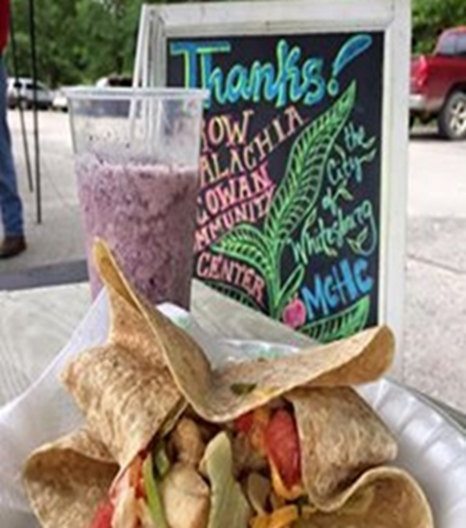
Senior Farmers’ Market Meals: Letcher County
Thursday night and Saturday morning meals
30 new participants served
Voucher cards monthly
Menus approved by SUA dietitian
Partner – local vendor to produce the meals
Partner helped increase participation
New updates

Slide 13
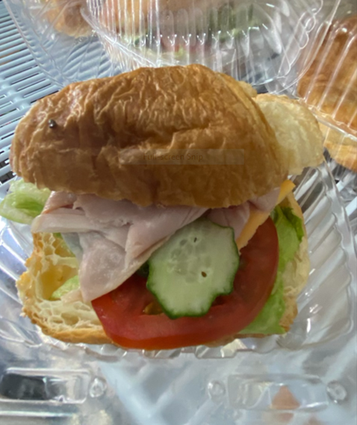
Senior Farmers’ Market Meals: Lee and Breathitt Counties
Wednesday night and Saturday morning meals
40 new participants served
Voucher cards issued monthly
Menus approved by SUA dietitian
Partner – Food truck vendor to produce meals
Partner helped increase participation
New updates

Slide 14
For more information, please contact Stacie Noble at 606-436-3158 or stacie@kradd.org

