Slide 1
Perfect Pitch! Marketing to the Healthcare Industry
Sharon R Williams,
Williams Jaxon Consulting, LLC
March 15, 2017

Slide 2
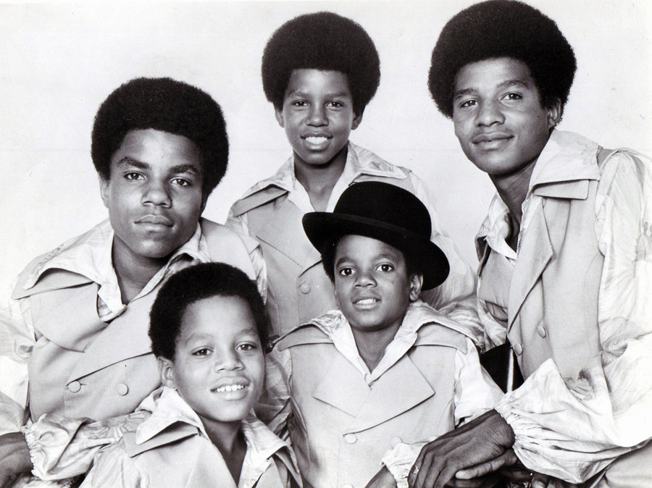
Learning Objectives
Understand critical issues for key decision makers within specific health care organizations
Tuning your value proposition for these diverse audiences
Managing standard objections

Slide 3
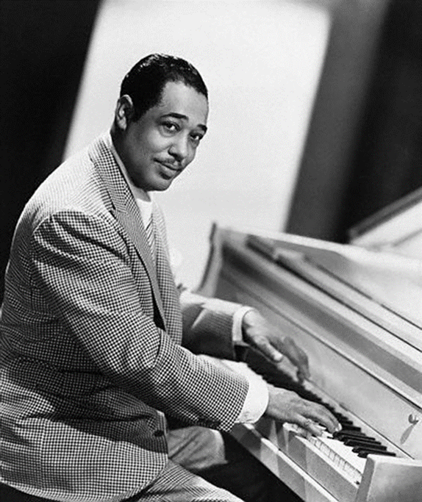
What’s The Tune, June?
Value-Based Payment (VBP) is a strategy used by purchasers to promote quality and value of health care services. The goal of any VBP program is to shift, from fee-for-services, volume related payments, to payments tied to performance/quality outcomes.

Slide 4
Band Notes
Value propositions should reflect a thorough assessment of your service/product(s)
Align your presenters with the folks to whom you are speaking, e.g., dieticians, nurses, case managers, finance administrators
Multiple initial presentations within an organization may be required

Slide 5
House of Blues… what’s keeping them up at night?
Membership
Activation/Compliance
Retention/growth
Satisfaction
Regulatory/ Industry
Accreditation
Contract standards
Performance
Profitability
Quality
Benchmarks
Outcomes
Rewards/Penalties
Cost containment
Reduction of institutional care
Reduction of Emergency Room utilization
Value and Performance Based pricing
Medical Loss Ratio

Slide 6
Diverse Genres, Common Themes
There is alignment among traditional healthcare organizations:
Health plans utilize provider, hospitals, nursing homes, CBOs, etc., to deliver care
ACO networks include hospitals, providers, CBOs
Hospital systems include home health, specialty providers, pharmacies and other ancillaries
Primary Care Providers (PCP) roles as principal care coordination hubs are expanding − nutrition assessments, treatment of mild behavioral health conditions, etc.

Slide 7
Is This the Right Music for this Audience?
Have you researched the organization’s needs/issues?
Do you understand the perspective/responsibility for achieving organizational success for the person to whom you are selling?
Are your value propositions aligned with organizational needs?
Can you demonstrate the capacity of your products/services to meet the organization’s needs?

Slide 8
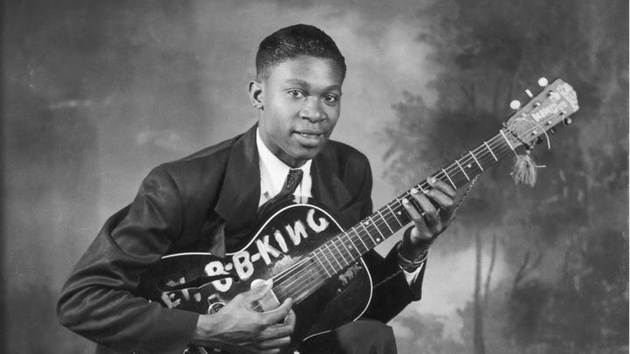
Whose Blues Are You Singing?
Provider Practice
Practice Administrator
Medical/Clinical Director
Case Management Team
Health Plans
Clinical/Case Management/Quality Leaders
Contract administrators/liaisons
(primarily Medicare/Medicaid products)
Marketing/Community Team
Financial Administrators
Hospitals
Clinical Director
Discharge Planning Team
Insurance Program Administrator
Special Program Administrator (e.g., ACO, clinical trials, etc.)
ACOs
Project Director
Clinical/Quality/ Administrators
Outreach Team
Finance Leader
Case Management Team

Slide 9
Don’t Stop the Music! Common Objectives
Cost
Medical Loss Ratio algorithm
Efficacy
National and local data
Evidence Base Practices/Accreditation
Data! Data! Data!
HIPAA
CBO Capacity
Is your infrastructure ready for this?
Alternative Resources

Slide 10
Is Your Orchestra Ready?
Selection of your spokesperson(s)
Presenting the right information
Pump up the volume!

Slide 11
THANK YOU!!!
Sharon R. Williams
Chief Executive Officer
Williams Jaxon Consulting, LLC
sharonr.williams@comcast.net
313-516-3326

