Slide 1

Title Slide Option A
Supporting Grandparents Raising Grandchildren
Advisory Council Meeting
September 15, 2020

Slide 2
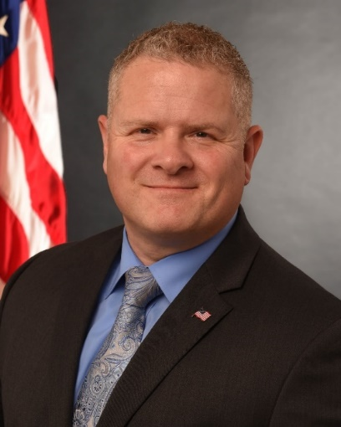
Call to Order
Lance Robertson
Administrator/Assistant Secretary for Aging
Administration for Community Living

Slide 3
A Message from the HHS Secretary
Secretary Alex Azar
U.S. Department of Health and Human Services

Slide 4
Council Chair Opening Remarks
Lance Robertson
Administrator/Assistant Secretary for Aging
Administration for Community Living

Slide 5
Roll Call

Slide 6
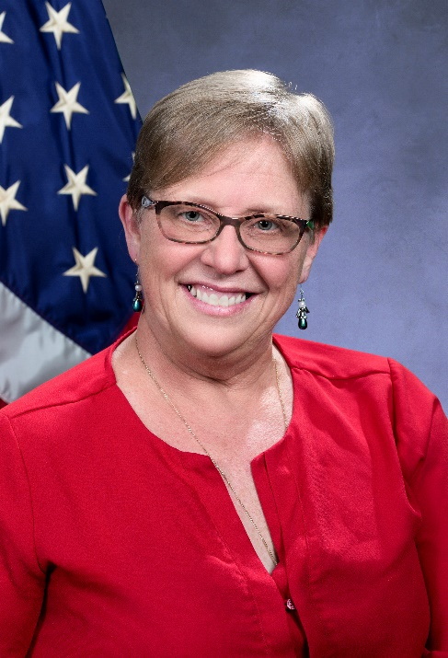
Agenda Overview
Lori Stalbaum
Office of Supportive and Caregiver Services
Administration for Community Living

Slide 7
Agenda Overview and ACL Updates
1:00-1:40 SGRG Request for Information (RFI) Analysis Findings
1:40-3:20 Report to Congress: Recommendations Discussion
3:20-3:30 Wrap Up & Next Steps

Slide 8

SGRG Request for Information (RFI) Analysis
Wilma Brockington-Parker, MBA, SPHR, PCC

Slide 9
RFI Analysis Purpose and Outcomes
Identify issues and trends facing grand and kinship families from various sources including but not limited to:
  Public and private stakeholders and entities,
  Tribal organizations, and
  Individuals and families impacted by the opioid crisis
Identify key takeaways to be included to the initial Report to Congress as required by the Supporting Grandparents Raising Grandchildren Act of 2018.

Slide 10
RFI Analysis Purpose and Outcomes (cont.)
Provide recommendations and resources to support grand and kinship families
Provide a framework for the Advisory Council to manage and take meaningful actions/activities to support grand and kinship families and other caregivers.
Focus on solutions

Slide 11

Acknowledgements
Respondents to the Request for Information
The SGRG Advisory Council
  Special thanks to:
    Amelia Karraker, Ph.D
    Beverley Yang
    Carmen Sanchez
    Charlotte Stephenson
    Gail Engel
    Michael Herndon
    Sonya Begay

Slide 12
Analysis Report Limitations
Limited demographic data (not specifically requested as a part of the RFI)
Request for information was pre-COVID-19
Use of acronyms for organizations and benefits (some challenging to identify)
In some cases, no specific breakdown to identify the type of respondent

Slide 13
Responses
Response Categories | # of Responses | Percentages
Meet the mental/physical health, educational or nutritional needs of those for whom they provide care | 254 | 13.3%
Address other concerns such as legal assistance, financial support and affordable housing associated with this population of caregivers and care recipients | 242 | 12.7%
Maintain their own physical and mental health, and emotional and financial wellbeing | 230 | 12%
Grand families/Kinship families affected by the opioid epidemic or other substance misuse. This could include issues experienced by children who were exposed prenatally to alcohol or drugs, as well as family issues associated with substance abuse. | 204 | 11%
Native American tribes | 90 | 5%
Grandparents and other older relatives who are raising or supporting grandchildren | 268 | 14%

Slide 14
Responses (cont.)
Response Catergories | # of Responses | Percentages
Children in the care of a grandparent and/or older relative | 196 | 10%
Do you think additional federal legislation is needed to better support and serve grandparents and older relatives raising children? Please describe. | 250 | 13%
Please share any additional recommendations you have for supporting grandparents and older relatives caring for children? | 174 | 9%
TOTALS | 1,908 | 100%

Slide 15
Respondent Categories
Respondent Categories | Numbers | Percentages
Grandparents | 146 | 47.56%
Community Organizations, Government Agencies | 96 | 31.27%
Unidentified | 53 | 17.26%
Kinship Caregivers | 5 | 1.63%
Attorneys | 3 | 0.98%
Non-Relative Caregivers | 3 | 0.98%
Foster Caregivers | 1 | 0.33%
TOTALS | 307 | 100.00%

Slide 16
Primary Issues and Themes
Health, safety, and what is best for the children
Unprepared for financial pressures and consequences (i.e., housing, legal, medical, employment opportunities, childcare)
Managing physical and mental health issues
“Gatekeeper” between biological parents and the children

Slide 17
Primary Issues and Themes (cont.)
Not having appropriate, affordable and/or supportive advocacy
Issues are multifaceted, variable and intertwined
They don’t know what they don’t know (i.e., resources, advocacy, financial support)

Slide 18
Areas of Concern for Respondents
Issues and Examples | Frequency | Percentages
Finances (fixed income, additional expenses, insurance costs, unable to work) | 581 | 20.91%
Legislation/Laws (laws more favorable to biological parents, child benefits not transferrable) | 289 | 10.40%
Legal Assistance (high costs, expensive adoption process accessibility) | 271 | 9.76%
Schools/Education (special needs not adequately addressed, lack of school system support) | 266 | 9.58%
Addictions (cycle of drug usage, resources for biological parents, impact on children) | 241 | 8.68%
Housing (affordability, limited space, repairs/ maintenance, children not accepted at 55+ communities, custody orders preventing relocation,) | 215 | 7.74%

Slide 19
Areas of Concern for Respondents (cont.)
Issues | Frequency | Percentages
Food/Nutrition (costs, nutritional value, special diets) | 213 | 7.67%
Childcare (high costs) | 195 | 7.02%
Respite (affordability, availability, quality) | 156 | 5.62%
Physical Health (disabilities—children and caregivers) | 145 | 5.22%
Mental/Emotional Health (stress, loss of social relationships, child trauma, separation, lack of support, grief) | 105 | 3.78%
Medical/Health (caregivers place their health after children, lack of self-care, children’s medical issues) | 101 | 3.64%
TOTALS | 2,778 | 100.00%

Slide 20
Roadblocks to Obtaining Support
Age limitations for support (i.e., 60+)
Statute language not correlating with federal law giving caregivers the right to be heard in hearings concerning children/lack of compliance with federal laws
Challenging/difficult for caregivers to comply with licensing requirements for foster families
Lack of food stamps, child only public assistance, Medicaid, school breakfast/lunch

Slide 21
Roadblocks to Obtaining Support (cont.)
If custody is not relinquished to the state, there is no support benefits/services
Affordability – special needs childcare
Inconsistencies in support can vary by location
Long waiting periods for assistance (i.e., 7 years)

Slide 22
Roadblocks to Obtaining Support (cont’d)
Lack of or challenging to find information about available resources (they don’t know what they don’t know--resources, advocacy, financial support)
Lapse in medical coverage--delays in getting counseling
Not feeling advocated for by state agencies
Lack of knowledge about the “new generation”

Slide 23
In Their Own Words…Financial Concerns
“I don't qualify for any support, but I need assistance, and guidance to create a job that would allow me to make money and be able to make my own schedule to take care of the child. I believe I'm capable of doing it. However, I need financial support.”
“I've done research to try to get financial assistance and I got no where. They also told me we don't qualify for food stamps, which I don't understand because I'm taking care of my grandson and I'm disabled, and my husband is 63 and disabled.”

Slide 24
In Their Own Words…Financial Concerns (cont.)
“… I am desperate for help. I receive $271 for TANF, and $308 food assistance each month. That is it. I have two chronic and at times, debilitating autoimmune disorders… that limit my earning potential, greatly, not to mention issues with affordable childcare and available hours applicable to my job hours. It feels as though I (which affects their quality of life too) am being punished for my decision to do the right thing…”

Slide 25
In Their Own Words…Financial Concerns (cont’d)
“Well retirement is pretty much out the window and who knows whether or not Social Security is going to be there anymore if we ever do get a chance to retire some day.”
“We are the new poor. I give up medications to have money to take care of my two granddaughters.”

Slide 26
Financial Recommendations
Increase knowledge of available resources from state, federal and community-based organizations
Provide resources for adoption
Partner with community-based organizations and utility companies (grants, scholarships, home repairs, energy assistance, etc.)
Partner with Workforce Development agencies for job training

Slide 27
Financial Recommendations (cont.)
Connect with pro-bono attorneys and legal clinics
Connect with churches and food pantries
Provide training for advocates to better support impacted caregivers
Webinars and teleconferences

Slide 28
In Their Own Words…Mental and Physical Concerns
“Unfortunately, grandparents put themselves last as far as taking care of their overall health and financial well-being. More needs to be done in the area of respite care services for grandparents raising grandchildren.”
“It's hard to take on grandchildren at our age. We can not retire or take a break. If so, who or how are these kids going to survive?”
“The children that were exposed to drugs are growing up with medical and educational issues.”

Slide 29
In Their Own Words…Mental and Physical Concerns (cont.)
“If you could have seen his little face when she had him in the car screaming at us, ‘You’re never seeing him again!’ He was crying, screaming, kicking and banging his little head trying to get out of that car seat to get to us, you would have thought I was his mom! He’s 20 something now and has lots of depression and still can’t get over the mental abuse he went through. He is not doing so well but he’s a good person. Plus now we try to help him when he needs something. ”

Slide 30
Recommendations to Improve Mental and Physical Well-being
Locate opportunities for individual and group therapy (schools, organizations, private)
Connect with existing support/solutions groups
Connect with community and health organizations specializing in support including substance abuse
Provide additional training and support to teachers, social workers and other advocates about mental health conditions
Webinars and teleconferences

Slide 31
In Their Own Words…Housing Concerns
“There is no public housing assistance in my county. I can't move because of the custody orders.”
“As we age, it's getting more difficult to take care of tasks such as lawn care, home repairs, etc. Senior housing doesn't allow for grandkids to live with the grandparents on a long-term or permanent basis.”
“Some of our members have needed to move into larger homes to be able to take in the relatives and this creates a financial burden since affordable housing is hard to find that takes in multi-generational families.”

Slide 32
In Their Own Words…Housing Concerns (cont.)
“Financial assistance for needy families should be available to all grandparents raising grandkids. Affordable housing somehow... we have no Section 8 housing per say. We have one complex with reduced rent but at my low income on Social Security, I can’t meet their requirement for ratio of income to rent. I'd have to make more money and that would take me out of income-based apartments.”

Slide 33
Housing Recommendations
Partner with community-based organizations and private industry (i.e., Habitat for Humanity, local businesses with philanthropic values)
Advocate for housing communities specifically for kinship families, grandfamilies and other caregivers
Provide information from utility companies for grants and subsidies (i.e., fuel funds, water consumption subsidies)
Partner with home buyer advocacy programs
Webinars and teleconferences

Slide 34
In Their Own Words…Native American Tribal Concerns
“It’s impossible trying to get anything done if one of the bio parents is part of a Native American Tribe. Attorney General wouldn't follow thru with child support.”
“Organizations need to become more educated on the norms of the many tribes in order to better assist Native Americans.”
“In Arizona, there are 22 Native American Tribes … we are working toward providing consistency of grandparent services amongst the Tribal entities.”

Slide 35
In Their Own Words…Native American Tribal Concerns (cont.)
“As a social worker assisting families (grandparents that have become the placement of children taken into the care and control of a Tribal court), I have found it is very difficult for some grandparents to get financial assistance (TANF & Medicaid for the children in question). This needs to be simplified at a higher level so that each state (and local counties) don't hinder this group from accessing much needed resources to take care of these children.”

Slide 36
Native American Tribal Recommendations
Educate advocates, social workers, etc. about nuances and norms related to Native American Tribal communities
Maintain family unity to reduce risks for suicide, incarceration (consider health, safety, etc.)
Encourage consistency for support among Tribal communities
Create and enhance collaborative partnerships between tribal, state and private agencies in an effort to improve services in the Tribal communities.
Provide resources for suicide, drug and alcohol prevention

Slide 37
Native American Tribal Recommendations (cont.)
More support services—after school care, skill education
Advocate for placing children in Native homes
Advocate for easier process for resources (i.e., TANF & Medicaid)
Encourage participation with established programs

Slide 38
RFI Question: Do you think additional federal legislation is needed to better support and serve grandparents and older relatives raising children?
Responses | Number | Percentage
Yes | 238 | 77.52%
No | 9 | 2.93%
No Response | 60 | 19.54%
TOTALS | 307 | 99.99%

Slide 39
In Their Own Words…Legislative Concerns
“I've spent well over $50,000 in legal fees to keep my granddaughter safe from a broken juvenile system that only promotes "reunification.”
“Additional federal legislation is needed and it needs to be uniform across the nation. Depending on which state you are in determines how the caregiver and the child is treated as far as finances. If a child is in need of a safe and stable home, then there should be one plan or guideline no matter where you live. I think the caregiver should have some representation on behalf of the caregiver. Currently caregivers have no voice.”

Slide 40
In Their Own Words…Legislative Concerns (cont.)
“We need laws updated addressing this crisis. We need timeframes for parents to step up or out of these children's lives and stop emotionally destroying them. We need legal assistance. Laws need to be changed and followed. In my case, I had 2 years abandonment and the bio mom was basically forced to see her child by the judge. Parents in and out of jail and prison, positive drug tests, mental/emotional abuse to the child.....none of that mattered. System is more than broken.”

Slide 41
Recommendations for Legislation
Partner to create legislative caucuses in every state to mobilize legislative support for caregivers
Partner with organizations for additional studies
Increase funding for support at the federal level
Create targeted tax breaks for caregivers
Update Social Security laws to include additional dependents
Require biological parents to pay child support

Slide 42
Recommendations for Legislation (cont.)
Advocate for same rights as adoptive parents
Partner with law schools for legal assistance
Strengthen grandparent visitation rights laws in addition to encouraging mediation for kinship caregivers with families that are in conflict.
Advocate for financial support to follow the child
Extend existing laws to include Grand and Kinship families and other caregivers
Webinars and teleconferences

Slide 43
General Recommendations
Create a “one-stop shop” for resources
Toll-free resource hotline; 211 resources
Database to include vetted resources on website
Learn and harness best practice strategies from community-based organizations and state agencies (i.e., Kinship Navigator programs, Kinship Councils)

Slide 44
General Recommendations (cont.)
Pilot some strategies; expand and roll out based on success rate and feedback from targeted population
Partner with community-based organizations to sponsor resource fairs and on-line summits (i.e., local libraries, churches, colleges/universities)
Encourage use of existing resources (build vs. create); enhance funding

Slide 45
Additional Support Systems
Develop an “app” for resources
No cost computers and tablets from private industry
Develop a list of presenters who can provide solutions and present timely topics to a variety of impacted caregivers
Post tips and strategies on social media and YouTube

Slide 46





Summary of Recommended Resources
337 Resources
201
Programs
78
Publications
39
Research Articles
13
Books
6
Videos

Slide 47
Questions?

Slide 48
Report to Congress: Recommendations Discussion

Slide 49
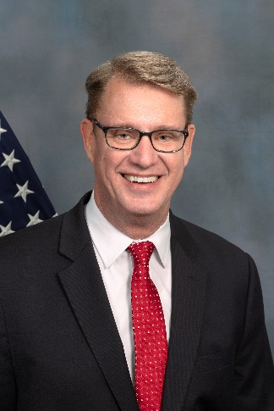
Wrap Up & Next Steps
Greg Link, Director
Office of Supportive and Caregiver Services
Administration for Community Living

Slide 50
Thank you

