Slide 1
The President’s Committee for People with Intellectual Disabilities (PCPID)
September Meeting
September 26-27, 2024

Slide 2
DAY ONE: THURSDAY, SEPTEMBER 26

Slide 3
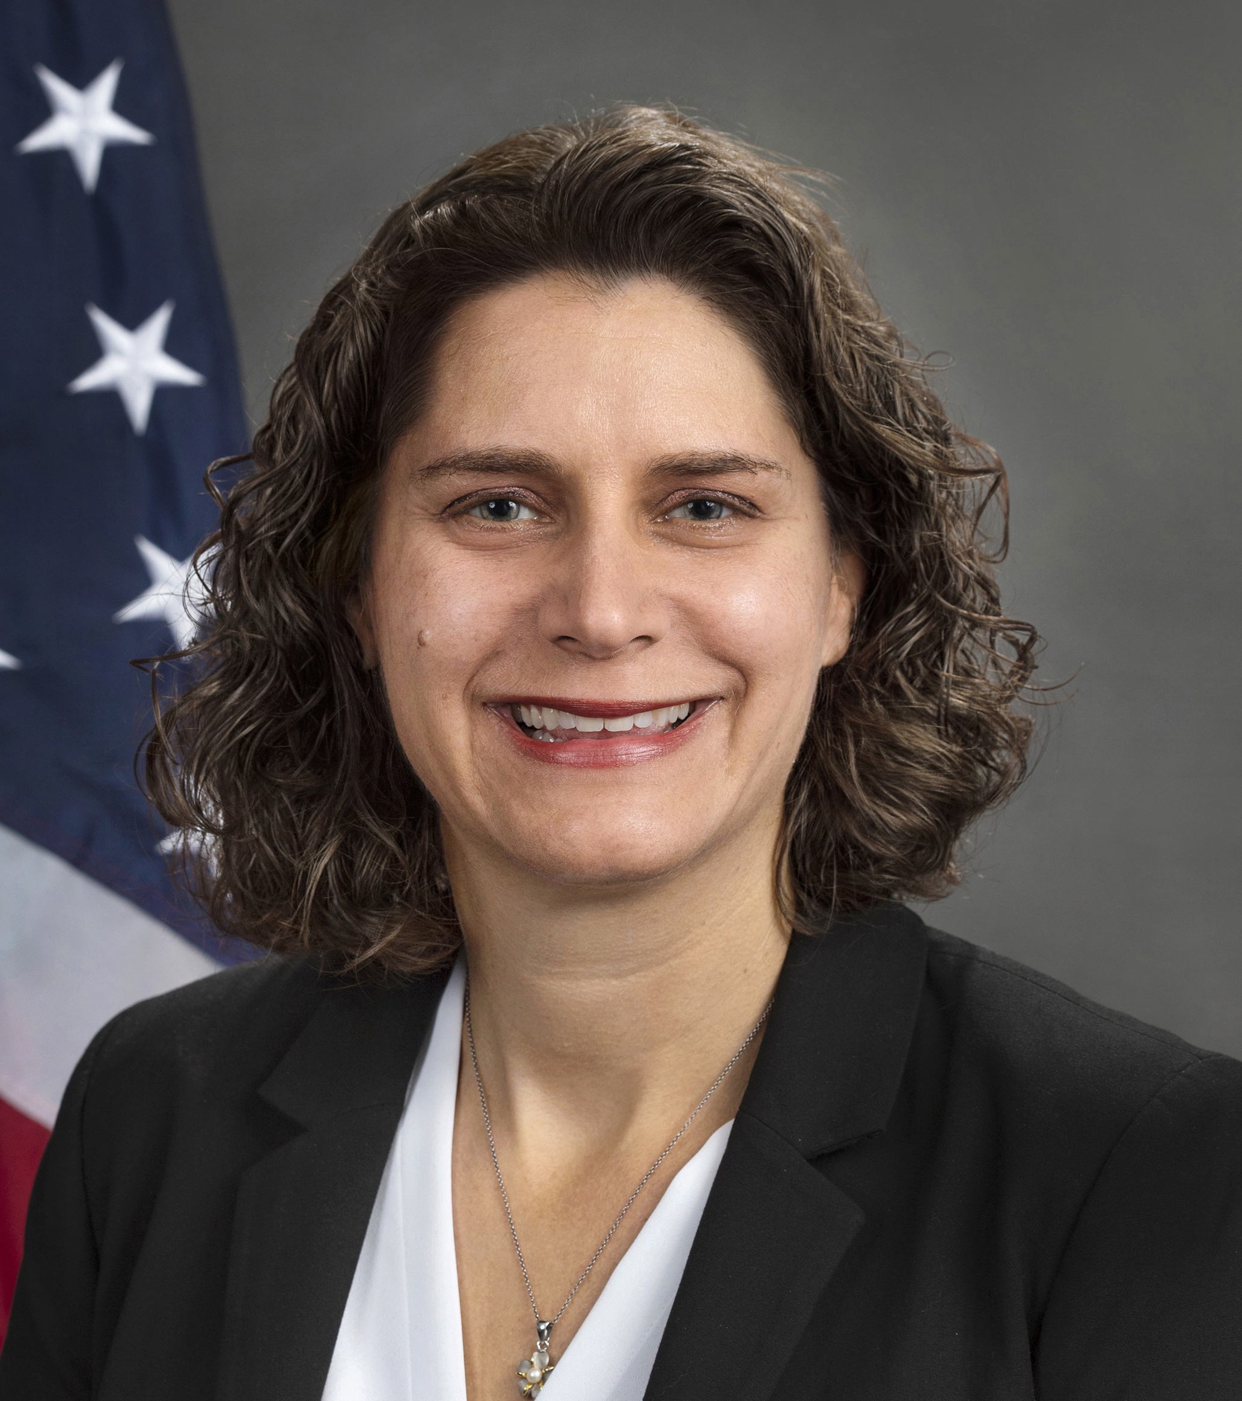
Alison Barkoff Performing the duties of ACL Administrator and Assistant Secretary for Aging
Remarks from Administration for Community Living

Slide 4
Rachel Patterson Director of Disability Policy
Remarks from The White House Domestic Policy Office

Slide 5
Jim Brett PCPID Chair
Remarks from PCPID Chair

Slide 6
PCPID 2024 Report to the President
Diana Caldwell
Vice President
The Lewin Group

Slide 7
Advancing Independence and Community Integration for All: Supporting Individuals with Intellectual Disabilities Through High-Quality Home and Community-Based Services
President’s Committee for People with Intellectual Disabilities September 26, 2024
Diana Caldwell, The Lewin Group
The President’s Committee for People with Intellectual Disabilities Report to the President

Slide 8
Background
The PCPID aims to improve the quality of life for individuals with intellectual and developmental disabilities (I/DD) by promoting independence and community inclusion. The PCPID report focuses on four areas that lead to high-quality home and community-based services (HCBS).
The PCPID met on July 28, 2022, and reached a consensus to focus on HCBS in the 2024 report. The PCPID formed four workgroups that:
Identified key policy challenge
Assessed current federal investments
Developed federal recommendations
Learned about promising practices at the local and state levels
The PCPID collected public comments and gave opportunities to provide feedback through submission on the PCPID website and through written comments in advance of each public meeting held in 2022, 2023, and 2024.

Slide 9
PCPID Priority: High-Quality Home and Community-Based Services
The PCPID prioritized four key areas:
Direct support professionals (DSP) and the DSP labor shortage crisis
Employment and how employment of people with I/DD can be supported to advance competitive integrated employment (CIE) in communities
Community living and the additional critical supports to promote independence and community inclusion in the areas of housing, safety, technological supports, and transportation
Federal supports and the impact of federal public entitlement programs, like Supplemental Security Income (SSI), Medicaid, and Medicare

Slide 10
Cross-Cutting Principles
Enhance self-advocacy: Invest in opportunities for people with disabilities to speak up for their needs.
Promote person-centered planning and thinking: Focus on individual preferences and inclusivity.
Ensure equity: Make sure everyone, especially those facing extra barriers, can access services.
Individualize supports: Offer flexible care options tailored to each person.
Create seamless navigation: Make it easier to find and use services. Build upon the No Wrong Door System initiative to simplify access to long-term services and supports for individuals with I/DD.
Leverage technology: Utilize the Technology First framework to enhance care and support.

Slide 11
Focus Area 1: DSP Challenges
Shrinking supply and growing demand of DSPs
The population is aging while the potential pool of both paid and unpaid caregivers is expected to remain stagnant. Current turnover rates exceed 40% and average vacancy rates are over 20%. The predicted increase in demand and stable supply of potential DSPs will exacerbate current shortages (American Network of Community Options and Resources, 2023).
A high turnover rate is well documented in the DSP workforce (Bogenshutz et al., 2014; Braddock & Mitchell, 1992; Larson, Lakin & Bruininks, 1998; Larson et al, 2005; ANCOR, 2010; Hewitt et al., 2015).
Lack of professionalization of the DSP workforce
Federal regulations are largely silent about the pre-service and in-service training necessary for DSPs.
Many states have not adopted competency standards.
Certified nursing assistants (CNAs) and home health assistants (HHAs) often benefit from higher wages and increased visibility due to the credentialed nature of their work.

Slide 12
Focus Area 1: DSP Federal Policy Recommendations
Recommendation 1.1: Develop a professional career pathway for the DSP workforce
Create a unique professional identity and labor category recognizing DSPs.
Establish professional standards.
Develop national career ladders and credentialing opportunities.
Recommendation 1.2: Build a robust DSP pipeline for the future
Initiate and advance wage parity.
Engage federal and state-level workforce and economic development initiatives.
Enhance marketing and recruitment to expand the pool of workers.
Recommendation 1.3: Diversify workforce solutions to adequately meet the growing demand for HCBS
Leverage technological solutions.
Offer guidance and technical assistance to ensure strong self-direction models.

Slide 13
Focus Area 1: DSP Spotlights
Innovation Spotlight – E-Badge Academy
Through the National Alliance of Direct Support Professionals’ (NADSP) E-Badge Academy, DSPs, and Front-Line Supervisors (FLSs) can get credit for competency by achieving stackable electronic badges, or e-badges, which can then be used to attain nationally recognized NADSP Certification. 29 states have enrolled and more than 10,000 professionals have had 118,700+ e-badges reviewed, with more than 4,220 applying those e-badges to achieve NADSP Certification.
Human Spotlight – BJ Stasio’s Story
BJ is the co-vice president of the board of directors of the Self- Advocacy Association of New York State (SANYS) and has been employed by the New York Office for People with Developmental Disabilities for over 20 years. During the COVID-19 pandemic, BJ was faced with a choice to either stay in bed or sleep in his chair to continue with his daily activities. He slept in his wheelchair for over two years so he could continue working. Currently, BJ has DSP services and is grateful for their support each day. BJ described how he has stopped strangers in grocery store asking if they would like to work as a DSP in supporting him due to labor shortage in his community.
“I am simply seeking a ‘hand up’ to live the life I want to lead, I’m not looking for a handout from the government.”

Slide 14
Focus Area 2: Employment Challenges
Lack of adequate publicly funded employment supports
Inconsistent state and federal funding for employment and job programs.
More Medicaid HCBS funding spent by states on day habilitation and sheltered work ($500 million) than supporting individuals with I/DD in CIE ($100 million) (Zalewska, A., Winsor, J., & Butterworth, J., 2023).
Lack of adequate customized employment supports by many state HCBS waiver programs despite more than two decades of documented evidence.
Limited private-sector employment opportunities
Lack of funding to scale and sustain inclusive apprenticeship, internship, and integrated work-based learning opportunities for individuals with I/DD.
Lack of sustained funding streams to cover additional specialized training and continual on-the-job supports.
Lack of employer familiarity with federal antidiscrimination requirements.
Fear among employees with I/DD and their families that having an income from a job will jeopardize their eligibility for health care and other essential benefits.
Little emphasis on promoting entrepreneurship and small business development
Rate of self-employment and small business development among people with disabilities nearly twice that of people without disabilities (National Disability Institute, 2022).
Lack of targeted technical and programmatic assistance as well as outdated attitudinal norms.
Lack of federal investment in training, funding, and programming, and lack of data focused on entrepreneurs with disabilities.

Slide 15
Focus Area 2: Employment Federal Policy Recommendations
Recommendation 2.1: Build employer capacity to recruit and retain workers with I/DD
Establish a national clearinghouse of employer resources.
Increase access to inclusive apprenticeships, internships, and work-based learning opportunities.
Offer and leverage federal tax incentives to encourage employers to hire, support, and retain workers with I/DD through customized employment, job carving or matching, supported employment, and job accommodations.
Strengthen existing efforts to prevent and eliminate workplace discrimination against individuals with I/DD.
Engage employers about the business benefits of hiring workers with disabilities.
Recommendation 2.2: Establish and invest in a federal CIE policy
Issue an executive order in the first 100 days of the publication of the PCPID report to establish a federal policy to promote CIE for individuals with I/DD.
Prioritize CIE as the preferred outcome of employment services.
Include additional investments in the president’s budget to elevate the focus on CIE outcomes for Native Americans and Alaska Natives with I/DD living in or near Indian Country and Alaska Native Villages.
Recommendation 2.3: Build the capacity of entrepreneurs and small business innovators with I/DD
Provide federal funding to support training, technical assistance, and resources to specifically aid small business owners and entrepreneurs with I/DD.
Establish a dedicated role to support entrepreneurs with disabilities.

Slide 16
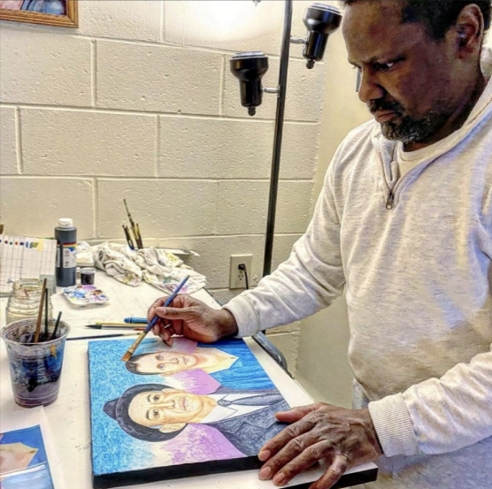
Focus Area 2: Employment Spotlights
Human Spotlight – Paul’s Story
Paul, who has intellectual and developmental disabilities and is deaf and legally blind, worked as a cart attendant for 16 years. After a manager fired Paul due to issues with his use of a job coach, Paul filed a complaint with the Equal Employment Opportunity Commission. A lawsuit followed, and the court found that the employer violated the Americans with Disabilities Act (ADA), awarding Paul $5 million in punitive damages, which was later reduced, along with additional compensation for lost wages.
Human Spotlight – Alton’s Story
Alton began drawing at 14 and developed his artistic skills through a day program and classes at Rhode Island School of Design. With support from the Rhode Island Developmental Disabilities Council (RIDDC), he expanded his work and founded his business, Alton Stuckey Portraits & Beyond, in 2019. Alton now sells his multimedia artwork online, at shows, and through his church, advocating for more self-employment programs. His advice to
others is to stay persistent
and believe in their abilities.

Slide 17
Focus Area 3: Community Living Challenges
The PCPID examined four elements within the focus area of community living:
Housing
Safety
Technology Support
Transportation
Safety
Inconsistent regulations to protect individuals with I/DD
Higher risk of spreading health conditions
Lack of emergency preparedness training for providers
Limited access to health and safety education
Technology Support
Limited access to technology
Limited funding to support technological advancements
Disparities in accessible communication
Transportation
Lack of accessible transportation
Lack of training for navigating public transportation
Limitations on the use of non-emergency medical transportation (NEMT)
Housing
Difficultly navigating systems
Lack of affordability
Exclusion from desirable areas
Lack of information about housing during the transition process
Segregated communities, zoning restrictions, and discrimination

Slide 18
Focus Area 3: Community Living Federal Policy Recommendations
Housing:
Recommendation 3.1: Launch a national housing education and awareness campaign
Launch a national housing education and awareness campaign on the negative impacts of rent increases.
Recommendation 3.2: Use funding to improve access to housing
Issue a joint funding announcement for Fair Housing Assistance Program and Fair Housing Initiatives Program recipients.
Designate funding to launch a joint grant program that incentivizes land use and zoning reforms.
Issue joint guidance (Department of Health and Human Services (HHS), Department of Housing and Urban Development (HUD), and Department of Education (ED) to educate individuals with I/DD on housing and HCBS options.
Increase funding for fair housing for individuals with I/DD.
Safety:
Recommendation 3.3: Promote regulations that increase protections for individuals with I/DD
Conduct studies that will strengthen adult protective services (APS) to assure greater expediency and success of complaint, investigation, and oversight processes.
Strengthen emergency preparedness processes.
Recommendation 3.4: Strengthen knowledge, education, and awareness of issues impacting individuals with I/DD
Conduct studies on how the COVID-19 public health emergency impacted HCBS for individuals with I/DD.
Ensure access to health education tailored for individuals with I/DD among school and Medicaid HCBS settings as well as state and local self-advocacy groups.

Slide 19
Focus Area 3: Community Living Federal Policy Recommendations (continued)
Technology Support
Recommendation 3.5: Revise federal regulations and guidance to promote technology advancements for individuals with I/DD
Offer technical assistance to local education agencies (LEAs).
Provide guidance on the importance of technological upgrades.
Increase HHS Office for Civil Rights and Department of Justice (DOJ) enforcement activities.
Issue additional guidance on communications accessibility.
Recommendation 3.6: Require all federal funding recipients to provide augmentative and alternative communication (AAC) as an auxiliary aid or service
Adopt a single definition of AAC.
Require AAC services if doing so does not result in a fundamental alteration or undue financial and administrative burden.
Ensure fair and equitable financing of AAC tools, methods, and support.
Transportation
Recommendation 3.7: Provide federal guidance and funding to increase transportation accessibility for individuals with I/DD
Issue guidance to reaffirm accessibility of publicly funded transit systems.
Fund infrastructure development and capacity-building innovation grants.
Revise guidance on NEMT.

Slide 20
Focus Area 3: Community Living Spotlights
Innovation Spotlight – Living Well Rights Guides
Wisconsin Board for People with Developmental Disabilities (WPDD) introduced the Let’s Talk About Rights Guides and the Know Your Rights Video Series, both designed to empower individuals with I/DD and train provider staff and families on the rights of individuals and how they can exercise those rights
The Let’s Talk About Rights Guides cover decision-making, personal freedoms, health care rights, and safety. They provide practical advice on planning, understanding one's rights, and accessing necessary supports.
The Know Your Rights video series complements the guides highlight key rights, emphasizes the importance of self-advocacy, and encourages proactive participation in one's own life decisions.
After implementing these resources at eight pilot provider sites, participants reported increased awareness of choices, rights, and opportunities for individuals with I/DD.
Together, these tools foster greater independence and community inclusion for individuals with I/DD, ensuring they are well-informed, well-equipped, and confident in exercising their rights.
Human Spotlight – Finding Home
“Finding Home (Kansas)” is an MFP Rebalancing Demonstration participant video from rural Kansas that documents the transition of a young woman from an intermediate care facility for individuals with intellectual disabilities (ICF/IID) to community placement and the use of HCBS.

Slide 21
Focus Area 4: Federal Support Programs Challenges
Income, asset, and resource limits are too low for SSI
SSI’s resource standard has been updated only once since the program’s inception in 1972 and has not increased since 1989.
Beneficiaries who exceed the limits are terminated from program participation if their savings remain above the limits, and they must repay any benefits paid while they are over the limit.
Income, asset, and resource limits are too low for most state Medicaid programs
Majority of states that have elected to cover the medically needy (34 states) impose a medically needy income level that is not greater than the SSI federal benefit rate.
Income and asset limits penalize couples wanting to get married
Individuals receiving SSI typically experience monthly benefits upon getting married that are less than the sum of two individuals’ benefits (AARP, 2022).
Lack of Medicaid HCBS portability restricts the ability of people with I/DD to move out of state
Because Medicaid HCBS cannot be transferred from one state to another, individuals with I/DD are prevented or greatly discouraged from moving to a different state.
Provider agencies are not required to report how individuals’ SSI funds are spent
Provider agencies are permitted to require residents’ full SSI payments without spending transparency. This directly contradicts one of the requirements of all Medicaid-HCBS provider settings as part of the federal HCBS regulation that “all beneficiaries must have control over personal resources.”
Medicare has a 24-month waiting period for people collecting Social Security Disability Insurance.
~1.8 million people with disabilities are waiting for Medicare. Since SSDI recipients are unable to work, they cannot access employer-sponsored insurance.
Nearly 39% of these individuals do not have health insurance coverage at some point during the waiting period, and 24% have no health insurance during this entire period.

Slide 22
Focus Area 4: Federal Support Programs Federal Policy Recommendations
Recommendation 4.1: Increase access to federal benefits
Increase SSI asset and income limits
Eliminate the Medicare waiting period
Eliminate “marriage penalties”
Recommendation 4.2: Limit provider access to individuals’ SSI funds
Establish rules for reporting SSI funds used for HCBS
Recommendation 4.3: Promote reciprocity of HCBS benefits
Allow for cross-state portability of Medicaid HCBS

Slide 23
Focus Area 4: Federal Support Programs Spotlights
Innovation Spotlight – ABLE Accounts
The Achieving a Better Life Experience (ABLE) Act, signed in 2014, authorized states to create tax-advantaged programs, or ABLE accounts, for individuals with disabilities to save and invest money. The accounts can be used for qualified disability expenses, including education, food, housing, transportation, employment training and support, assistive technology, and health care expenses.
Individuals receiving federal benefits typically must have less than $2,000 in savings, however ABLE accounts recognize the significant cost of living with a disability. To be eligible for an ABLE account, an individual must have a disability with an age of onset before turning age 26 and be eligible to receive SSI or SSDI benefits.
By providing a financial safety net, ABLE accounts empower people with disabilities to achieve greater independence and improve their quality of life.
Human Spotlight – Diana and Matt’s Story:
Can Love Conquer All…. Even SSI and Medicaid?
Diana and Matt, lifelong friends since 1982, realized their love for each other in 2009 and became inseparable, later moving into an independent living complex together.
Due to the "marriage penalty" in
Medicaid and other support programs,
Diana and Matt, as people with
intellectual disabilities, could not
legally marry without risking loss of
essential benefits. Despite this, they
held a “commitment ceremony” in
2022.

Slide 25
PART I – Surfacing the Barriers

Slide 26
PCPID Citizen Members Describing one leading barrier you are observing in your community for People with Intellectual Disabilities and their Families
Shawn Aleong, Pennsylvania
Paul Aronsohn, New Jersey
Paul Boskind, Texas
Jim Brett, Massachusetts
Kara Nicole Jones, Maryland
Nicole Jorwic, Illinois
Cathy Kanefsky, Delaware
Brent Leonhard, Washington
Joe Macbeth, Vermont

Slide 27
Break 15 minutes

Slide 28
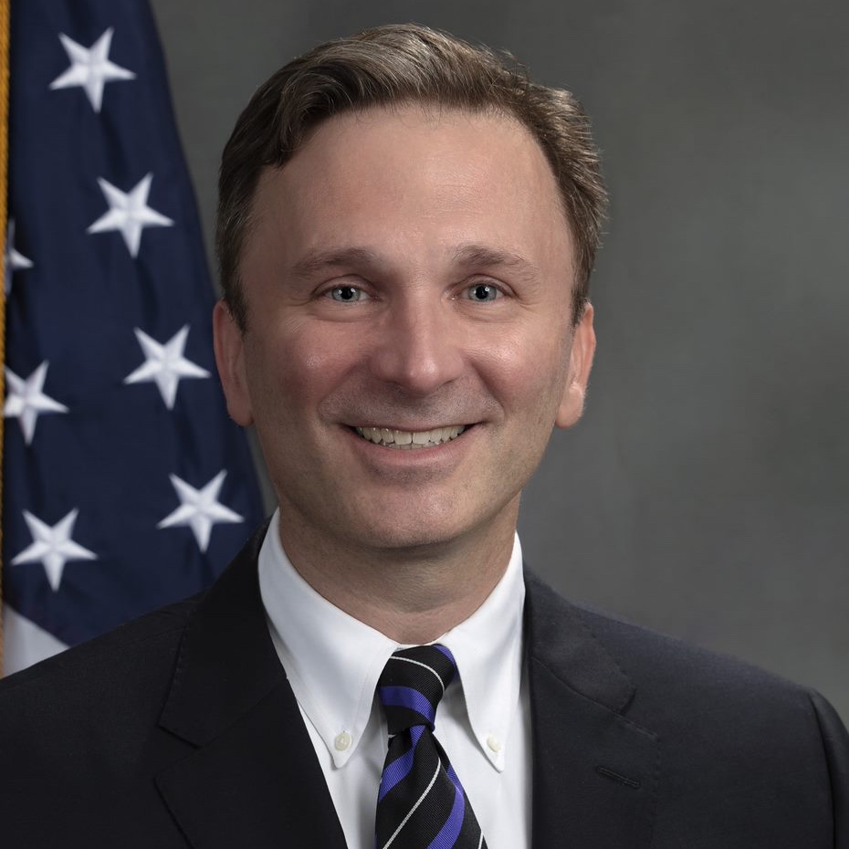
David Jones Director, Office of Intellectual and Developmental Disabilities
Summary of Public Comments Received

Slide 29
Statements from Members of the Public

Slide 30
LUNCH

Slide 31
PART II – THE CURRENT INTELLECTUAL DISABILTIY LANDSCAPE

Slide 32
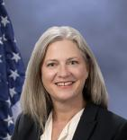
Jennifer Johnson Acting Commissioner
Remarks from Administration on Disabilities

Slide 33
Policy – Federal Regulatory Updates and Impact on I/DD Community from HHS
Section 1557 of the Affordable Care Act, Nondiscrimination in Health Programs and Activities
Dan Shieh, Associate Deputy Director, Policy Division Office for Civil Rights (OCR)
Section 504 of the Rehabilitation Act
Maggie Hart, Policy Advisor, Policy Division Office for Civil Rights (OCR)
Ensuring Access to Medicaid Services Final Rule (Access Rule)
Jennifer Bowdoin, Director, Division of Community Transitions Centers for Medicare & Medicaid Services (CMS)
Adult Protective Services (APS)
Stephanie Whittier-Eliason, Aging Services Program Specialist, Administration for Community Living (ACL)

Slide 34
Section 1557 of the Affordable Care Act, Nondiscrimination in Health Programs and Activities
Dan Shieh, Associate Deputy Director
Policy Division
Office for Civil Rights (OCR)

Slide 35
Section 1557 of the Affordable Care Act
These slides provide a brief educational summary not an independent interpretation of the Section 1557 Final Rule. To read the Final Rule visit: Federal Register :: Nondiscrimination in Health Programs and Activities
Office for Civil Rights (OCR)​ U.S. Department of Health and Human Services
Dan Shieh, Associate Deputy Director
September 26, 2024​

Slide 36
What Is Section 1557 of the ACA?
The Affordable Care Act (ACA) is a comprehensive health care reform law passed in 2010. It advanced health equity by making health care more affordable and accessible to millions of Americans.
Section 1557 is the nondiscrimination provision of the ACA. It prohibits discrimination on the basis of race, color, national origin, sex, age, and disability in certain health programs and activities.
On May 6, 2024, the HHS Office for Civil Rights (OCR) published a final rule to restore and bolster civil rights protections under Section 1557.
The prior versions were published in 2020 and 2016.

Slide 37
Who Is Covered Under the Section 1557 Final Rule?
Health programs or activities that receive Federal financial assistance from HHS.
Health programs or activities administered by HHS.
Health programs or activities administered by an ACA Title I entity (i.e., Exchanges).
Medicare Part B payments will be treated as Federal financial assistance for the purpose of triggering coverage under the Federal civil rights statutes.

Slide 38
Key Provisions of the Section 1557 Final Rule
Clarifies disability protections consistent with existing law.
Ensures people with limited English proficiency and people with disabilities can access and understand information about their health and health care.
Requires entities to establish written policies and procedures and provide staff training on the rule’s requirements.
Restores clear nondiscrimination standards for the health insurance industry.
Protects patients from discrimination on the basis of sex (sexual orientation, and gender identity, as well as pregnancy and related conditions).*
Prohibits discrimination in the use of artificial intelligence (AI) and telehealth.
Outlines a clear assurance process with regard to religious freedom and conscience protections under Federal laws.
*Please Note: Pursuant to decisions by various district courts regarding the 2024 Final Rule implementing Section 1557, entitled Nondiscrimination in Health Programs and Activities, 89 Fed. Reg. 37,522 (May 6, 2024) (“2024 Final Rule”), certain provisions regarding gender identity are stayed nationwide. Other provisions are stayed or enjoined as indicated at www.hhs.gov/1557.

Slide 39
Disability Provisions
The final rule requires those covered to:
Provide effective communication to individuals with disabilities.
Provide appropriate auxiliary aids and services free of charge and in a timely manner.
Provide reasonable modifications to policies, practices, or procedures.

Slide 40
Disability Provisions – Integration
The final rule requires those offering health insurance coverage or other health-related coverage to:
Provide coverage in the most integrated setting appropriate to the needs of qualified individuals with disabilities, including practices that result in the serious risk of institutionalization or segregation.

Slide 41
Disability Provisions – Accessibility and IT
The final rule requires those covered to:
Make their facilities accessible to individuals with disabilities and comply with applicable physical accessibility standards in the ADA.
Ensure their health programs and activities provided through information and communication technology are accessible to individuals with disabilities.
Ensure their health programs and activities provided through websites and mobile applications are accessible to individuals with disabilities by complying with Section 504 requirements.

Slide 42
How Will the Final Rule Be Implemented?
Most of the final rule goes into effect 60 days after publication on July 5, 2024.
The final rule has delayed applicability dates for certain requirements regarding updating certain Policies and Procedures; Trainings; Notices; Insurance Coverage requirements; and Use of Patient Care Decision Support Tools.

Slide 43
Resources
For more information on the Section 1557 Final Rule visit:
https://www.HHS.gov/1557
The Final Rule
Factsheet
Press Release
Frequently Asked Qs
Complaint Portal: https://www.hhs.gov/ocr/complaint

Slide 44
Section 504 of the Rehabilitation Act
Maggie Hart, Policy Advisor
Policy Division
Office for Civil Rights (OCR)

Slide 45
Section 504 of the Rehabilitation Act
These slides provide a brief educational summary not an independent interpretation of the Section 504 Final Rule. To read the Final Rule visit: Federal Register :: Nondiscrimination on the Basis of Disability in Programs or Activities Receiving Federal Financial Assistance
Office for Civil Rights (OCR)​ U.S. Department of Health and Human Services
Maggie Hart, Policy Advisor
September 26, 2024​

Slide 46
What is Section 504 of the Rehabilitation Act?
These slides provide a brief educational summary not an independent interpretation of the Section 504 Final Rule. To read the Final Rule visit: Federal Register :: Nondiscrimination on the Basis of Disability in Programs or Activities Receiving Federal Financial Assistance
Section 504 of the Rehabilitation Act prohibits discrimination on the basis of disability in any program or activity that receives Federal financial assistance.
The final rule helps ensure people with disabilities served by federally funded health and human services programs receive equitable care and treatment.
Had not been meaningfully updated since the 1970s.

Slide 47
Notice of Proposed Rulemaking
These slides provide a brief educational summary not an independent interpretation of the Section 504 Final Rule. To read the Final Rule visit: Federal Register :: Nondiscrimination on the Basis of Disability in Programs or Activities Receiving Federal Financial Assistance
On September 14, 2023, HHS OCR issued a Notice of Proposed Rulemaking to update and amend its Section 504 regulation. The comment period closed on November 13, 2023.
HHS received over 5200 comments. Commenters included regulated entities, government officials, health care professionals, people with disabilities and allies, and organizations representing various interest groups. We reviewed and considered all comments received.
On May 1, 2024 the HHS Office for Civil Rights (OCR) final rule was published and, on July 8, 2024, it went into effect, with some exceptions we will highlight today.

Slide 48
What Does the Final Rule Change?
These slides provide a brief educational summary not an independent interpretation of the Section 504 Final Rule. To read the Final Rule visit: Federal Register :: Nondiscrimination on the Basis of Disability in Programs or Activities Receiving Federal Financial Assistance
The final rule updates and modernizes the Section 504 rule prohibiting discrimination on the basis of disability.
The rule clarifies and strengthens civil rights protections for people with disabilities in areas like medical treatment, accessible web content, accessible medical diagnostic equipment, and child welfare programs and activities.
The rule advances equitable health outcomes for people with disabilities by ensuring consistency with current law and addressing newer forms of disability related discrimination.

Slide 49
Medical Treatment Provisions
These slides provide a brief educational summary not an independent interpretation of the Section 504 Final Rule. To read the Final Rule visit: Federal Register :: Nondiscrimination on the Basis of Disability in Programs or Activities Receiving Federal Financial Assistance
Discrimination on the basis of disability in accessing medical care leads to significant health disparities and poorer health outcomes for individuals with disabilities.
The final rule ensures medical treatment decisions are not based on biases or stereotypes about individuals with disabilities, judgments that they will be a burden to others, or beliefs that their life has less value than the life of a person without a disability.

Slide 50
Value Assessment Methods Provisions
These slides provide a brief educational summary not an independent interpretation of the Section 504 Final Rule. To read the Final Rule visit: Federal Register :: Nondiscrimination on the Basis of Disability in Programs or Activities Receiving Federal Financial Assistance
Value assessment methods can influence access to resources, including medications, and may lead to discrimination against people with disabilities when they place a lower value on life extension for people with disabilities.
The final rule prohibits the discriminatory use of value assessment methods and analytics.

Slide 51
Child Welfare Programs and Activities Provisions
These slides provide a brief educational summary not an independent interpretation of the Section 504 Final Rule. To read the Final Rule visit: Federal Register :: Nondiscrimination on the Basis of Disability in Programs or Activities Receiving Federal Financial Assistance
Children, parents, caregivers, foster parents, and prospective parents with disabilities may encounter discrimination in the child welfare systems designed to protect children and strengthen families.
The final rule clarifies that Section 504 applies to child welfare programs and prohibits discrimination on the basis of disability in any federally funded child welfare program or activity.
This includes decisions based on speculation, stereotypes, or generalizations about a child with a disability or to determine that someone with a disability cannot safely care for a child.

Slide 52
Web and Mobile Accessibility Provisions
These slides provide a brief educational summary not an independent interpretation of the Section 504 Final Rule. To read the Final Rule visit: Federal Register :: Nondiscrimination on the Basis of Disability in Programs or Activities Receiving Federal Financial Assistance
Technology often strengthens health and human services programs and activities, but inaccessible web content and mobile apps create barriers for people with disabilities.
The final rule implements a standard to ensure non-discrimination in the use of technologies routinely used in health care, including web content and mobile apps so that these technologies are accessible to and usable by people with disabilities.

Slide 53
Accessible Medical Equipment Provisions
These slides provide a brief educational summary not an independent interpretation of the Section 504 Final Rule. To read the Final Rule visit: Federal Register :: Nondiscrimination on the Basis of Disability in Programs or Activities Receiving Federal Financial Assistance
People with disabilities experience barriers to medical care because of inaccessible medical equipment. These barriers result in inequities and exclusion from basic health services, contributing to poor health outcomes.
The final rule adopts the U.S. Access Board’s standards for accessible medical equipment. It also requires that, within two years of the effective date, recipients that use that equipment must acquire at least one accessible examination table and/or weight scale.

Slide 54
Legislative Consistency
These slides provide a brief educational summary not an independent interpretation of the Section 504 Final Rule. To read the Final Rule visit: Federal Register :: Nondiscrimination on the Basis of Disability in Programs or Activities Receiving Federal Financial Assistance
Section 504 has received minimal updates since being implemented in 1977. The final rule improves consistency between Section 504 and major judicial and legislative developments, including the Americans with Disabilities Act (ADA).
New sections related to service animals, mobility devices, and effective communication, among others, reflect amendments to Section 504, enactment of the ADA, and significant case law and codify civil rights protections for people with disabilities.

Slide 55
Judicial Consistency- Integration Provisions
These slides provide a brief educational summary not an independent interpretation of the Section 504 Final Rule. To read the Final Rule visit: Federal Register :: Nondiscrimination on the Basis of Disability in Programs or Activities Receiving Federal Financial Assistance
The final rule reflects principles established through the Supreme Court's Olmstead decision and other significant court decisions and clarifies that services must be provided in the most integrated setting appropriate to the needs of individuals with disabilities.
The final rule helps recipients better understand and comply with their obligations under Section 504 and provides more detail about the right to be served in the most integrated setting appropriate for individuals with disabilities.

Slide 56
How will the Final Rule be Implemented?
These slides provide a brief educational summary not an independent interpretation of the Section 504 Final Rule. To read the Final Rule visit: Federal Register :: Nondiscrimination on the Basis of Disability in Programs or Activities Receiving Federal Financial Assistance
The final rule is in effect now. HHS OCR is responsible for enforcement of the rule. The complaint and enforcement process has not changed.
Complaint Portal: https://www.hhs.gov/ocr/complaint
Technical assistance support is being provided by the HHS Office of Civil Rights.

Slide 57
Resources
These slides provide a brief educational summary not an independent interpretation of the Section 504 Final Rule. To read the Final Rule visit: Federal Register :: Nondiscrimination on the Basis of Disability in Programs or Activities Receiving Federal Financial Assistance
For more information on the Section 504 Final Rule visit:
https://www.hhs.gov/civil-rights/for-individuals/disability/section-504-rehabilitation-act-of-1973/index.html
The Final Rule
Factsheet and Detailed Factsheet
Press Release
YouTube video
Stakeholder Webinar

Slide 58
Q & A

Slide 59
Connect with Us
Office for Civil Rights
U.S. Department of Health and Human Services
www.hhs.gov
Join our listservs at LISTSERV 16.5 - Subscribe or Unsubscribe to the OCR-CIVILRIGHTS-LIST List (nih.gov)
@HHSOCR

Slide 60
Ensuring Access to Medicaid Services Final Rule (Access Rule)
Jennifer Bowdoin, Director,
Division of Community Transitions
Centers for Medicare & Medicaid Services (CMS)

Slide 61
Home and Community-Based Services Provisions in the Ensuring Access to Medicaid Services Final Rule
September 2024

Slide 62
Background
The Ensuring Access to Medicaid Services final rule (Access final rule) and the Managed Care Access, Finance, and Quality (Managed Care final rule) were published in May 2024
The final rules establish historic national standards for access to care regardless of whether that care is provided through managed care plans or directly by states through fee-for-service (FFS), including by:
Establishing national maximum standards for certain appointment wait times for Medicaid and CHIP managed care enrollees
Requiring states to conduct secret shopper surveys of Medicaid and CHIP managed care plans
Requiring states to conduct enrollee experience surveys annually for each managed care plan
Establishing a framework for states to implement a Medicaid and CHIP quality rating system, a “one-stop-shop” for enrollees to compare Medicaid and CHIP managed care plans
Creating new rate transparency requirements for FFS and managed care
Strengthening how states use state Medicaid Advisory Committees
Strengthening HCBS oversight, monitoring, quality assurance, quality improvement, and payment adequacy

Slide 63
Home and Community-Based Services (HCBS) Provisions in the Access Final Rule
Background
Workforce shortages are reducing access to services and are expected to worsen in the future.
Inadequate investment in oversight and monitoring increases risks for poor quality of care and harm for people receiving HCBS.
Gaps in measurement and reporting prevent CMS and states from assessing and improving HCBS quality and outcomes and addressing racial and other disparities.

Slide 64
Overview of HCBS Provisions
Strengthen oversight of person-centered service planning in HCBS
Require states to meet nationwide incident management system standards for monitoring HCBS programs
Require states to establish a grievance system in FFS HCBS
Require that states report on the percentage of payments for certain HCBS that is spent on compensation for direct care workers
Require that a minimum percentage of payments for certain HCBS is spent on compensation for direct care workers, subject to certain flexibilities and exemptions
Require states to report on waiting lists in waiver programs and on service delivery timeliness for certain HCBS
Require states to report on a standardized set of HCBS quality measures and sets requirements for CMS to develop and update the measure set
Promote public transparency related to the administration of Medicaid‑covered HCBS through public reporting of quality, performance, and compliance measures

Slide 65
HCBS Access Provisions

Slide 66
Questions?
Send questions to HCBSAccessRule@cms.hhs.gov

Slide 67
Appendix: HCBS Provisions in the Ensuring Access to Medicaid Services Final Rule

Slide 68
HCBS Provisions: Focused on Improving Access and Quality, Promoting Health Equity, and Strengthening the HCBS Workforce
Person-Centered Service Planning and Reporting Requirements (§§ 441.301(c), 441.450(c), 441.540(c), 441.725(c), 441.311(b)(3), 441.474(c), 441.580(i), and 441.745(a)(1)(vii))
Incident Management Systems and Critical Incident Reporting Requirements (§§ 441.302(a)(6), 441.464(e), 441.570(e), 441.745(a)(1)(v), 441.745(b)(1)(i), 441.311(b)(1) and (2), 441.474(c), 441.580(i), and 441.745(a)(1)(vii))
FFS Grievance Systems (§§ 441.301(c)(7), 441.464(d)(5), 441.555(e), and 441.745(a)(1)(iii))
Waiting List and Access Reporting Requirements (§§ 441.311(d), 441.474(c), 441.580(i), and 441.745(a)(1)(vii))
HCBS Payment Adequacy Reporting Requirements (§§ 441.311(e), 441.474(c), 441.580(i), and 441.745(a)(1)(vii))
HCBS Payment Adequacy Minimum Performance Level (§§ 441.302(k), 441.464(f), 441.570(f), and 441.745(a)(1)(vi))
HCBS Quality Measure Set and Reporting Requirements (§§ 441.312, 441.474(c), 441.585(d), 441.745(b)(1)(v), 441.311(c), 441.474(c), 441.580(i), and 441.745(a)(1)(vii))
Website Transparency (§§ 441.313, 441.486, 441.595, and 441.750)

Slide 69
Person-Centered Service Planning and Reporting Requirements (§§ 441.301(c), 441.450(c), 441.540(c), 441.725(c), 441.311(b)(3), 441.474(c), 441.580(i), and 441.745(a)(1)(vii))
Strengthens oversight of person-centered service planning in HCBS
Prior Requirements | Final Rule | Major Changes from NPRM | Applicability Date
No prior regulatory requirements | Establishes standardized annual reporting requirements and sets a 90% minimum performance level for states related to: Percent of individuals continuously enrolled for at least 365 days who received a reassessment of functional need at least every 12 months; and Percent of individuals continuously enrolled for at least 365 days who had the person-centered service plan reviewed, and revised as appropriate, based on the results of the required reassessment of functional need at least every 12 months | Minor changes only | Beginning July 9, 2027

Slide 70
Incident Management Systems and Critical Incident Reporting Requirements (§§ 441.302(a)(6), 441.464(e), 441.570(e), 441.745(a)(1)(v), 441.745(b)(1)(i), 441.311(b)(1) and (2), 441.474(c), 441.580(i), and 441.745(a)(1)(vii))
Requires states to meet nationwide incident management system standards for monitoring HCBS programs
Prior requirements | Final Rule | Major Changes from NPRM | Applicability Date
No prior regulatory requirement | Requires states to define critical incidents to include, at a minimum: Verbal, physical, sexual, psychological, or emotional abuse; Neglect; Exploitation including financial exploitation; Misuse or unauthorized use of restrictive interventions or seclusion; A medication error resulting in a telephone call to, or a consultation with, a poison control center, an emergency department visit, an urgent care visit, a hospitalization, or death; or An unexplained or unanticipated death, including but not limited to a death caused by abuse or neglect | Minor changes only | Beginning July 9, 2027

Slide 71
Incident Management Systems and Critical Incident Reporting Requirements (cont.) (§§ 441.302(a)(6), 441.464(e), 441.570(e), 441.745(a)(1)(v), 441.745(b)(1)(i), 441.311(b)(1) and (2), 441.474(c), 441.580(i), and 441.745(a)(1)(vii))
Requires states to meet nationwide incident management system standards for monitoring HCBS programs
Prior requirements | Final Rule | Major Changes from NPRM | Applicability Date
No prior regulatory requirement | Requires states to operate and maintain an electronic incident management system to identify report, triage, investigate, resolve, track, and trend critical incidents | Changed applicability date from 3 years to 5 years | Beginning July 9, 2029
No prior regulatory requirement | Requires providers to report to the state, within state-established timeframes and procedures, any critical incident that occurs during the delivery of services or as a result of the failure to deliver services | Minor changes only | Beginning July 9, 2027
No prior regulatory requirement | Requires states to use other data sources (e.g., claims, Medicaid Fraud Control Unit, Child and Adult Protective Services, law enforcement) to the extent permissible under state law to identify critical incidents that are unreported by providers and occur during the delivery of services or as a result of the failure to deliver services | Minor changes only | Beginning July 9, 2027

Slide 72
Incident Management Systems and Critical Incident Reporting Requirements (cont.) (§§ 441.302(a)(6), 441.464(e), 441.570(e), 441.745(a)(1)(v), 441.745(b)(1)(i), 441.311(b)(1) and (2), 441.474(c), 441.580(i), and 441.745(a)(1)(vii))
Requires states to meet nationwide incident management system standards for monitoring HCBS programs
Prior Requirements | Final Rule | Major Changes from NPRM | Applicability Date
No prior regulatory requirement | Requires states to ensure there is information sharing about the status and resolution of investigations between the state and the entities responsible for investigating critical incidents if the state refers critical incidents to other entities for investigation | Minor changes only | Beginning July 9, 2027
No prior regulatory requirement | Requires states to separately investigate critical incidents if the investigative agency fails to report the resolution of an investigation within state-specified timeframes | Minor changes only | Beginning July 9, 2027
No prior regulatory requirement | Establishes standardized annual reporting requirements and sets a 90% minimum performance level for states related to whether the following occur within state-specified timeframes: Critical incident investigations are initiated; Critical incidents are investigated and resolved; and Corrective actions related to critical incidents are completed | Minor changes only | Beginning July 9, 2027
No prior regulatory requirement | Requires states to report on an incident management system assessment every 24 months (may be reduced to every 60 months for states that meet incident management system requirements) | Minor changes only | Beginning July 9, 2027

Slide 73
FFS Grievance Systems (§§ 441.301(c)(7), 441.464(d)(5), 441.555(e), and 441.745(a)(1)(iii))
Requires states to establish a grievance (complaint) system in FFS HCBS
Prior Requirements | Final Rule | Major Changes from NPRM | Applicability Date
No prior regulatory requirement | Requires states to establish a grievance (complaint) system in FFS HCBS, and sets requirements for the state’s grievance system, to allow beneficiaries to file a grievance related to the state’s or a provider’s performance of person-centered planning and service plan requirements and HCBS settings requirements | Revised to specify a beneficiary may file a grievance related to the state’s or a provider’s performance of (rather than compliance with) the person-centered planning and service plan requirements and the HCBS settings requirements Revised to specify beneficiaries and their authorized representatives should be able to involve other individuals or entities of their choosing to assist them throughout the grievance process, in addition to filing a grievance Revised to ensure that authorized representatives or other individuals (including family members or other beneficiaries) are protected from punitive action when helping beneficiaries file grievances Removed the proposed expedited FFS grievance resolution process and filing timeframe requirements | Beginning July 9, 2026

Slide 74
Waiting List and Access Reporting Requirements (§§ 441.311(d), 441.474(c), 441.580(i), and 441.745(a)(1)(vii))
Requires states to report on waiting lists in waiver programs and on service delivery timeliness for certain HCBS
Prior Requirements | Final Rule | Major Changes from NPRM | Applicability Date
No prior regulatory requirement | Requires states to report annually on waiting lists for section 1915(c) waiver programs (and section 1115 demonstrations), including: A description of how the state maintains the waiting list; Number of people on the waiting list; and Average amount of time new waiver enrollees waited to enroll | Minor changes only | Beginning July 9, 2027
No prior regulatory requirement | Requires states to report annually on: Average amount of time from when services were approved to when they started for individuals newly approved for homemaker, home health aide, personal care, and habilitation services within the past 12 months; and Percent of authorized hours for homemaker, home health aide, personal care, and habilitation services provided within the past 12 months Note: States may report metrics using statistically valid random sampling of beneficiaries | Minor changes only | Beginning July 9, 2027

Slide 75
HCBS Payment Adequacy Reporting Requirements (§§ 441.311(e), 441.474(c), 441.580(i), and 441.745(a)(1)(vii))
Requires that states report on the percentage of payments for certain HCBS that is spent on compensation for direct care workers
Prior Requirements | Final Rule | Major Changes from NPRM | Applicability Date
No prior regulatory requirement | Requires states to report on their readiness to collect data regarding the percentage of Medicaid payments for homemaker, home health aide, personal care, and habilitation services spent on compensation to direct care workers | Added as a new requirement | Beginning July 9, 2027

Slide 76
HCBS Payment Adequacy Reporting Requirements (cont.) (§§ 441.311(e), 441.474(c), 441.580(i), and 441.745(a)(1)(vii))
Requires that states report on the percentage of payments for certain HCBS that is spent on compensation for direct care workers
Prior Requirements | Final Rule | Major Changes from NPRM | Applicability Date
No prior regulatory requirement | Requires states to report annually on the percentage of Medicaid payments for homemaker, home health aide, personal care, and habilitation services spent on compensation to direct care workers, subject to certain exceptions Requires states to report separately on self-directed services and on facility-based services | Added habilitation as a service subject to the reporting requirement Exempted the Indian Health Service and Tribal health programs subject to 25 U.S.C. 1641 Clarified that clinical supervisors are included in the definition of direct care workers Excluded costs associated with travel, training, and personal protective equipment (PPE) for direct care workers from the calculation Required states to exclude data on self-directed services in which the beneficiary sets the direct care worker’s payment rate Required states to report separately on facility-based services | Beginning July 9, 2028

Slide 77
HCBS Payment Adequacy Minimum Performance Level (§§ 441.302(k), 441.464(f), 441.570(f), and 441.745(a)(1)(vi))
Requires that a minimum percentage of payments for certain HCBS is spent on compensation for direct care workers
Prior Requirements | Final Rule | Major Changes from NPRM | Applicability Date
No prior regulatory requirement | Requires that states generally ensure that a minimum of 80% of Medicaid payments for homemaker, home health aide, and personal care services be spent on compensation for direct care workers, as opposed to administrative overhead or profit, subject to certain flexibilities and exceptions | Changed applicability date from 4 years to 6 years Exempted the Indian Health Service and Tribal health programs subject to 25 U.S.C. 1641 Clarified that clinical supervisors are included in the definition of direct care workers Excluded costs associated with travel, training, and PPE for direct care workers from the calculation Excluded self-directed services in which the beneficiary sets the direct care worker’s payment rate | Beginning July 9, 2030

Slide 78
HCBS Payment Adequacy Minimum Performance Level (cont.) (§§ 441.302(k), 441.464(f), 441.570(f), and 441.745(a)(1)(vi))
Allows flexibilities and exemptions to the requirement that a minimum percentage of payments for certain HCBS is spent on compensation for direct care workers
Prior Requirements | Final Rule | Major Changes from NPRM | Applicability Date
No prior regulatory requirement | Gives states the option, subject to certain reporting requirements, to establish a hardship exemption based on a transparent state process and objective criteria for providers facing extraordinary circumstances. States must submit a plan, subject to CMS review and approval, for reducing the number of providers that qualify for a hardship exemption within a reasonable period of time | Added as a new flexibility for states | Beginning July 9, 2030
No prior regulatory requirement | Gives states the option, subject to certain reporting requirements, to establish a separate minimum performance level for small providers meeting state-defined criteria based on a transparent state process and objective criteria. States must submit a plan, subject to CMS review and approval, for small providers to meet the 80% minimum performance requirement within a reasonable period of time | Added as a new flexibility for states | Beginning July 9, 2030
No prior regulatory requirement | CMS may waive the plan reporting requirements if the state demonstrates it has applied the small provider minimum performance level or the hardship exemption to less than 10 percent of the state’s providers | Added as a new flexibility for states | Beginning July 9, 2030

Slide 79
HCBS Quality Measure Set and Reporting Requirements (§§ 441.312, 441.474(c), 441.585(d), 441.745(b)(1)(v), 441.311(c), 441.474(c), 441.580(i), and 441.745(a)(1)(vii))
Requires states to report on a standardized set of HCBS quality measures and sets requirements for CMS to develop and update the measure set
Prior Requirements | Final Rule | Major Changes from NPRM | Applicability Date
No prior regulatory requirements | Sets the process for CMS to develop and update, no more frequently than every other year, the HCBS Quality Measure Set through a process that allows for public input and comment, including through the Federal Register | Revised the frequency for updating the measure set from at least every other year to no more frequently than every other year with the exception of annual technical updates and corrections Required that CMS establish the measure set no later than December 31, 2026 | No later than December 31, 2026

Slide 80
HCBS Quality Measure Set and Reporting Requirements (cont.) (§§ 441.312, 441.474(c), 441.585(d), 441.745(b)(1)(v), 441.311(c), 441.474(c), 441.580(i), and 441.745(a)(1)(vii))
Requires states to report on a standardized set of HCBS quality measures and sets requirements for CMS to develop and update the measure set
Prior Requirements | Final Rule | Major Changes from NPRM | Applicability Date
No prior regulatory requirement | Requires states to report every other year on mandatory measures in the HCBS Quality Measure Set and establish performance targets and quality improvement strategies Also allows for reporting on additional voluntary measures and for CMS to report on certain measures on a state’s behalf | Changed applicability date from 3 years to 4 years | Beginning July 9, 2028
No prior regulatory requirement | Phases in requirements for stratification of data for certain measures by race, ethnicity, sex, age, rural/urban status, disability, language, or other factors | Delayed phase-in schedule by one year Removed Tribal status as a stratification factor | 25%: July 9, 2028 50%: July 9, 2030 100%: July 9, 2032

Slide 81
Website Transparency (§§ 441.313, 441.486, 441.595, and 441.750)
Promotes public transparency related to the administration of Medicaid-covered HCBS through public reporting of quality, performance, and compliance measures
Prior Requirements | Final Rule | Major Changes from NPRM | Applicability Date
No prior regulatory requirement | Requires the state to operate a website (either directly or by linking to managed care plan websites) that provides the results of the HCBS reporting requirements and meets availability and accessibility requirements | Minor changes only | Beginning July 9, 2027
No prior regulatory requirement | Requires CMS to report on its website the results of the HCBS reporting requirements that states report to CMS | None | Beginning July 9, 2027

Slide 82
Adult Protective Services (APS)
Stephanie Whittier-Eliason, Aging Services Program Specialist
Administration for Community Living (ACL)

Slide 83
Break 15 minutes

Slide 84
Data – Briefing on Emerging Issues
Sheryl Larson
Institute on Community Integration / Residential Information Systems Project / University of Minnesota
Jean Winsor
Institute for Community Inclusion / School for Global Inclusion and Social Development (SGISD) / UMass Boston
Emily Shea Tanis
State of the States in Intellectual and Developmental Disabilities / Kansas University Center on Developmental Disabilities

Slide 85
Data – Briefing on Emerging Issues
Sheryl Larson
Institute on Community Integration / Residential Information Systems Project
University of Minnesota

Slide 86
The Intellectual and Developmental Disabilities Landscape: Residential Information Systems Project (RISP)
Sherri Larson, larso072@umn.edu
University of Minnesota
Residential Information Systems Project
Notes:
RISP is one of three longitudinal data projects of national significance funded by the US Department of Health and Human Services.
Our focus is on describing the prevalence and characteristics of people with IDD who are served by state IDD agencies.
We describe the places people with IDD who are getting services live now and how they have changed over time.
We also provide annual updates on the number of people with IDD waiting for Medicaid Home and Community-Based Services (HCBS) Waiver funded supports.
The main purpose of our research is to help Congress, Legislatures and federal and state policy staff make informed decisions about funding for supports for people with IDD.
----
About Me:
My favorite things to do when I am not working is travel, and swimming or snorkeling.
I worked as a Graduate Research Assistant while I pursued my PhD at the U of MN, and never left.
I am now a Research Manager 3 and have been at ICI for 35 years
Brian Begin
Brian is an Education Program Specialist at the University of Minnesota.
He splits his time between the RISP project and providing technical assistance to providers in Minnesota who are making the transition from supporting people with IDD working in subminimum wage jobs to competitive integrated employment.

Slide 87
The Residential Information Systems Project
5 Key Questions
RISP.UMN.EDU
Notes:
The RISP project answers many questions. The most frequently asked questions are answered via links on our website home page and are shown here.

Slide 88
About 8.3 million people in the US have IDD
6.1 million children
2.9 million have developmental delays (most do not get adult services)
3.2 million have intellectual disabilities or autism spectrum disorders
2.28 million adults have intellectual and/or developmental disabilities
Notes:
8.38 million people in the United States had an intellectual or developmental disability in 2020
There were 6.1 million children with ID, ASD or Developmental Delays. Of those, 644,948 (6%) were known to state IDD agencies, 2.6 million had ID and/or ASD but were not known to state IDD agencies, and 2.9 million had developmental delays and were not known to state IDD agencies
There were 2.3 million adults with intellectual or developmental disabilities (meaning they have 3 or more significant functional limitations). Of those, 1.0 million (44%) were known to state IDD agencies

Slide 89
1.6 million People with IDD are Known to State IDD Agencies
Known to State IDD Agencies
11% of children
44% of adults
Notes:
8.38 million people in the United States had an intellectual or developmental disability in 2020
There were 6.1 million children with ID, ASD or Developmental Delays. Of those, 644,948 (6%) were known to state IDD agencies, 2.6 million had ID and/or ASD but were not known to state IDD agencies, and 2.9 million had developmental delays and were not known to state IDD agencies
There were 2.3 million adults with intellectual or developmental disabilities (meaning they have 3 or more significant functional limitations). Of those, 1.0 million (44%) were known to state IDD agencies

Slide 90
Fewer than 16,000 People Live in Large State Run IDD Institutions
Notes:
The three national longitudinal data projects of national significance highlighted in this presentation monitor national progress on key policy initiatives.
This slide super imposes a list of many key federal policies that made home and community-based services an option for people with IDD with a chart showing the number of people with IDD living in large state-run IDD institutions.
The 2014 HCBS Rule comes near the very end of this chart and reflects a change in focus from downsizing institutions to ensuring access to high quality home and community-based services for people wherever they live (in their own home, with a family member, or in a small group setting).
Background
1963 The Developmental Disabilities and Bill of Rights (DD) Act funds University Centers of Excellence in Developmental Disabilities, Developmental Disabilities Councils, and Protection and Advocacy organizations in each state.
1971 Medicaid authorized to fund Intermediate Care Facilities for Individuals with Intellectual Disabilities to improve conditions in institutions.
1975 PL 94-142 (Individuals with Disabilities Education Act - IDEA) requires schools to educate all children with disabilities in the least restrictive setting
1981 the Medicaid Home and Community-Based Waiver authorized to fund long-term services or supports provided in the home of a family member, a person’s own home or a community residence.
1990 Americans with Disabilities Act (ADA) prohibits discrimination based on disability
1999 Supreme Court Olmsted Decision (Olmstead v. L.C.) establishes the right to receive LTSS in the most integrated setting
2010 Affordable Care Act (ACA) allows states to fund HCBS through state plan, expands federal funding for health insurance, and prohibits discrimination based on disability in federally-funded health care.
2014 Workforce Innovation and Opportunity Act (WIOA) defines competitive integrated employment, mandates pre-employment transition services for students with disabilities and limits access to subminimum wage jobs.
2014 HCBS Rule specifies conditions for using HCBS funds, requires person-centered planning and conflict free case management, and establishes rights for people living in provider-controlled housing.

Slide 91
In Medicaid HCBS most children live with family; more than half of adults live in other places
Notes:
Services and living arrangements differ for children and adults
Most children (91%) live with a family member
Most adults (55%) live in a setting other than the home of a family member.
States differ widely in whether and how many children the IDD agency serve. In some states services for children are managed by other state agencies and do not show up in RISP data.

Slide 92
Where You Live Matters: Access to Services Adults with IDD on Caseload per 10,000 population
US Average 42
Low MS 15
High WI 90
CT 49
DE 48
DC 46
HI 26
MD 44
MA 49
NJ 37
RI 57
Notes:
While the federal government provides financial incentives to states to provide long-term supports and services (LTSS) to people with IDD, state participation varies widely. Access to LTSS depends largely on where a person lives.
Overall, state IDD agencies served 42 adults with IDD for every 10,000 adults in the state.
The rate ranged from a low of 15 per 10,000 in Mississippi to a high of 90 per 10,000 in Wisconsin. People in Wisconsin were six times more likely than people in Mississippi to be on the caseload of the state IDD agency.

Slide 93
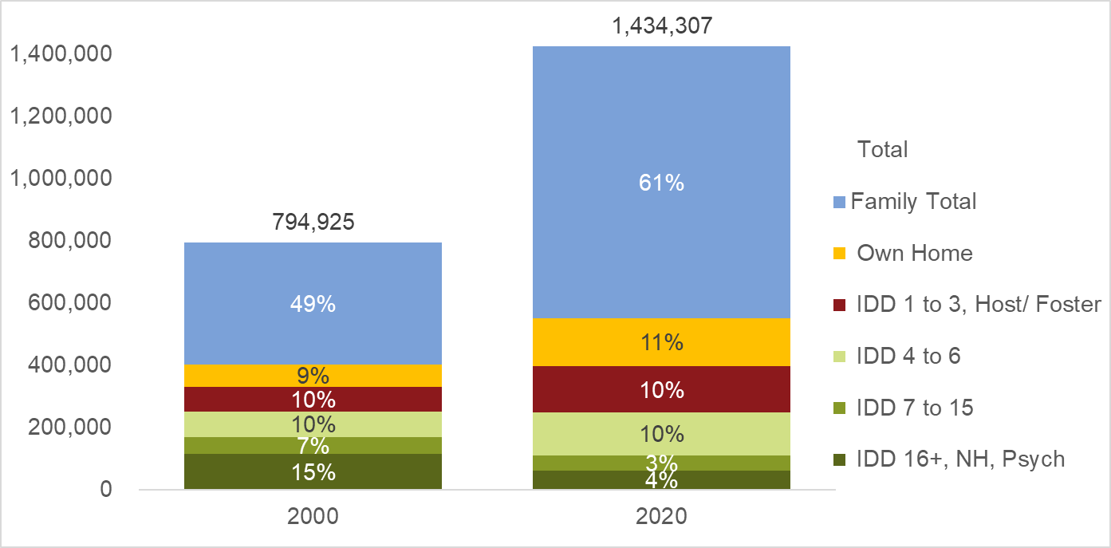
Living Arrangements for Service Recipients 2000 vs 2020
Notes:
Living arrangements for long-term services and supports recipients continue to change.
In 2007, state IDD agencies served 1.03 million people, 25% of whom lived in group homes of four or more people.
By 2014, when the HCBS rule was implemented agencies served 1.18 million people, 22% of whom lived in group homes of four or more people.
In 2020, states served 1.43 million people:
17% of whom lived in group settings of 4 or more people,
10% of whom lived in group settings or host or foster homes shared by 1 to 3 people with IDD,
11% lived in their own homes, and
61% of whom lived with family members

Slide 94
Using RISP Data to Inform Policy and Practice
Tracking progress on the 2014 Home and Community Based Services Rule

Slide 95
Percent living in a setting serving 7 or more people declined more slowly after the rule was implemented
Notes:
We continue to monitor deinstitutionalization and facility downsizing but using a finer measure than just the number of people in large state-run institutions.
This slide compares changes in the percent of all people with IDD getting LTSS who don’t live with family members who continue to live in large group homes, nursing homes, state or nonstate IDD institutions, and psychiatric facilities.
While the proportion of people living in settings of 7 or more people continues to decline from:
32% in 2007, to
24% in 2014, to
20% in 2020
The rate of decline slowed after the HCBS rule was promulgated.
The overall percentage in 2020 was consistent with the predicted percentage based on the trend from 2007 to 2014.

Slide 96
Access to HCBS funded supports for people living with a family member increased
Notes:
Probably the biggest change in LTSS for people with IDD post the HCBS Rule came for the total number of people living with a family member who got LTSS funded by an HCBS Waiver.
The number of people living with family members increased from:
576,163 in 2007, to
661,166 in 2014, to
876,958 in 2020
Had the trend from 2007 to 2013 continued there would have been as many as 100,000 fewer HCBS Waiver recipients getting supports while living with family members

Slide 97
HCBS Rule State IDD Agency Focus Group Findings
The HCBS Rule helped states make progress in
Person Centered Planning
Civil Rights
Stakeholder engagement
Changing expectations and timelines from the Centers for Medicaid and Medicare made implementation very difficult
Implementing the rule required “mobilizing the whole state for change”
“Incorporating the rule into policy gave us “teeth to hold providers accountable”
CMS changes “provided moving targets for states”
Notes:
Rather than go into a lot of detail about this study we want to share a few of the quotes from participants that illustrate some of the key themes.
Read one or two of the red quotes.

Slide 98
Focus Groups – Covid 19
Initiatives and Progress
New services (remote services)
Pay for families to care for person
Expansion of integrated employment and engagement
More technology and remote supports
Increased stakeholder engagement
Increased access to individualized services
Challenges
Workforce crisis deepened
Covid closed services and isolated many people for a long time
“Before we offered 30 services, now we offer 80”
“Now… providers compete about who can best ensure that people have choices and meaningful things to do”
“COVID-19 did what the HCBS rule and lawsuits could not”
Notes:
COVID-19 had a dramatic impact on the LTSS service system.
It’s effect was so dramatic that it is not possible to fully disentangle what happened due to the HCBS Rule versus what happened because of Covid and the associated PHE.
Read one or two of the pull quotes.

Slide 99
Impact of Covid: Deaths per 1,000 Adults on IDD Agency Caseloads Increased
Year ending June 30 | Deaths per 1,000 | Reporting States
2018 | 15.5 | 35
2019 | 15.4 | 35
2020 | 17.0 | 36
2021* | 17.9 | 32
2022* | 17.6 | 38
*Data reviews for 2021 and 2022 continue.
Notes:
We separated the analysis of deaths per 1,000 people on state IDD caseloads by age because states are vastly different in the proportion of people served who were children
Between 2018 and 2020, the number of deaths per 1,000 adults on state IDD caseloads increased from 15.5 to 17.0 (an increase of 10%).
Based on preliminary analyses, increases in deaths per 1,000 on state IDD agency caseloads remained elevated in 2021 and 2022.

Slide 100
RISP Resources
RISP.UMN.edu
Products
5 Key Questions
Infographics
State Profiles
Technical Reports
RISP Data Bytes
Jails, prisons and large state institutions
Fewer people live in ICF/IID’s but progress is uneven
Expenditures per person by age
ACL.gov/30years
ICI.umn.edu
Policy Research Briefs
Policy Forums
Community Services Reporter
Notes:
For more information about the places people with IDD live please visit our website at RISP.UMN.edu.
There you will find
Presentation ready infographics describing key RISP findings
Individual profiles of the status and trend in residential supports for each state
A chart gallery where you can create customized reports on more topics and
Our technical report and other products .

Slide 101
RISP State Profiles – United States 2020
Download graph
Scroll to view data
View underlying data
https://publications.ici.umn.edu/risp/state-profiles/united-states

Slide 102
Topic Recommendations
The direct support workforce crisis continues but other things are important too.
We need better information about how many people have IDD
IDD Counts!
10 years later, states need to do better to meet the requirements of the 2014 Home and Community Based Services rule
Helping people chose for themselves (Person-centered planning)
Ensuring people’s rights (Freedom from Restraint)
Access to food and visitors
Community participation

Slide 103
RISP Acknowledgements
The RISP project is funded through a cooperative agreement from the Administration on Community Living, U.S. Department of Health and Human Services, Cooperative Agreement #90DNPA0001 with supplemental funding from the National Institutes on Disability, Independent Living and Rehabilitation Research Grant # 90RTCP0011.
Grantees undertaking projects under government sponsorship are encouraged to express freely their findings and conclusions. Points of view or opinions do not therefore necessarily represent official ACL or NIDILRR policy.
This presentation uses data and analyses from the Residential Information Systems Project at the University of Minnesota, Dr. Sheryl A Larson, Director. RISP.UMN.EDU
Notes:
Our products are jointly funded by the Administration for Community Living through the projects of national significance and through a NIDILRR Research and Training Center on Community Living for People with IDD.

Slide 104
Contact RISP@umn.edu
Sheryl Larson, Ph.D. | Principal Investigator
612.624.6024 | larso072@umn.edu
U of MN: Jon Neidorf, Brian Begin, Sandy Pettingell, Kristin Dean, Jonathon Walz, Shawn Lawler, Sarah Hollerich, John Westerman, and Jerry Smith
Residential Information Systems Project Institute on Community Integration (UCEDD) University of Minnesota, Twin Cities
NASDDDS: Laura Vegas, Mary Sowers
Notes:
If you need help creating a customized report, contact us by emailing your request to RISP@UMN.edu.

Slide 105
Background Information
2014 Home and Community Based Services Rule

Slide 106
2014 Home and Community Based Services (HCBS) Rule
Services cannot be provided in institutional settings
Person-centered planning
Conflict-free case management and services
Services must be integrated in and support full access to the greater community
Service and service settings chosen by the individual
Access to competitive integrated employment
Ensure individual rights
Privacy, dignity and respect
Freedom from restraint
Optimize autonomy and independence in making choices
Notes:
The 2014 Medicaid Home and Community-Based Services Rule applies to nearly all of the Medicaid non-institutional service options.
The rule clarifies and updates the expectations of the federal government for HCBS funded services.
In addition to prohibiting the use of federal HCBS funding for institutional services, the rule articulates many civil rights expectations, requires services to be based on individual desires and choices, and codifies the definition of person-centered planning, conflict free case management, clarifies that access to competitive integrated employment is an expectation for working age recipients.

Slide 107
Provider Operated Settings
Lease or other legally enforceable agreement
Physically accessible spaces
Privacy in living unit including locking doors
Choice of roommates
Freedom to furnish or decorate the unit
Control over schedule
Access to food and visitors at any time
Free from restraints
Notes:
Additional provisions apply to people living in settings that are owned or operated by provider agencies (whether for residential or adult day services).
States have now had 10 years to implement services in accordance with these rules and some still have not finished transitioning their entire system to be compliant with these provisions.

Slide 108
Data – Briefing on Emerging Issues
Jean Winsor
Institute for Community Inclusion / School for Global Inclusion and Social Development (SGISD) / UMass Boston

Slide 110
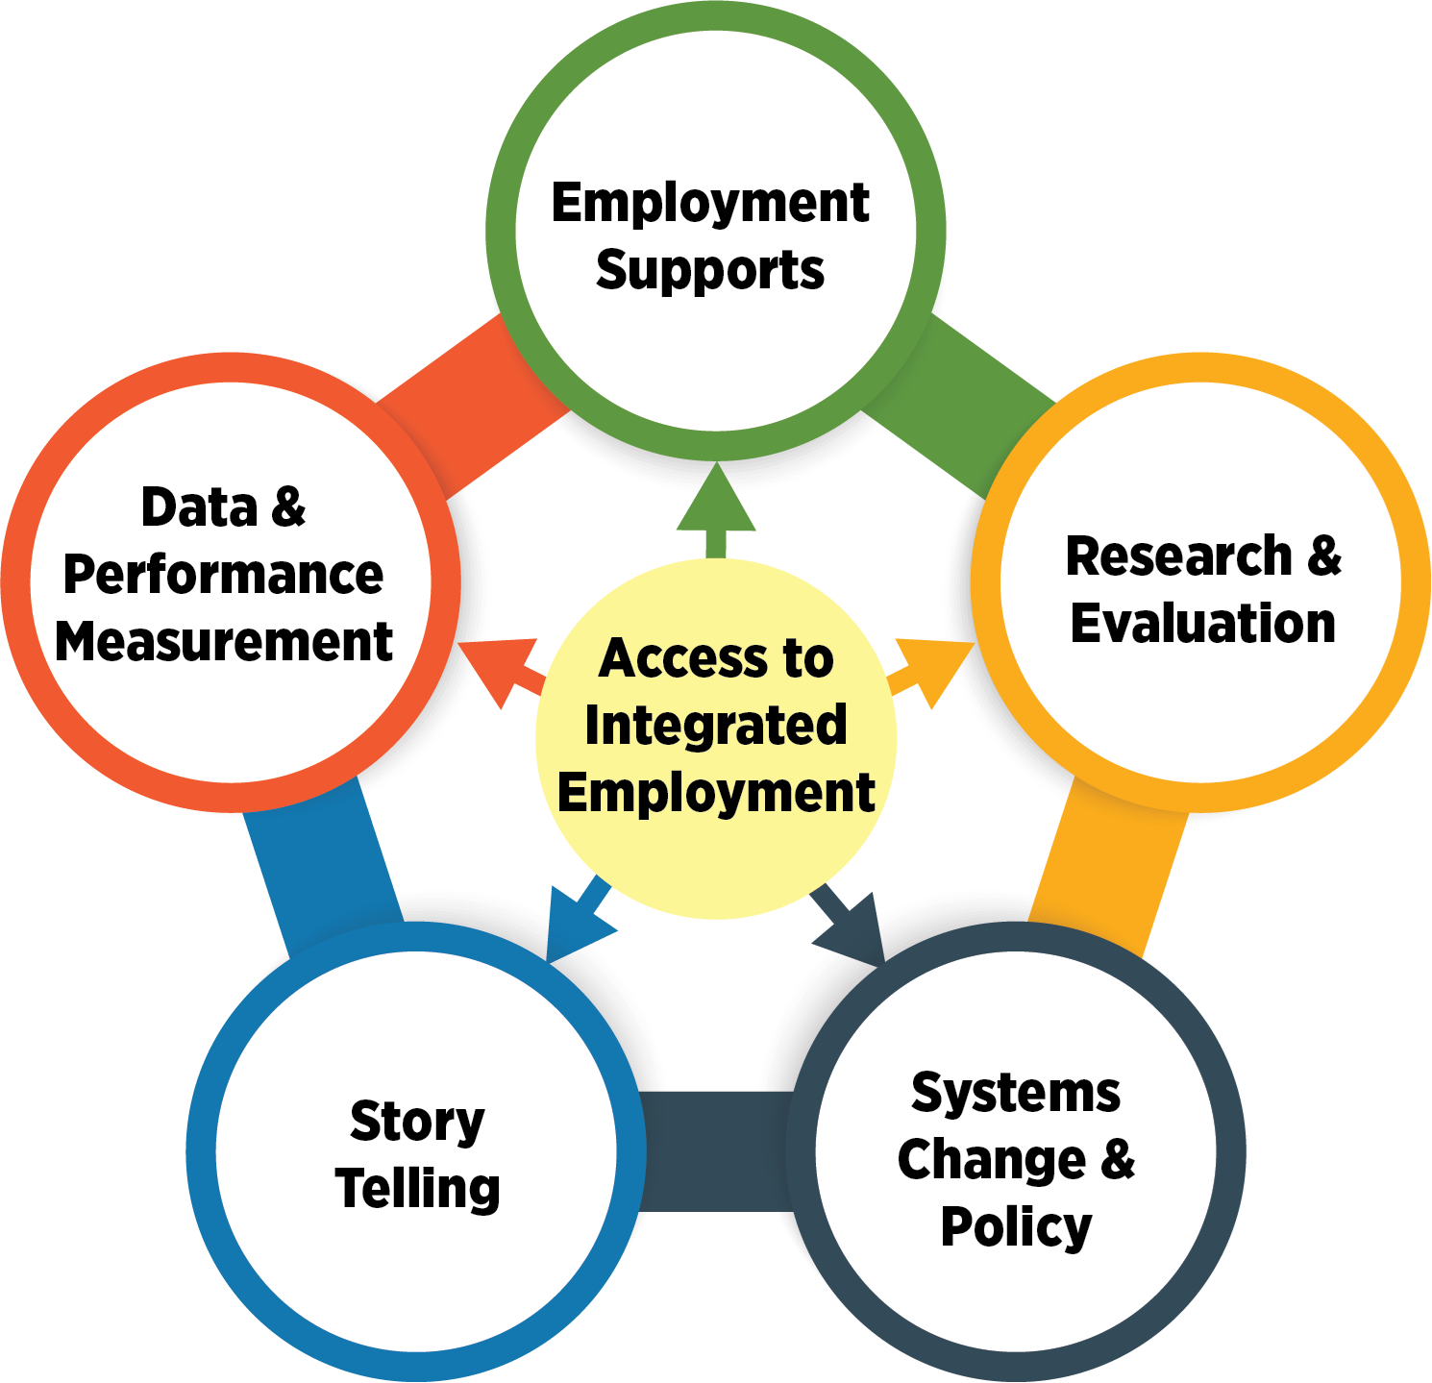
Access to Integrated Employment: Outcomes, Services, & Opportunities

Slide 111
2
1
3

Slide 112
Data, data, data
National Survey of State Intellectual and Developmental Disabilities Agencies' Employment and Day Services State IDD Agencies
VR services and outcomes RSA 911
National Core Indicators
American Community Survey Employment participation and outcomes
Social Security Administration Work incentive use, work participation

Slide 113
Number in Employment and Day Services
591, 571
24%
Source: ICI National Survey of State IDD Agencies

Slide 114
Employment relates to everything
The ID systems needs to provide:
A clear focus on work and whole life supports
Belief that people can work and support for people who want to work
Commitment to a long-term systematic shift in how we approach supports
Good news! We have the tools
to meet these needs

Slide 115
Higher-Performing States Model
Hall et al., 2007; Winsor et al., 2023
Notes:
115

Slide 116
Putting the elements into practice
ThinkWork.org has a comprehensive catalogue promising practices
State agency: https://www.thinkwork.org/aie/ppsa
Provider agency: https://www.thinkwork.org/aie/crp
Individual promising practice: https://www.thinkwork.org/think-work-stories

Slide 117
For more information
Principal investigator:
Jean Winsor, jean.Winsor@umb.edu
Additional resources:
StateData.info
ThinkWork.org
National Survey of State Intellectual and Developmental Disabilities Agencies' Employment and Day

Slide 118
Data – Briefing on Emerging Issues
Emily Shea Tanis
State of the States in Intellectual and Developmental Disabilities /
Kansas University Center on Developmental Disabilities

Slide 119
State of the States in Intellectual and Developmental Disabilities Project of National Significance (PNS)
Shea Tanis, Ph.D.
September 26, 2024

Slide 120
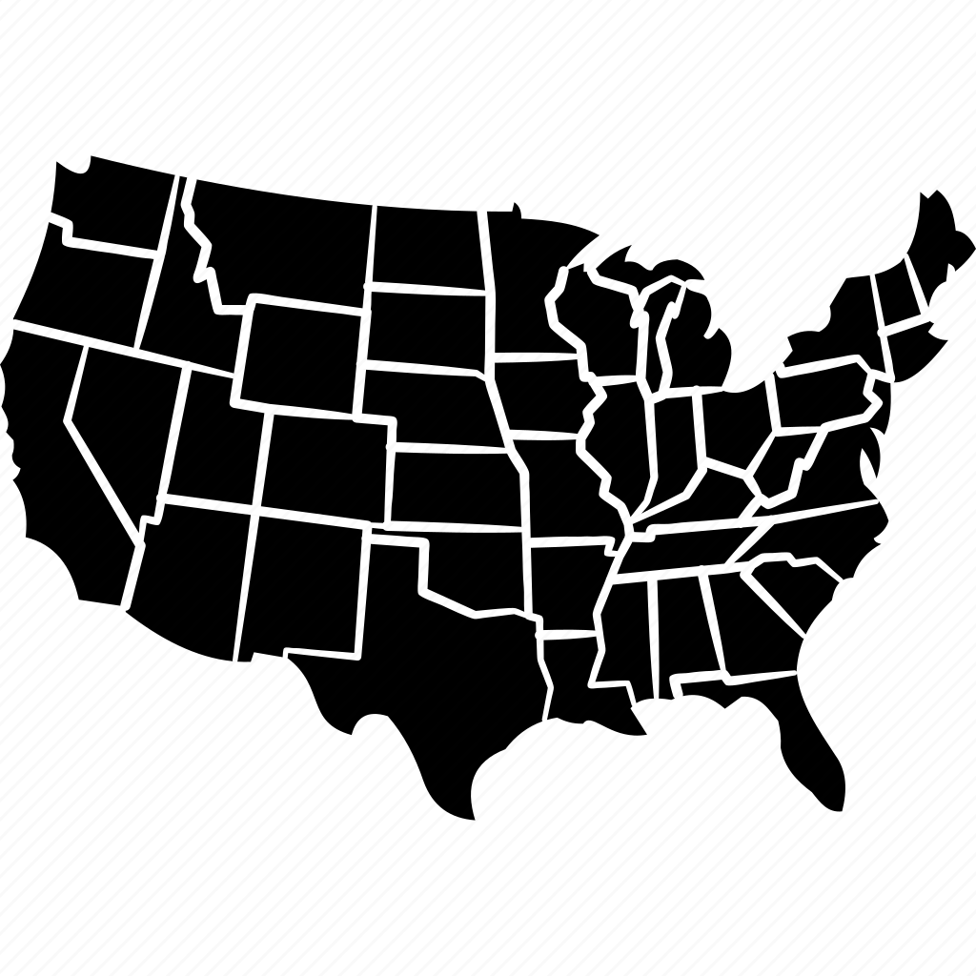
STATE OF THE STATES DATA COLLECTION 1848-2024
WHAT?
WHO?
WHY?
Advocacy
Policy
Programs
Accountability
Systems Change
Money
People
ID/DD Services and Supports
States
National Data Sources
©2024 Tanis, E.S. All Rights Reserved

Slide 121
5 KEY QUESTIONS
Stateofthestates.ku.edu
©2024 Tanis, E.S. All Rights Reserved

Slide 122
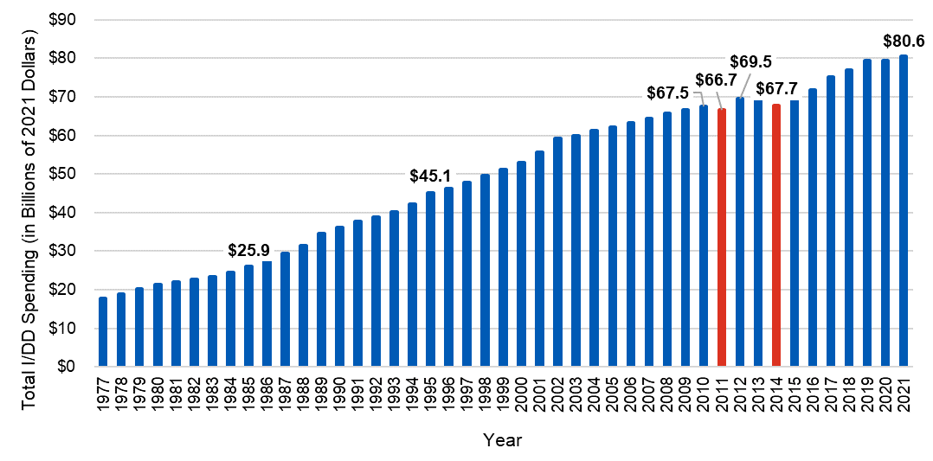
Total Public ID/DD Spending in the U.S. Fiscal Years (FY) 1977 – 2021
©2024 Tanis, E.S. All Rights Reserved

Slide 123
DATA ACCESSIBILTY = DATA EMPOWERMENT
Notes:
Through making data accessible we can allow people to take control of their data to promote outcomes that they want and deserve

Slide 124
COGNITIVELY ACCESSIBLE DATA
INCLUSIVE DESIGN, COLLECTION, AND USE OF DATA
DATA
AGENCY –
PEOPLE WITH ID/DD CONTROL AND DIRECT DATA
COGNITIVELY ACCESSSIBLE DATA VISUALIZATION
INCLUSIVE DATA LITERACY TRAINING
ACCESSIBLE STRATEGIES
FOR DATA STORYTELLING
©2024 Tanis, E.S. All Rights Reserved

Slide 125
RECOMMENDATIONS
Creation of in data infrastructures inclusively designed with people with ID/DD (including the ethical use of artificial intelligence in data collection, management, and dissemination).
Consistency of terminology for programs and services across states and the nation for impact measurement and accessibility.
Evolving and accessible data literacy training for community living, civic engagement, employment, and innovation.
Policies to protect and enhance data agency.
©2024 Tanis, E.S. All Rights Reserved

Slide 126
CONTACT
Email
Tanis@ku.edu
Stateofthestates@ku.edu
Website
www.Stateofthestates.ku.edu
©2024 Tanis, E.S. All Rights Reserved

Slide 127
ACL Community Living Initiatives
The Link Center
Mary Sowers, Executive Director, NASDDDS
The RAISE Act - National Strategy to Support Family Caregivers
Greg Link, Director, Office of Supportive & Caregiver Services, Administration for Community Living (ACL)

Slide 128
The LINK Center
Mary Sowers, Executive Director
NASDDDS

Slide 129
Welcome to Shared Learning Groups
A Project of National Significance funded by Administration for Community Living aimed at improving access to mental health services for people with I/DD, Brain Injury and other Neurodevelopmental Disabilities
September 2024
Mary Sowers, NASDDDS Executive Director
Notes:
Stacy – 20 mins
Thank you for this opportunity to talk a bit more about the work of The Link Center – a grant funded by ACL
We left 10-15 mins at the end for Qs and reactions

Slide 130
A Much Needed Project of National Significance
Nation struggles to provide community mental health services for individuals with I/DD, brain injury, and other cognitive disabilities – causing significant trauma and adverse outcomes for people on a daily basis
People with complex needs stretching systems of care
Lawsuits relating to care occurring in multiple states
Lack of expertise, resources and capacity to best support people with a dual diagnosis
Siloed systems responsible for different elements of care
Lack of trained medical, law enforcement, and crisis care providers
Notes:
Humans are multi-dimensional but we tend to offer solutions, interventions, and services in a very myopic and usually singular way often predicated on what is available or what we systems have and not always what ppl need
This is often a consequence of siloes systems and lack of understanding, knowledge and skills to support people with I/DD, brain injury and other cognitive disabilities who may also have MH conditions
This results in undesired outcomes for these folks including lawsuits, negative health outcomes, difficulties accessing community-based services, to prolonged stays in hospital emergency departments, placement at psychiatric settings without proper accommodations for communication or disability-related needs and engagement with law enforcement

Slide 131
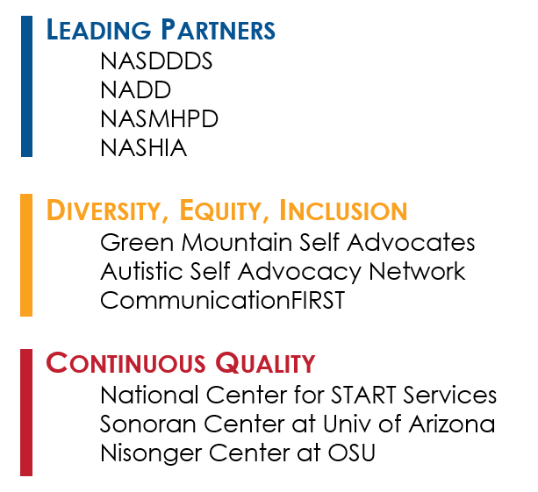
The Link Center Partner Organizations
Notes:
Figuring out how to address this need relies on partnerships on many levels to ensure we are not only addressing the task at hand but also considering sustainability and quality as well as ensuring consideration of diversity, equity, and inclusion. As you can see, we have many partners who are involved with this grant who represent a very diverse group who has also been thinking about how we better support people.

Slide 132
NASDDDS – NASMHPD – NADD -NASHIA An Increasingly Necessary Partnership
While our associations have long recognized the importance of working together on shared issues, our partnership was renewed with vigor in recent years, when our collective memberships report increases in situations requiring a cross-system collaborative approach
Despite the fact that we know that many individuals have multi-system involvement, our state structures have often impeded truly whole-person support
We have partnered on several other initiatives - like the Dual Diagnosis Capacity Building Institute - bringing those learnings to The Link Center
Notes:
This grant was awarded to 3 main partners – NASMHPD and NADD. To us, this is an important partnership. Independently, our members have been seeking guidance and support in finding better ways to support people with cognitive and MH conditions. Recognizing the power in partnerships to tackle this need, we convened a roundtable discussion where promising practices were identified like
Opportunities to Transcend Structural Stovepipes and/or Misaligned Incentives
Clinical Capacity Building and DSP Workforce Development Efforts
Service Design Innovation Opportunities within States
Ensuring a lens on cultural and linguistically appropriate approaches to ensure meaningful access across systems
These really were the motivation for the partnership with this grant.
And, we capitalized on the partnership for other efforts that seek to address this need like a 2 year national clinical and system capacity building effort offered to member states focusing on creating trauma informed, restorative supports that are include MH tx and other initiatives like translating evidenced based MH treatments like CBT and DBT for people who have cognitive limitations but may benefit from these treatments

Slide 133
Key Goals of The Link Center
Systems Change | DSW & Clinical Capacity | Service Access
Improvements in policies, service design, and service coordination | Build a diverse workforce to support individuals with I/DD, brain injury and other cognitive disabilities who also have MH support needs | Improve access to person-centered, culturally and linguistically appropriate MH services and community supports

Slide 134
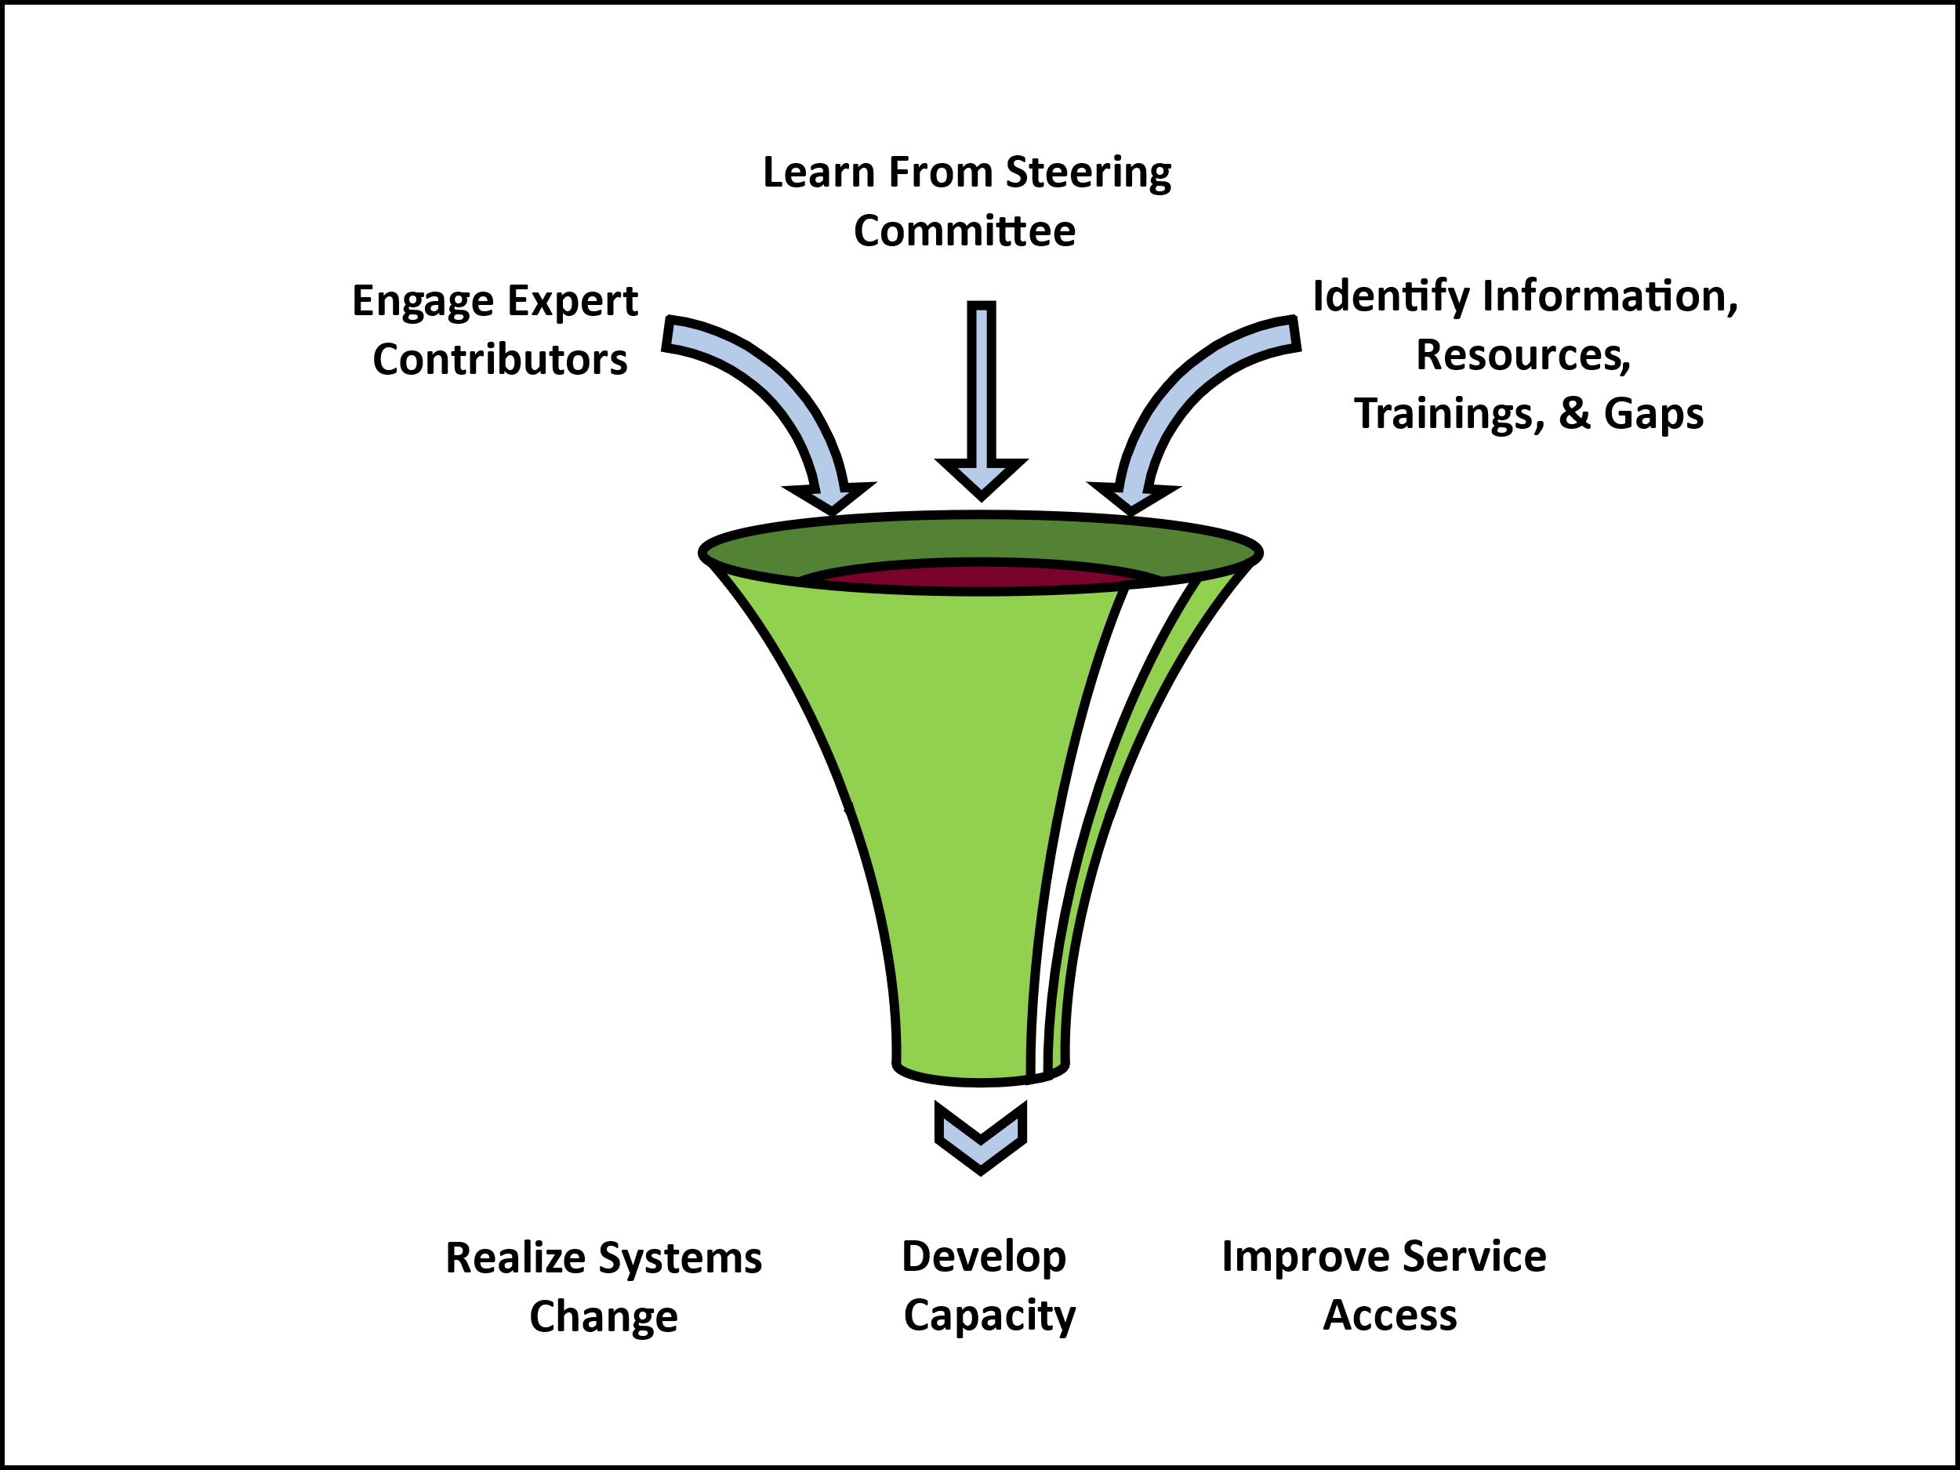
Key Project Activities & Outputs
Curated resource library for a wide array of audiences
Accessible website as the hub for all TA center activities
Identification of best practices and strategies for scalability
Model policies and protocols for state systems and clinicians
Training curricula to support workforce competencies in trauma-informed supports for people with ID/DD/MH
Toolkits and resources for meaningful engagement and adaptive approaches to treatment for people with ID/DD/MH

Slide 135
Lived Experience Driving the Work: The Link Center Steering Committee
Over 100 applications submitted
Selection focused on diversity, specifically related to the person’s area of residence, race, culture, ethnicity, age, communication strategy, and lived experience
To date, feedback on topics including a) language use, b) engaging families and persons with lived experience in other grant activities, and c) priority areas for resource identification and development
Steering Committee actively shaping the work of The Link Center
Notes:
Want to take a second and talk about the piece of the grant that we find is most important is the SC.
Feb 2023 put out a call- Information related to their experiences and reasons for interest in this committee was collected from each applicant via Google forms, emails, texts, and phone calls. After careful review of the applicant information and after follow-up conversations with some applicants to clarify or expand upon their information, The Link Center selected twelve people with distinct and diverse backgrounds and experiences to serve on the committee.
The Link Center compensates Steering Committee members for their time and for support staff they may need to participate in committee activities.
There is a focus on ensuring that meetings and materials are accessible for all members to ensure full inclusion, engagement, and participation. Additionally, the Steering Committee has committed to an in-person meeting once a year for the life of the grant and The Link Center is exploring to respond to members desire to create community and engage with one another in various outside the structured meetings.
It has been abundantly clear that members are passionate about this work based on their comfort and eagerness to share and express opinions and experiences in these meetings

Slide 136
Steering Committee Member States
Alaska
California
Colorado
Iowa
Kansas
Kentucky
Missouri
New Jersey
New York
Ohio
Washington, DC

Slide 138
Partnership with SAMHSA
Notes:
Wendy – 10 mins

Slide 139
988 Suicide and Crisis Lifeline

Slide 140
Six-State Policy Academy to Build Inclusive 988/Crisis Lifeline Supports
Aimed at building strong, collaborative systems of support that enable states to effectively support individuals in crisis regardless of disability and/or communication differences – State teams include Mental Health, I/DD, 988, Medicaid, Child Welfare and others
GA, MD, KS, OH, WV, VA
Survey and Public Listening Sessions
State tailored interventions and workplans
Virtual, peer learning opportunities
In person academy
Notes:
Exploratory survey • An effort to collect information prior to state participant selection related to general areas of need that will inform and give an aggregate scope of focus for succeeding academy activities State Tailored Interventions: • State specific planning meetings with state leads • State-level (virtual) town hall discussions to provide landscape information on areas of need • Strategic plan of target areas for state team Virtual Learning Opportunities: • Based on state target areas, develop a series of six (6) virtual learning engagements for crossstate participation (identifying peers for both elevation of good practice and group solution identification) In Person Academy: • A two-day symposium in the Washington DC area focused on cultivating sustainable networks and ongoing information sharing. In-in person participation is prioritized with virtual accommodations provided to address extenuating circumstances. The symposium will include: o Pre-planning with each state (two meetings) o Group learning and state-specific breakout sessions to optimize learning, sharing, and action plan development. Post-meeting follow up activities with each state, including development of a plan for implementation and sustainability Post Meeting Activities and Follow-Along Technical Assistance: • TA Collaborative will meet with state teams to finalize action steps developed from the inperson meeting; • TA Collaborative will meet monthly with state teams to provide follow-along support of implementation and sustainability activities.

Slide 141
Preliminary Learnings: There is Much Work Ahead
Cross agency collaboration is essential
Myths and misperceptions about people with disabilities persist
Call center staff require ongoing support and coaching on supporting individuals who may not use spoken word alone to communicate
988 partnerships with community leaders are key
What happens after the call – important to have services to meet needs (and to overcome exclusions related to I/DD)
Understanding role of family in supporting individual is important
Trust and safety is paramount
First responders need support and training, and mobile crisis teams need support and on-demand expertise
Strategies for communication, in all of its forms, is necessary

Slide 142
The Biggest Challenges Smashing the Myths and Changing the Paradigms the Myths Have Produced
Notes:
Access Challenges for Individuals with I/DD, BI and Other Cognitive and Communication Differences and Co-Occurring MH Needs

Slide 143
Myths that Obstruct Access to Mental Health Treatment
MYTHS
People with I/DD, Brain Injury and/or other neurodevelopmental disabilities cannot experience mental illness. | FALSE
People with I/DD, Brain Injury and/or other neurodevelopmental disabilities don’t experience trauma because of cognitive challenges | FALSE
People with I/DD, Brain Injury and/or other neurodevelopmental disabilities cannot benefit from evidence-based mental health treatments | FALSE
All behavior exhibited by people with I/DD, Brain Injury and/or other neurodevelopmental disabilities is bad behavior, not symptoms of mental health diagnoses or trauma. | FALSE

Slide 144
The Truth About Individuals with Disabilities and Mental Health
MYTHS
People with I/DD, Brain Injury and/or other neurodevelopmental disabilities experience mental health conditions at rates higher than the general population – a meta study estimates prevalence at or above 33% incidence. | TRUE
People with I/DD, Brain Injury and/or other neurodevelopmental disabilities have life experiences that increase likelihood of trauma: Higher rates of abuse, neglect and exploitation, including higher victimization rates of sexual abuse Social isolation and bullying Extensive and invasive medical procedures (with or without consent) For some, separation from family, love and support | TRUE
People with I/DD, Brain Injury and/or other neurodevelopmental disabilities can benefit from evidence-based mental health treatments – sometimes with necessary but simple accommodations | TRUE
Behavior supports can be important to support people with disabilities, but they should be used alongside mental health treatments to ensure that the person is supported holistically | TRUE
Notes:
The NCI date is consistent from year to year and state to state

Slide 145
Myths Led to Policy and Practices that Impede Progress Today
Because of the presumption that individuals with disabilities, especially those with I/DD, could not experience mental health conditions, there was a presumption that they could not benefit from rehabilitative or restorative treatments.
This led to Medicaid in many states excluding individuals from rehabilitative benefits if they had a “primary diagnosis of intellectual disability”
This manifested in both coverage and medical necessity policies where they continue to exist today
This had far reaching ramifications on clinical availability as payment was out of reach for services and/or training/accommodations
This contributed to a generation of clinical providers unwilling to provide mental health treatment – and a perpetuation of bias regarding the capacity of people with disabilities.
Notes:
Sources of the data
One in three children with a disability are victims of some type of maltreatment (i.e., either neglect, physical abuse, or sexual abuse) whereas one in 10 nondisabled children experience abuse. (Sullivan & Knutson, 2000)
Children with I/DD are 3.5 x more likely to experience sexual abuse as compared to peers without I/DD and have a higher post-abuse consultations for physical and mental health disorders (Childhood Sexual Abuse, Intellectual Disability, and Subsequent Physical and Mental Health Disorders: A Matched Cohort Study, AIDD 2023)
Sexual victimization and exploitation risk increases as intellectual abilities decrease (Carrellas et al., 2021)
Adults with I/DD are sexually assaulted at a rate 7 times higher than those without disabilities (DOJ)
33.6% of children in Child Welfare and 52.7 % of the transition age have I/DD (Youth with disabilities in the United States Child Welfare System E. Slayter )
Call out this reverse phenomenon…..the incidence is high because trauma causes mental illness
Nearly one-half of children investigated by child protective services were not typically developing (Nat. Survey of Child/Adolescent Well-Being II)

Slide 146
Removing Siloed Approaches to Support is Urgent and Essential
EARLY CHILDHOOD
Mental health
Health
aging
education
JUSTICE
i/dd sUPPORTS
Housing & RECREATION
Child welfare
Medicaid & Medicare
VOCATIONAL
Social & Protective services

Slide 147
An Emerging Service Paradigm for Individuals with Disabilities and Mental Health Conditions is Evolving ….but it Requires Recognition and Active Support
Restorative Environment –
HCBS Essential Element of the Solution
Treatment for Trauma – Mental Health and HCBS
A place to live that is safe, trauma informed
Stable staff
Develop trusting relationship with others
A life worth living – a person-centered approach
People can see people important to them as frequently as possible – this is the basis for resiliency
People doing things important to him/her as frequently as possible
Being in the community
Having a pet
People making choices and decisions
Focus on brain health
Good diet/attractive food – reduce caffeine and sugar; critical nutrients (brain/gut connection)
Exercise – increase oxygen flow –biking, swimming, walking running, sports
Sleep – building good habits
Implementing meaningful routines – predictable and reliable
Mental and physical health treatments integrated into the program
Trauma Focused Cognitive Behavioral Therapy TF-CBT
Individual therapy; group therapy
Peer counseling
Internal Family Systems Therapy (IFST)
Intensive Systems Therapy (IST)
Sex education and counseling
Education about the mind and body
Mindfulness training
Neuro Affective Relational Model Therapy
Dyadic Developmental Psychotherapy
Sensory interventions that calm; breathing, weighted blankets, warm baths, swinging, etc.
EMDR; Bio/Neurofeedback
Neuro-Entrainment
Play therapy, art therapy, music therapy, Psychodrama
Animal therapy
Movement therapy e.g., yoga, tai chi, exercise
Group activities that involve movement with others – drumming, dancing, singing
Medical
Psychiatry
Physical Health
Notes:
This is a service paradigm for both children and adults in their family homes, foster homes, life sharing or small residential living arrangements
There are three component:
An environment that cools down all the stimuli that are causing the behavior and that allows for healing from trauma – this is HCBS and it’s where people are 24/7
Mental and physical health treatments that are effective for people with cognitive disabilities
Integration of treatment into the everyday living arrangement and daily life

Slide 148
Challenges, Opportunities, and Next Steps
Notes:
Access Challenges for Individuals with I/DD, BI and Other Cognitive and Communication Differences and Co-Occurring MH Needs

Slide 149
Continued efforts to debunk historical misperceptions of individuals with I/DD and their ability to benefit from mental health treatment
Opportunities for improved cross-system partnerships, including child welfare and substance use
Workforce development
Accessibility issues
Notes:
3. (clinical and direct support)
4. (Informed by Steering Committee and other key project partners)

Slide 150
Think about your go-to resources
A Project of National Significance funded by ACL and led by NASDDDS, in partnership with NASMHPD, NASHIA, and NADD
https://acl.gov/TheLinkCenter
Email: thelinkcenter@nasddds.org
150

Slide 151
Questions: Msowers@NASDDDS.org
Notes:
Questions/feedback - 15 minutes

Slide 152
The RAISE Act - National Strategy to Support Family Caregivers
Greg Link, Director
Office of Supportive & Caregiver Services,
Administration for Community Living (ACL)

Slide 153
The National Strategy to Support Family Caregivers: A Catalyst for Change President’s Committee for People with Intellectual Disabilities
Greg Link, MA
Director, Office of Supportive and Caregiver Services
Administration on Aging, Administration for Community Living
September 26, 2024

Slide 154
“How do we create a world where caregiving is central to who we are, as opposed to something that diverts us or is a sideline of our real lives?” -Carol Zernial, RAISE Council Co-Chair

Slide 155
The national strategy to support family caregivers: the nuts and bolts

Slide 156
Legislative Milestones in Family Caregiver Support
Legislative actions
National Family Caregiver Support Program/Native American Caregiver Support Program (2000)
VA Caregiver Support Program
Lifespan Respite Program (2006)
RAISE Family Caregivers Act of 2017
Family First Prevention Services Act (2018)
Supporting Grandparents Raising Grandchildren Act (2018)
National Technical Assistance Center on Kinship and Grandfamilies (2021)

Slide 157
The Recognize, Assist, Include, Support, and Engage (RAISE) Family Caregivers Act
Became law: Jan 22, 2018
Three key components:
Family Caregiving Advisory Council
Initial Report to Congress
National Family Caregiving Strategy

Slide 158
Public Engagement at Every Step
For Starters:
ACL RFI (2019)
1613 responses
75% from caregivers
Caregiver Focus Groups
13 sessions/80 individuals
All populations, including teens
Delved into RFI findings
Stakeholder Listening Sessions
Aging and disability organizations
60 invited/42 participated
6 sessions focused on operationalizing the recommendations
Public input during council meetings
From 12/2020 - 12/2021:
Interviews & Listening Sessions
17 key informant interviews
22 listening sessions
145 stakeholder organizations
Stakeholders included
State entities
Counties
Employers (large and small)
LTSS and healthcare providers
Respite providers
CBOs/faith-based organizations

Slide 159
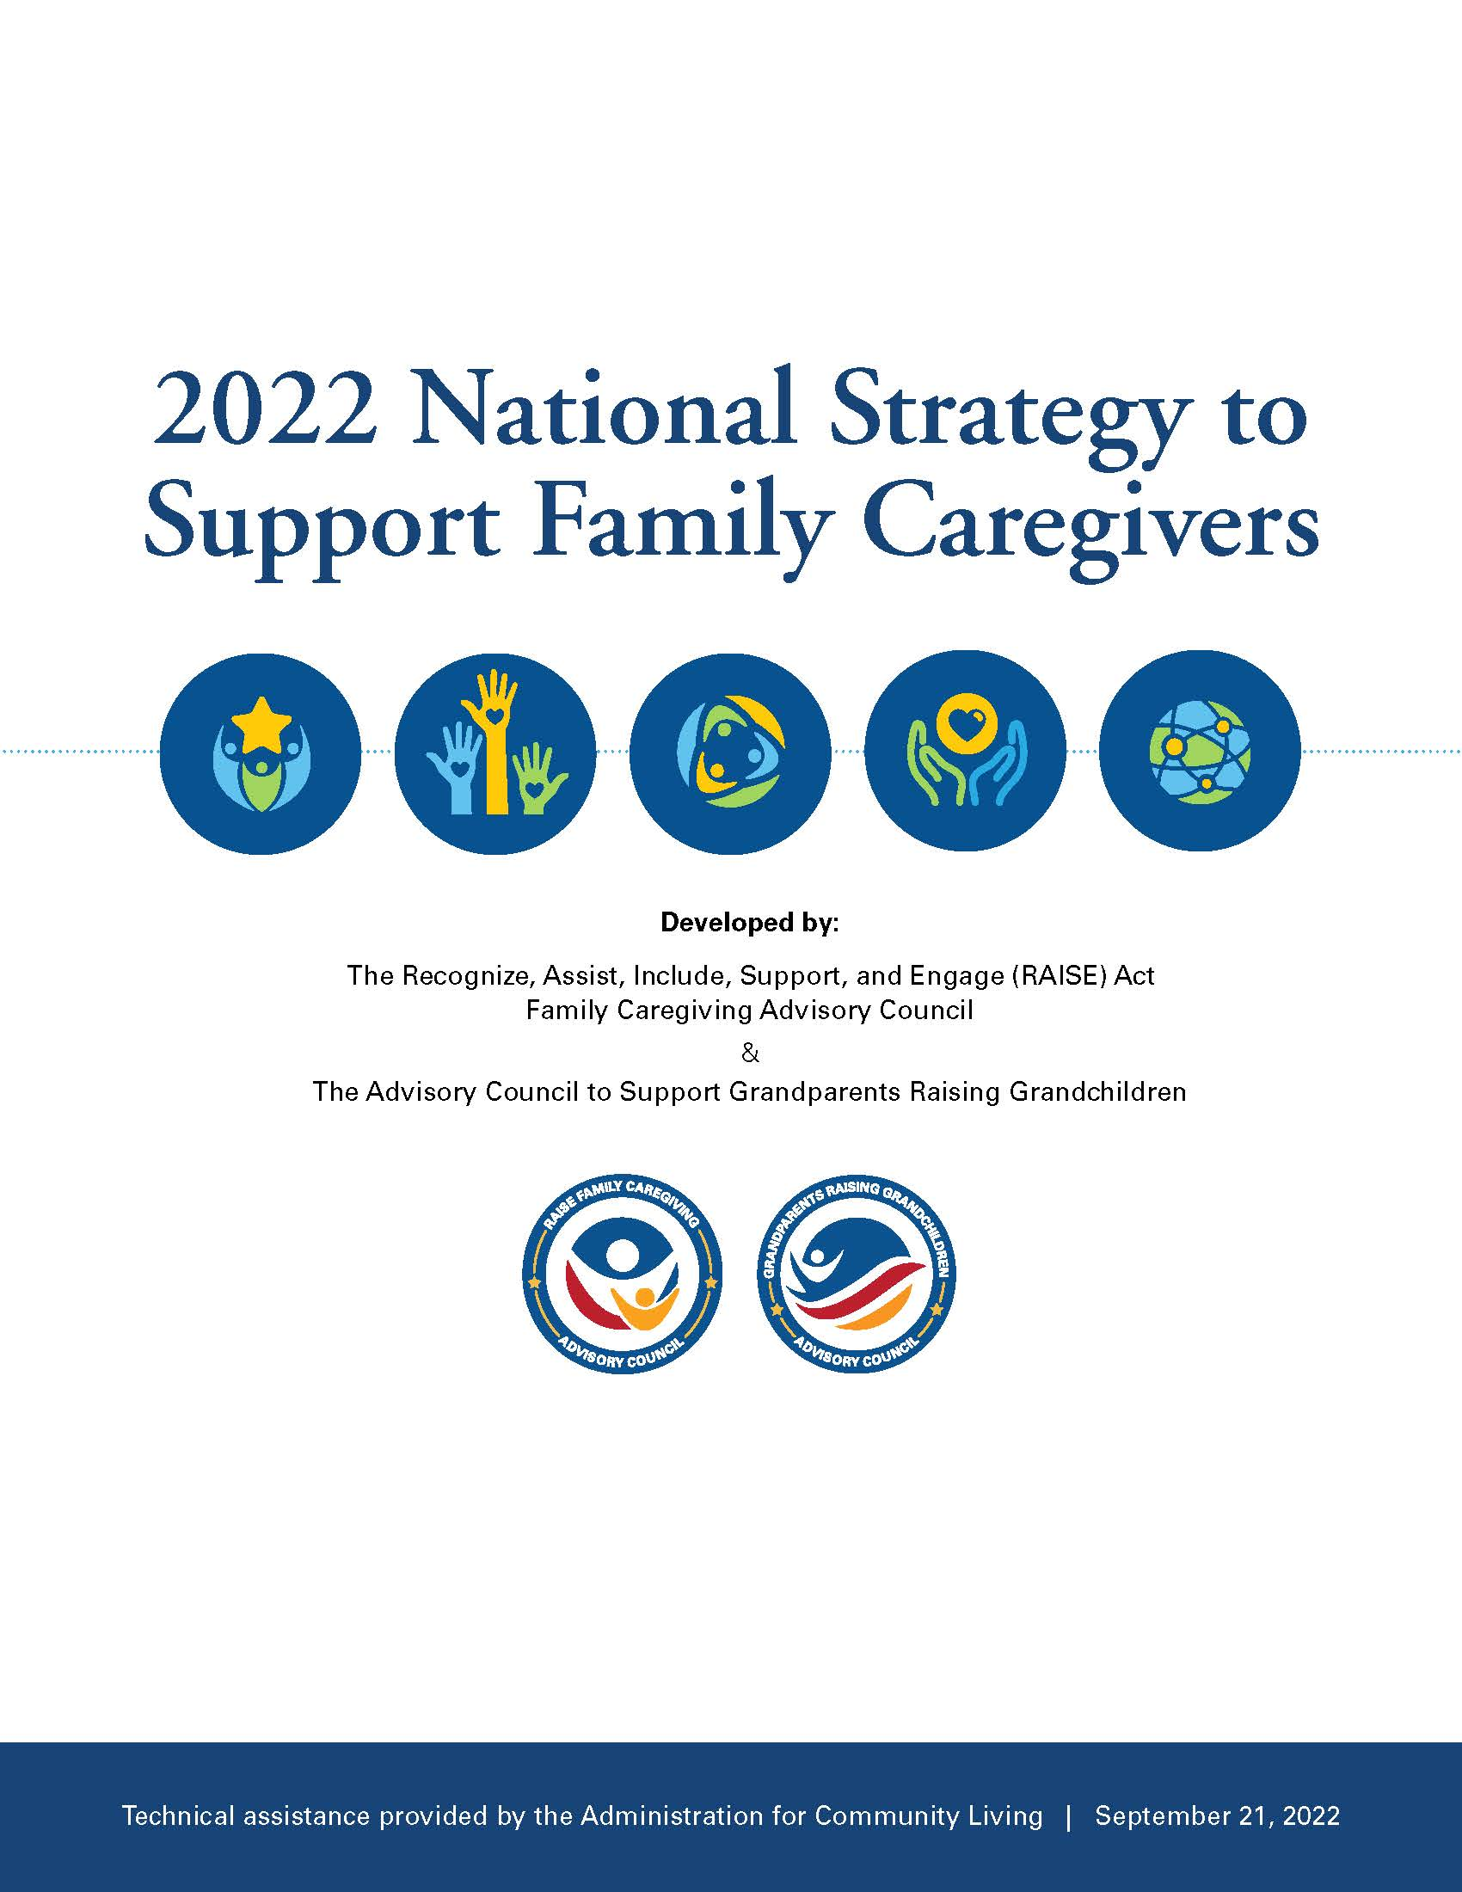
2022 National Strategy to Support Family Caregivers - An overview and description of the strategy's goals and intended outcomes First Principles: Cross-Cutting Considerations for Family Caregiver Support - Describes the four key principles that must be reflected in all efforts to improve support to family caregivers Federal Actions - Nearly 350 actions that 15 federal agencies will take in the near term to begin to implement the strategy. Actions for States, Communities, and Others - More than 150 actions others can take.
One Strategy | Four Components

Slide 160
Cross-Cutting Themes & Considerations
Placing the person and family at the center of all interactions
Addressing trauma and its impact on families
Advancing racial equity and support for family caregivers in underserved communities
Understanding the implications of the direct care workforce

Slide 161
What the Strategy is…and is Not
The Strategy is…
The Strategy is not…
A vision and roadmap for change
A baseline for action and progress
A framework for all caregiving situations and experiences
Intended for use by many stakeholder groups
A timeline or how-to document
A list of requirements or “musts”
Specific to any particular caregiving situation, topic or condition
Exhaustive of all the possibilities
Most Importantly…It’s the first…Not the last

Slide 162
A “Whole of Society” Approach is Needed
States, tribes, county governments, and communities
Community-based providers of long-term services and supports
Child welfare agencies
Kinship support systems
Health care systems
Business leaders and employers
Communities of faith/faith-based organizations
National, state, regional and local philanthropic organizations and funders
Academic institutions and researchers
Advocates, family caregivers, care recipients, you, me, anyone!

Slide 163
A Catalyst for Change
Approximately 40 additional Federal actions added
The President’s Care Executive Order
ACL’s new National Caregiver Support Collaborative
Updated Older Americans Act Regulations
CMS’ new Guiding and Improved Dementia Experience (GUIDE) Model
International attention and focus

Slide 164
the National strategy as a framework Action

Slide 165
Opportunities to Advance Policy and Program
Create pathways for better communication between family caregivers, care receivers and service systems
Where appropriate and desired, include family caregivers early in the provision of care and planning
Employ dedicated staff to engage with and include family caregivers
Assess family caregiver needs along side those of the care receiver
Partner with local community-based agencies to ensure caregiver needs are included in referrals for support

Slide 166
Opportunities to Advance Aging Policies & Programs
Appoint family caregivers as board members to ensure their voices are included in all levels of policy planning.
Ensure that policy-setting processes include documenting and responding to family, kin and grandparent caregiver needs.
Pilot the use of caregiver assessments in a variety of care settings to improve identification of caregivers who need services and supports.
Ensure that all intake forms adopt inclusive language to help family caregivers self-identify

Slide 167
Resources & next steps

Slide 168
Resources for Implementation
Funded by: The John A. Hartford Foundation
National Academy for State Health Policy (NASHP)
National Alliance for Caregiving
UMass Boston
Community Catalyst
The RAISE Family Caregiver Resource and Dissemination Center
Support Caregiving.org

Slide 169
What’s Next?
New ACL Initiatives to Support Implementation of the Strategy
National Caregiver Support Collaborative (NCSC)
Lifespan Respite Program Grants
New Alzheimer’s Disease Program Initiative (ADPI) Respite Demonstration
Community Care Corps Program
Kinship and Grandfamily Support Network
Bridging Aging and Disability Networks
Advancing State Implementation of the National Strategy – New Grant Program
2024 Joint RAISE/SGRG Council Updated Report
Early 2025 (tentative): Updated National Strategy to Support Family Caregivers

Slide 170
We now have an unprecedented opportunity to achieve – and go far beyond – the goals Congress established in the RAISE Family Caregivers Act -Alison Barkoff, 2021

Slide 171
Thank you!

Slide 172
DAY ONE: THURSDAY, SEPTEMBER 26
ADJOURNMENT OF DAY 1 OF 2

Slide 173
THANK YOU

